Slide 1


2018 Community Survey
City of Washougal, Washington
Presented by
June 2018

Slide 2
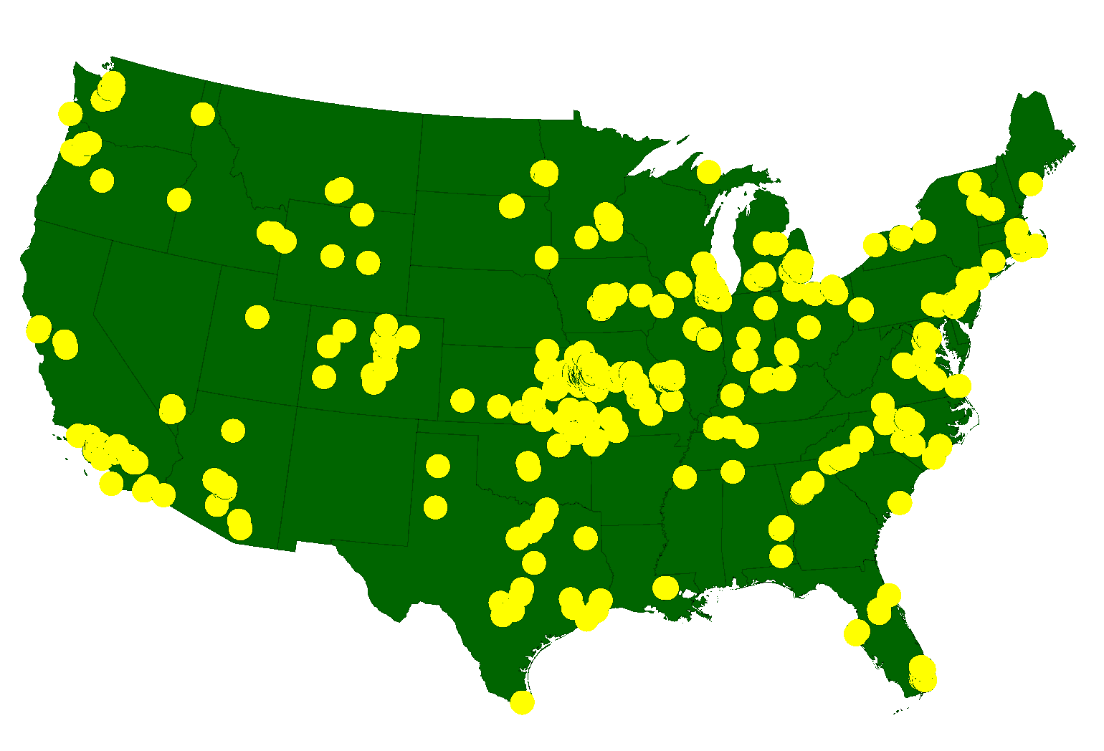
ETC Institute
A National Leader in Market Research
for Local Governmental Organizations
…helping City and county governments gather and use survey data to enhance organizational performance for more than 35 years
More than 2,150,000 Persons Surveyed Since 2007
for more than 900 cities in 49 States

Slide 3
Agenda
Purpose and Methodology
Bottom Line Upfront
Major Findings
2
Summary
Questions

Slide 4
Purpose
To objectively assess satisfaction among residents with the delivery of City services
To measure trends from previous surveys
To help determine priorities for the community
To compare the City’s performance with other communities regionally and nationally
4

Slide 5
Methodology
Survey Description
  six-page survey; included many of the same questions that were asked in previous years
  3rd Community Survey conducted for the City
Method of Administration
  by mail and online to a random sample of City residents
  each survey took approximately 15-20 minutes to complete
Sample size:
  goal number of surveys: 400
  goal far exceeded: 666 completed surveys
  demographics of survey respondents accurately reflects the actual population of the City
Confidence level: 95%
Margin of error: +/- 3.8% overall

Slide 6
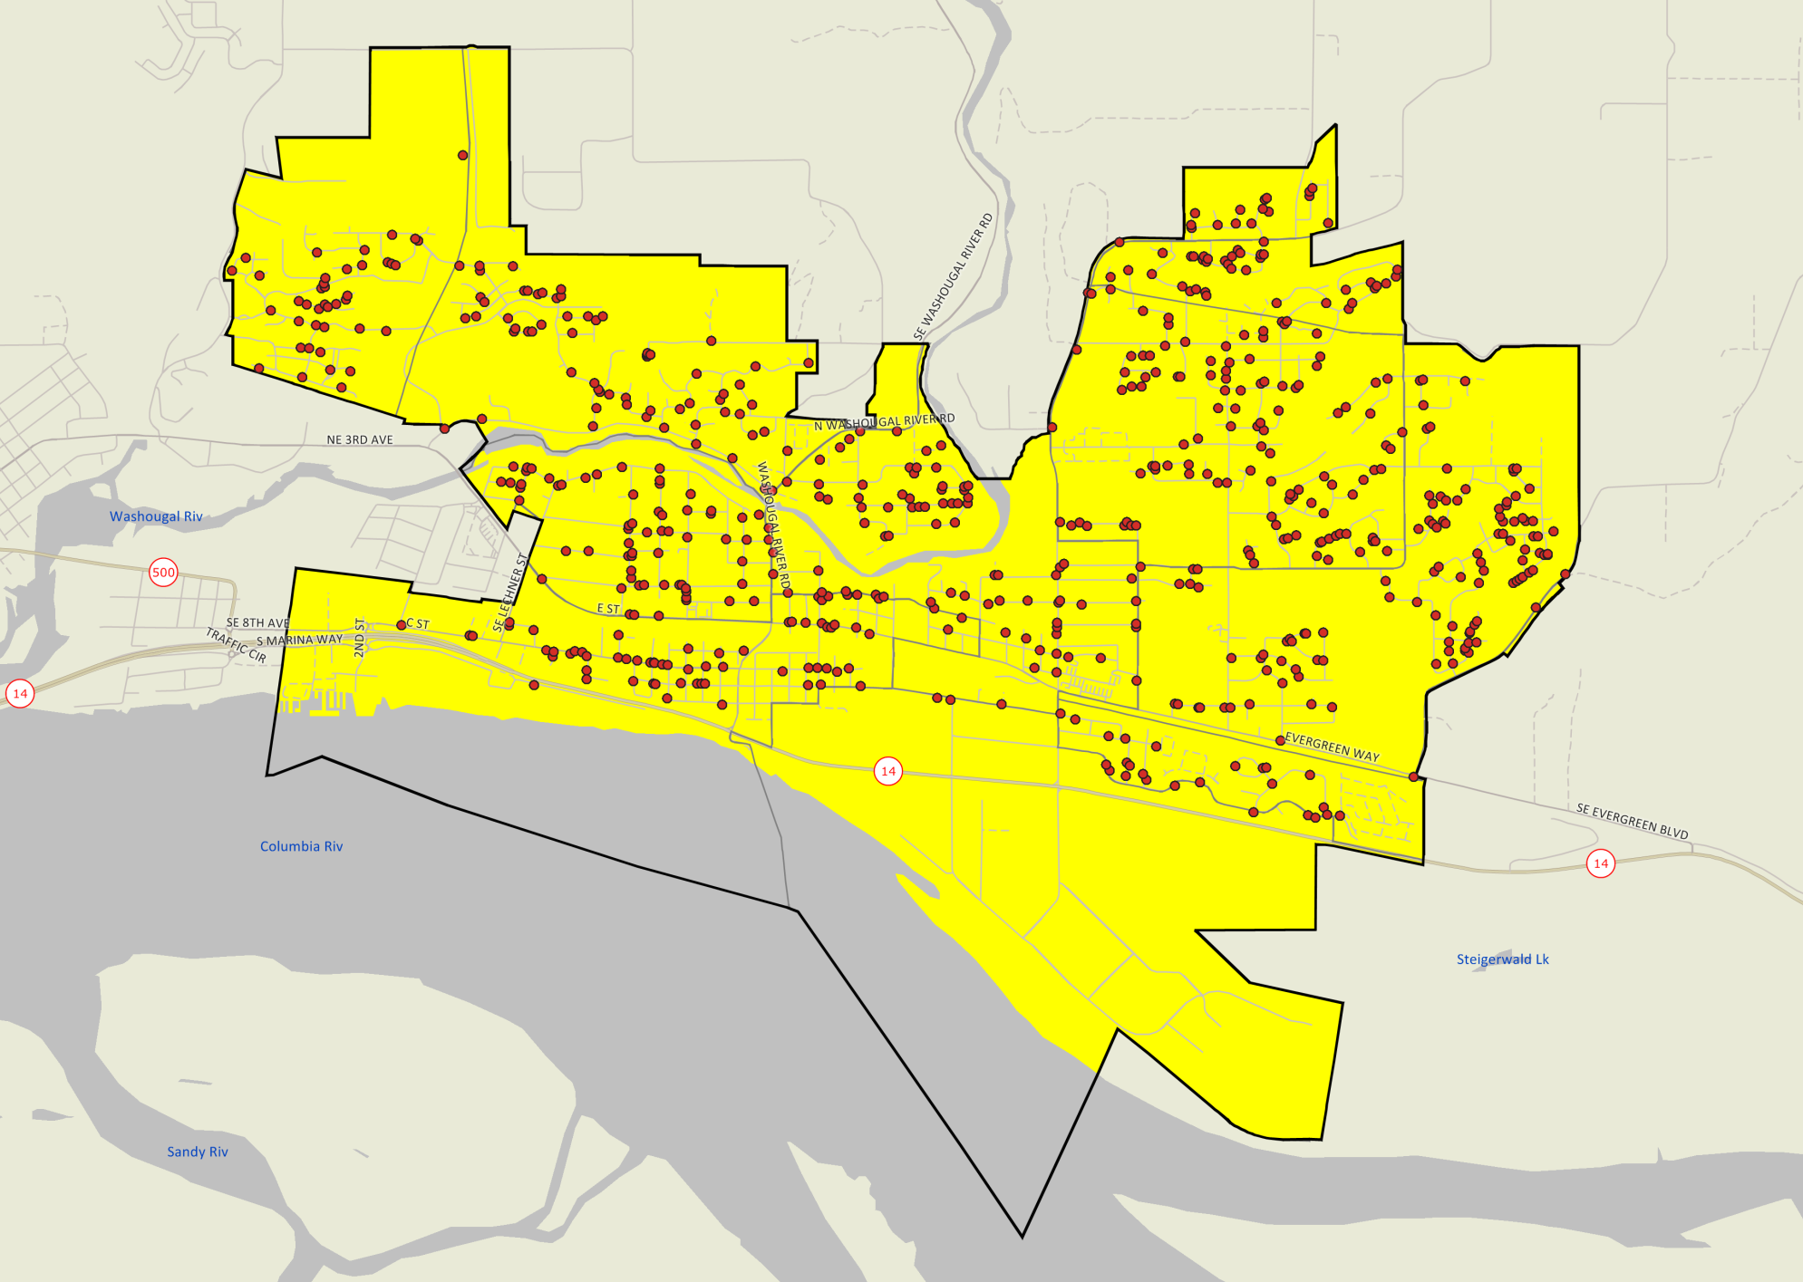

Location of Survey Respondents
Good representation throughout the City
City of Washougal 2018 Community Survey

Slide 7
Bottom Line Up Front
Residents Have a Positive Perception of the City
    60% are satisfied with the overall quality of City services; only 7% are dissatisfied
The City Is Moving in the Right Direction
  Satisfaction ratings have increased or stayed the same in 36 of 54 areas since 2016, and increased or stayed the same in 31 of 54 areas since 2014
Washougal Rates Higher Than Other Cities in the Overall Quality of City Services
  The City rated 17% above the Northwest Regional Average and 11% above the U.S. Average in the overall quality of services provided by the City
Washougal Rates Higher Than Other Cities in Providing Customer Service
  The City rated 21% above the Northwest Regional Average and the U.S. Average in the quality of customer service provided by City employees
Overall Priorities for Improvement:
  Maintenance of City Streets
  Effectiveness of Economic Development Efforts

Slide 8
Major Finding #1
Residents Have a Positive Perception of the City

Slide 9
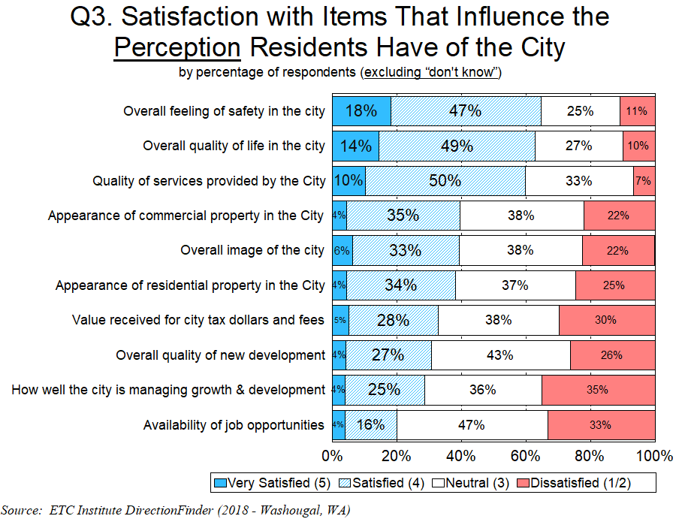
More Than a 8-1 Ratio of Residents Who Are Satisfied vs. Dissatisfied (60% vs. 7%) with the Overall Quality of Services Provided by the City

Slide 10
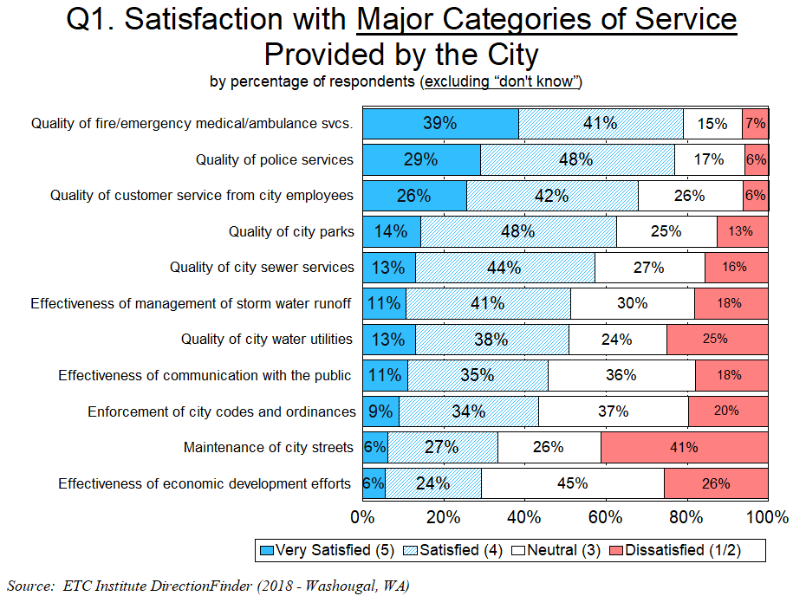
Most Services Receive High Ratings, but There Are Concerns with Maintenance of Streets

Slide 11
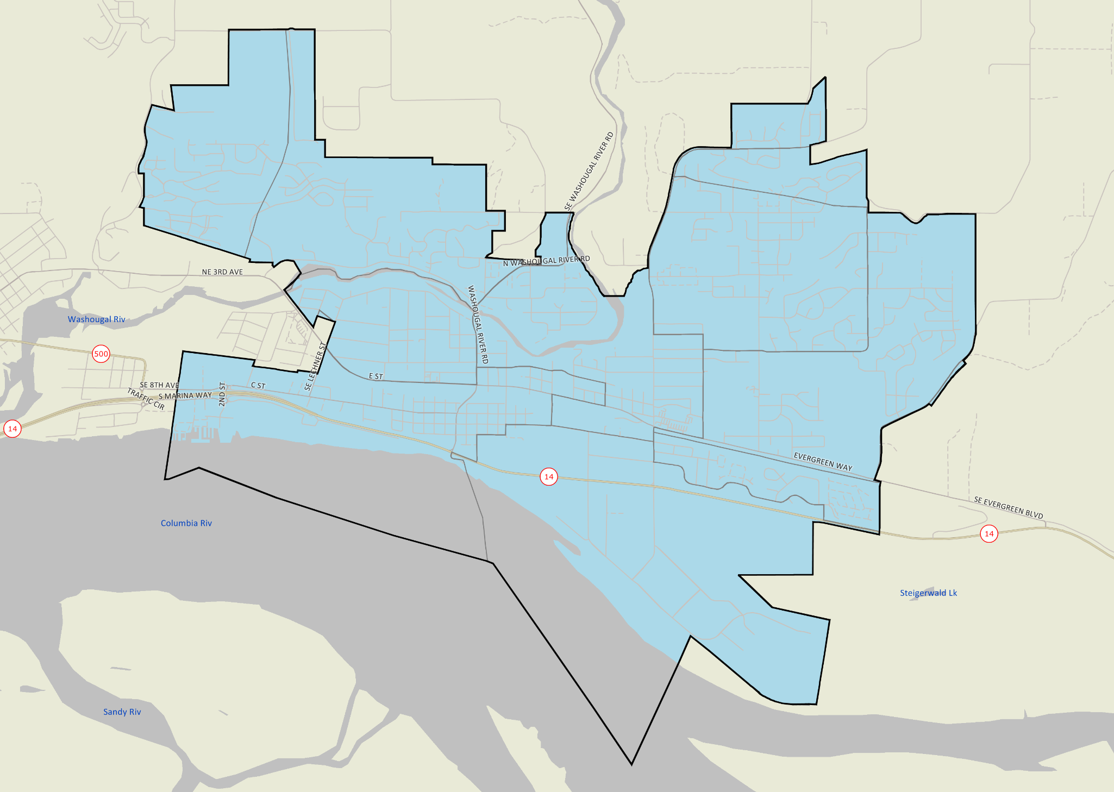


Overall Quality of Services Provided by the City of Washougal
Legend
Mean rating on a 5-point scale
1.0-1.79 Very Dissatisfied
1.8-2.59 Dissatisfied
2.6-3.39 Neutral
3.4-4.19 Satisfied
4.2-5.0 Very Satisfied
No Response
All areas are in BLUE, indicating that residents in all parts of the City are satisfied with the overall quality of City services
ETC INSTITUTE

Slide 12
Major Finding #2
The City Is Moving in the Right Direction

Slide 13
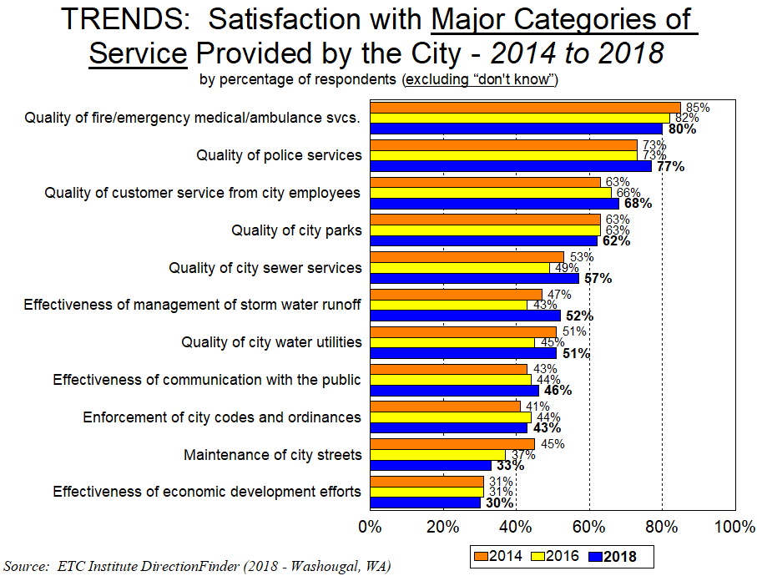
13
Significant Increases From 2016: Significant Decreases From 2016:

Slide 14
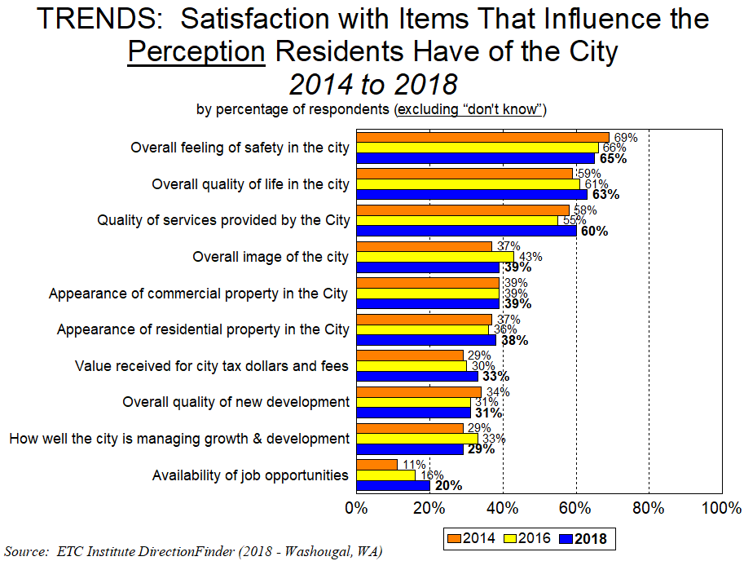
14
Significant Increases From 2016: Significant Decreases From 2016:

Slide 15
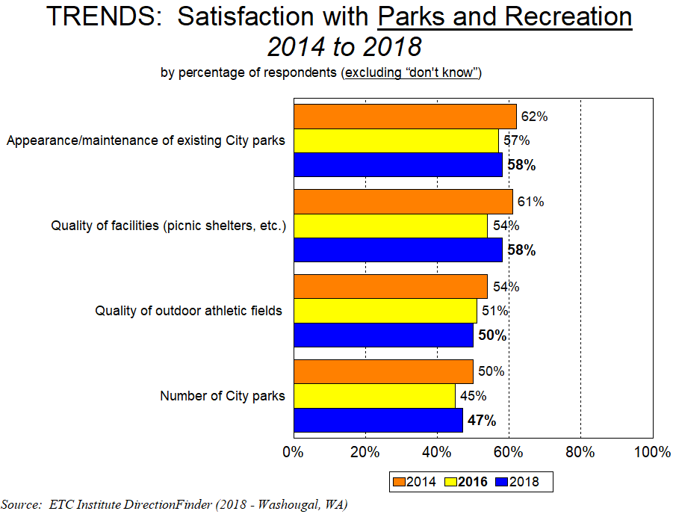
15
Significant Increases From 2016: Significant Decreases From 2016:

Slide 16
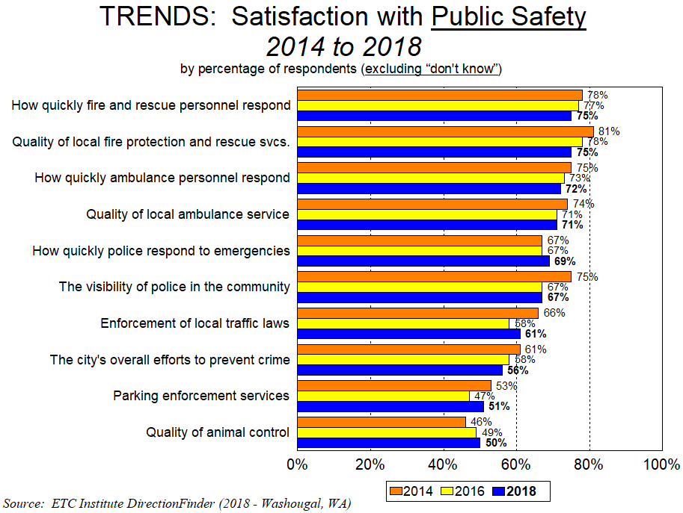
16
Significant Increases From 2016: Significant Decreases From 2016:

Slide 17
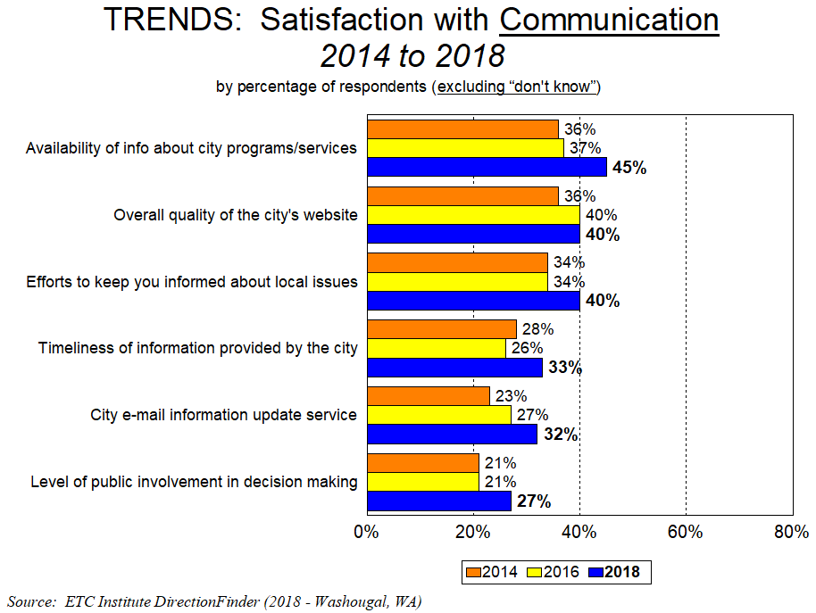
17
Significant Increases From 2016: Significant Decreases From 2016:

Slide 18
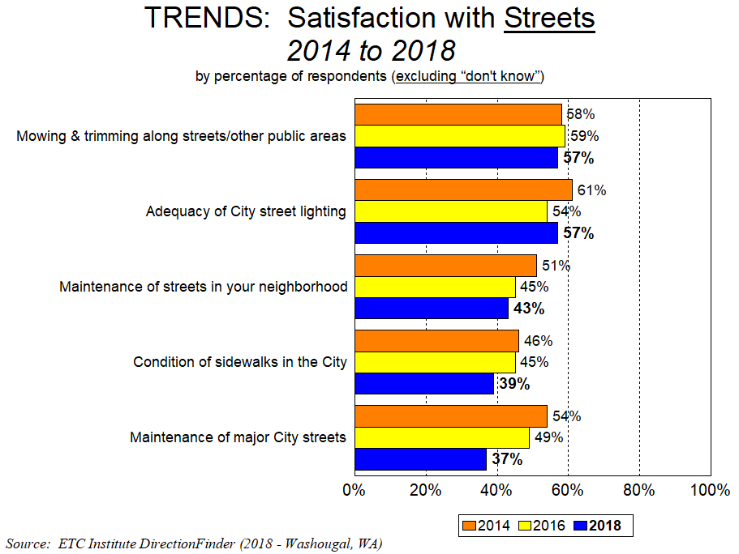
Ongoing construction of major roads likely had a negative impact on perceptions of street maintenance
18
Significant Increases From 2016: Significant Decreases From 2016:

Slide 19
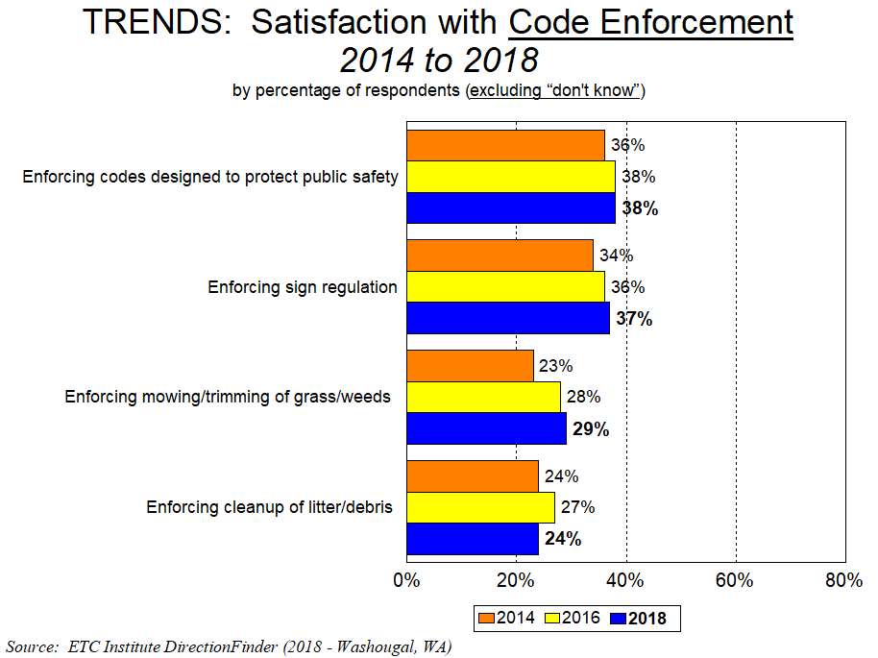
19
Significant Increases From 2016: Significant Decreases From 2016:

Slide 20
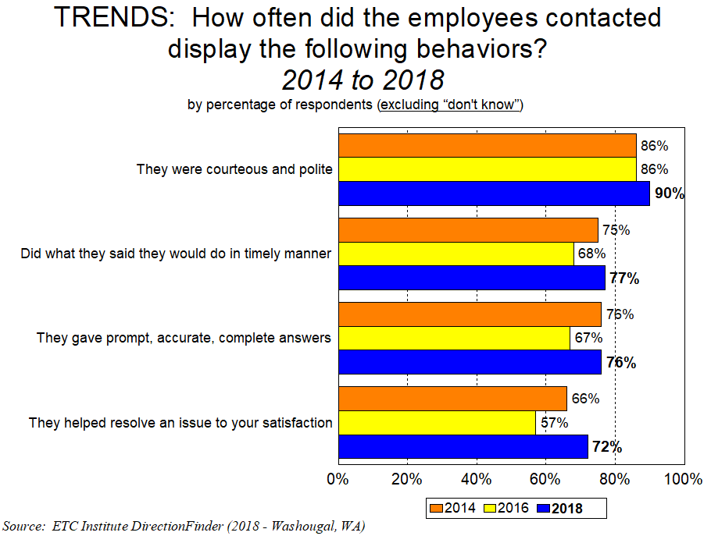
20
Significant Increases From 2016: Significant Decreases From 2016:

Slide 21
Major Finding #3
How Washougal Compares to Other Communities

Slide 22
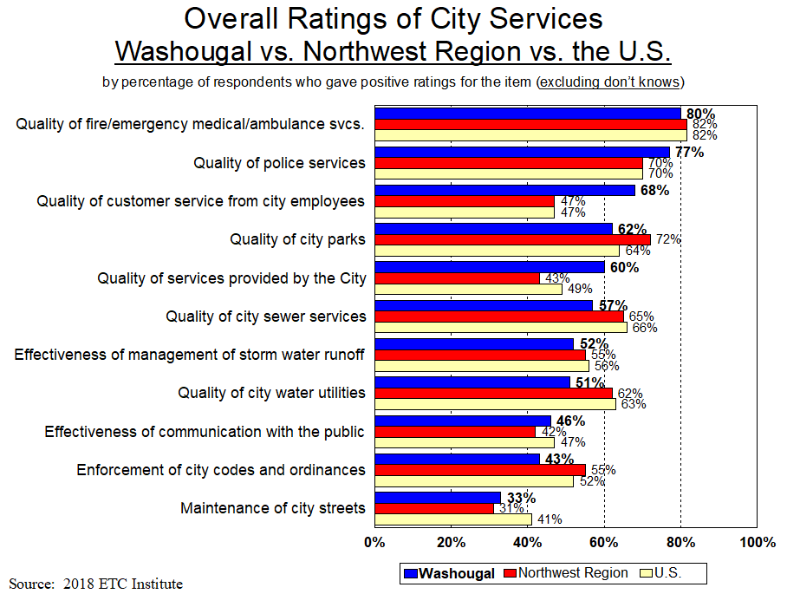
22
Significantly Higher: Significantly Lower:

Slide 23
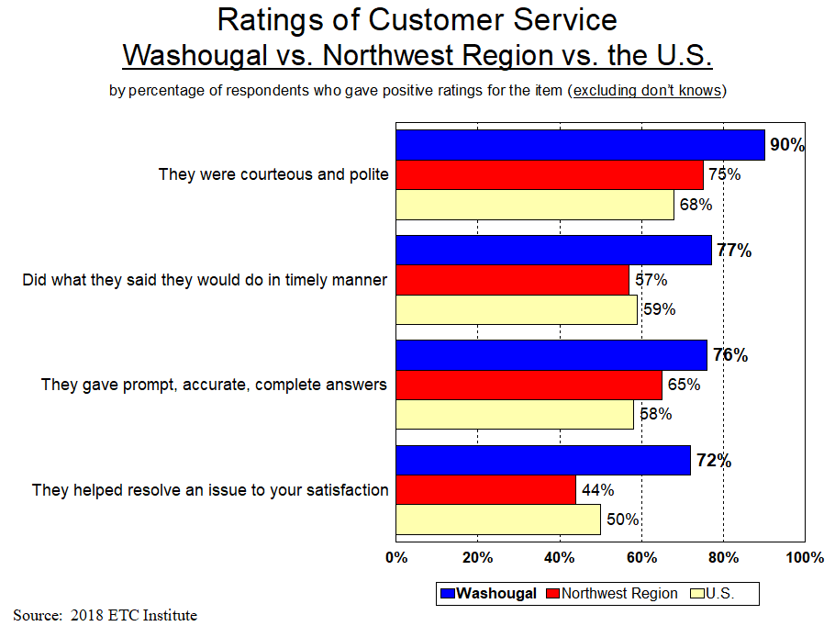
23
Significantly Higher: Significantly Lower:

Slide 24
Major Finding #4
Priorities for Improvement

Slide 25
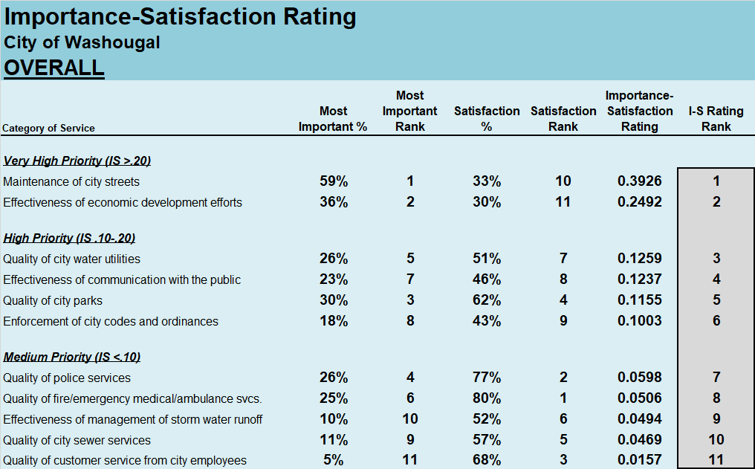
Overall Priorities:
25

Slide 26
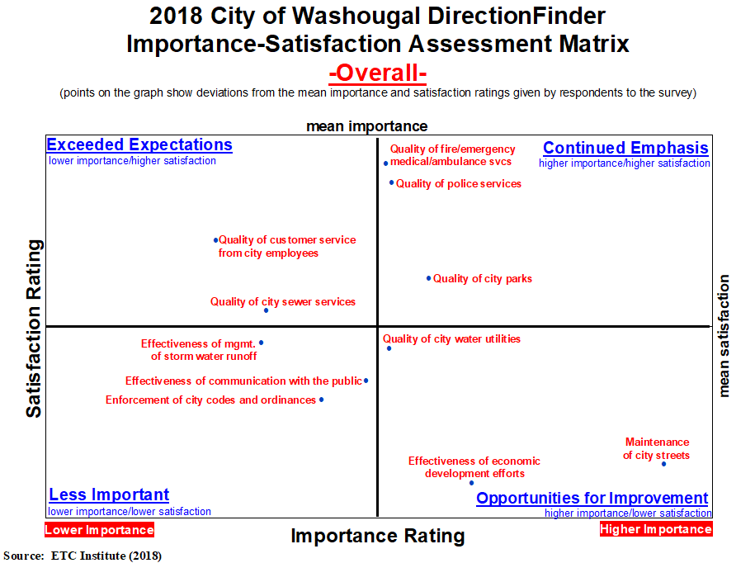

Slide 27
Other Findings

Slide 28
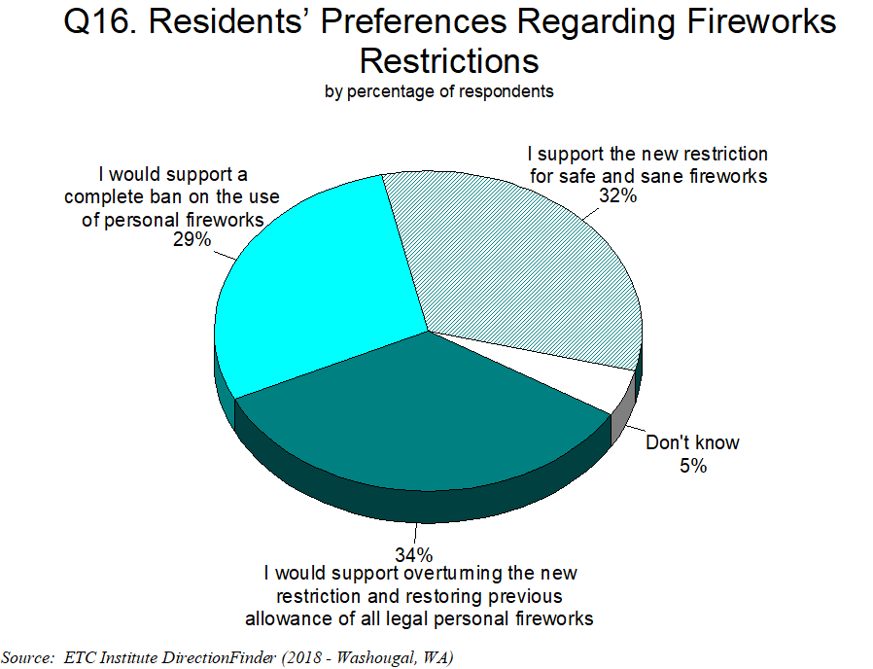
61% Support the New Firework Restrictions or Support Even Further Restrictions

Slide 29
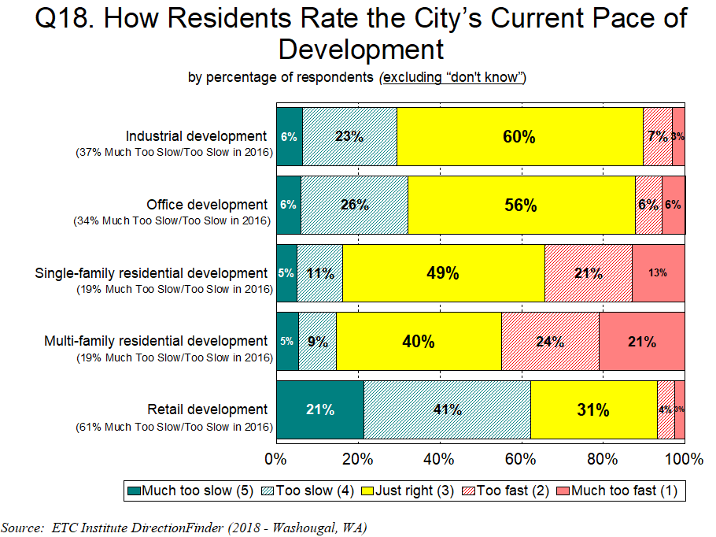
Over 60% Feel Retail Development Is Too Slow; For All Other Areas “Just Right” Is the Top Response

Slide 30
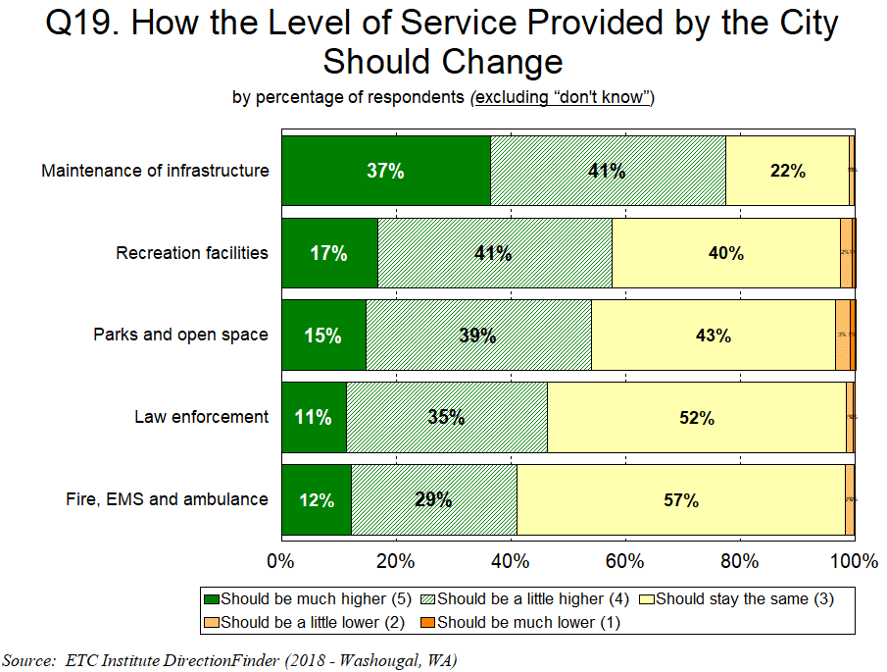
Over 75% Would Like to See Higher Levels of Service for Maintenance of Infrastructure
Over 50% Would Like to See Higher Levels of Service for Rec Facilities & Parks/Open Space

Slide 31
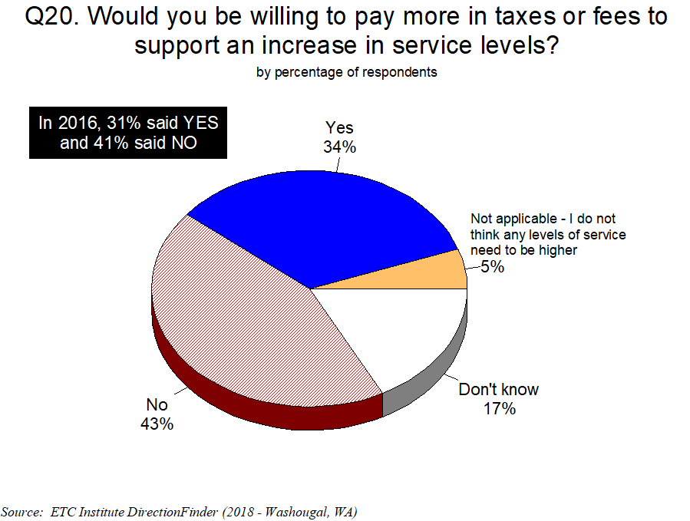

Slide 32
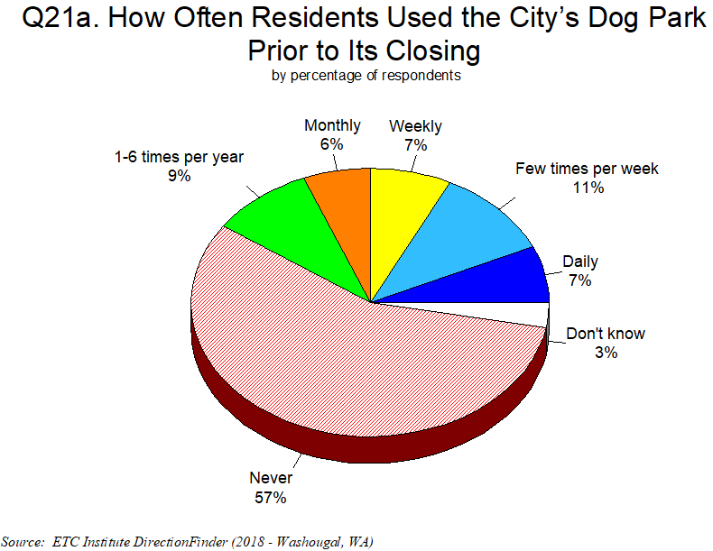
57% Never Used the Dog Park Prior to its Closing

Slide 33
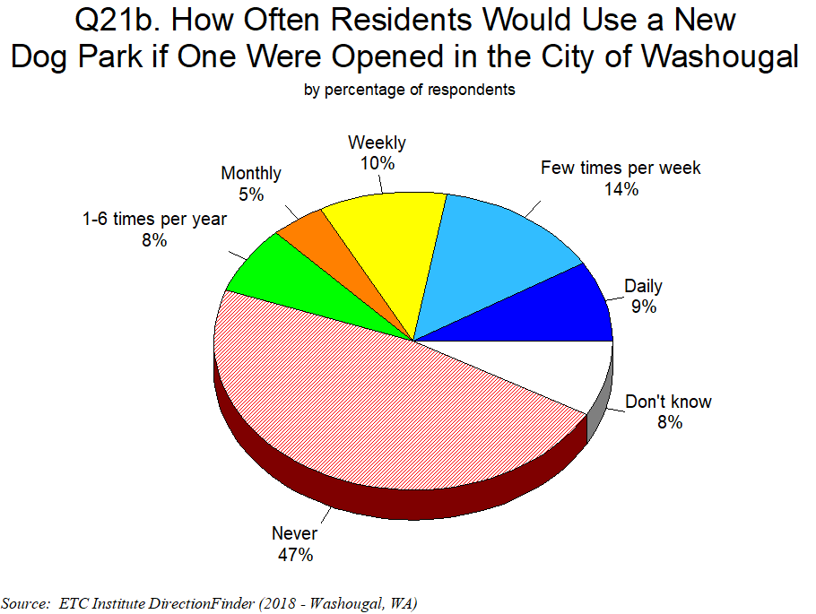
47% Would Never Use a New Dog Park

Slide 34
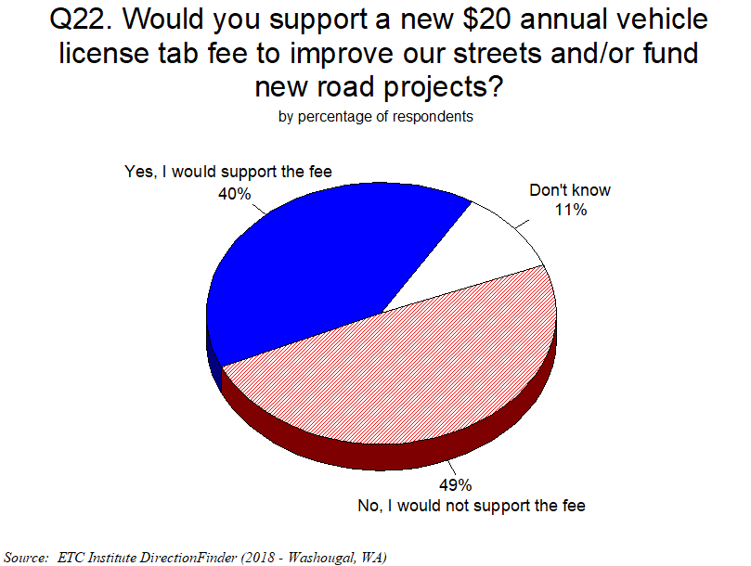

Slide 35
Summary

Slide 36
Summary
Residents Have a Positive Perception of the City
    60% are satisfied with the overall quality of City services; only 7% are dissatisfied
The City Is Moving in the Right Direction
  Satisfaction ratings have increased or stayed the same in 36 of 54 areas since 2016, and increased or stayed the same in 31 of 54 areas since 2014
Washougal Rates Higher Than Other Cities in the Overall Quality of City Services
  The City rated 17% above the Northwest Regional Average and 11% above the U.S. Average in the overall quality of services provided by the City
Washougal Rates Higher Than Other Cities in Providing Customer Service
  The City rated 21% above the Northwest Regional Average and the U.S. Average in the quality of customer service provided by City employees
Overall Priorities for Improvement:
  Maintenance of City Streets
  Effectiveness of Economic Development Efforts

Slide 37
Questions?
THANK YOU!!

