Slide 1





Utility Rate Update
November 18, 2019

Slide 2
Agenda
Recommended Approach
Next Steps

Slide 3
Recommended Approach
  Adopt proposed rates which reduce the increases from the currently adopted rates
  Maintain the current bimonthly billing policy and re-evaluate monthly billing once AMI is rolled out
  Phase in the single-family flow-based sewer rates change through 2023 to eliminate intra-class subsidy for residential sewer
  Adopt this rate model on 12/2
  Begin development of a “Balance Billing” or “Equal Pay” program for residential
  Explore potential outsourcing options (Council direction)

Slide 4
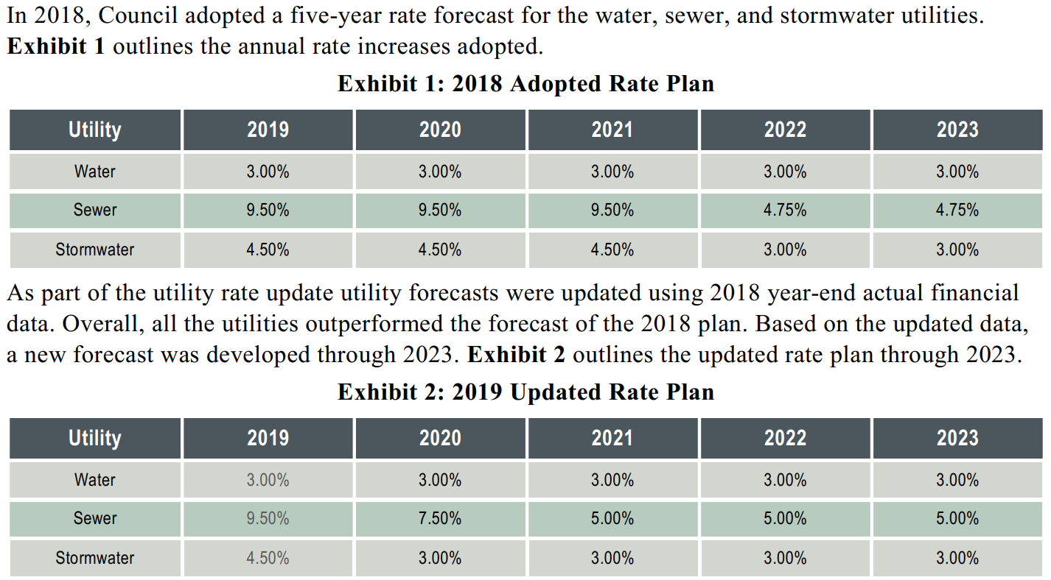
Updated 2019 Rate Forecast

Slide 5
Combined Bill Comparisons
*Assumes 14 ccf bimonthly usage

Slide 6
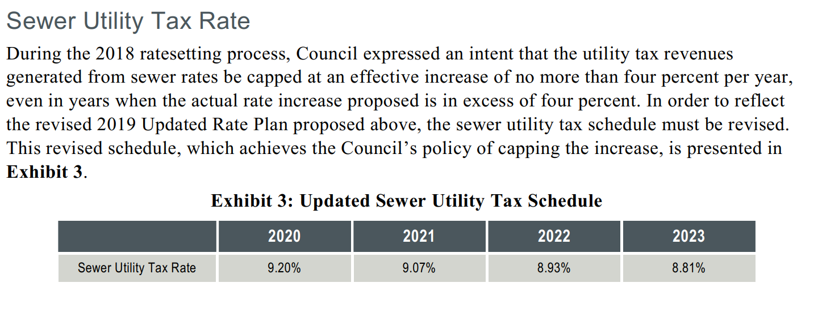
Updated Sewer Utility Tax Rate

Slide 7
Residential Sewer Rate Design
Current: Fixed charge for all residential customers
Proposed: Flow-based component
  Based on winter average usage
  Objective: improves intra-class equity for residential users
  Customers pay based on their usage of the system

Slide 8
Rate Design Alternatives
Full Implementation
  Collect 60% of SFR revenue through the fixed charge in 2020
Phase-In
  Phase-in to 60% fixed revenue by 2023
Policy Recommendation:
Collect enough revenue from the fixed charge to cover debt service (~60% of SFR revenue)

Slide 9
Rate Schedule

Slide 10
Combined Bill Comparisons
*Assumes 14 ccf bimonthly usage, 8 ccf bimonthly winter average usage

Slide 11
Next Steps
  12/2 ordinance
  New rates effective January 1, 2020 and so on annually for the rate window through 2023
  Future worksessions in 2020 re:
    “Balance Billing or Equal Pay”
    Industrial Sewer SDC update
    Potential outsourcing options

