Slide 1


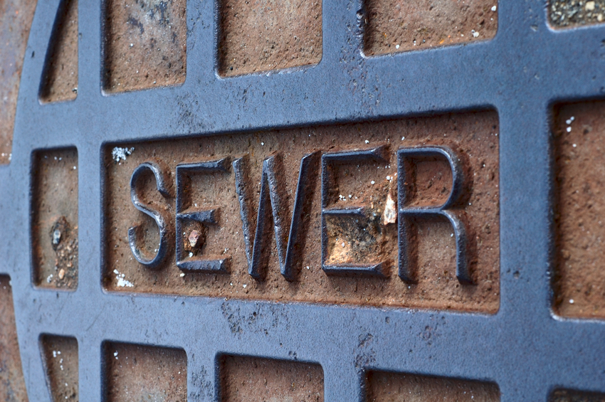


Water, Sewer, and Stormwater Rate Study: Phase II.a
Courtney Black, Project Manager
August 13, 2018

Slide 2
Study Segments
Study Phase I | Study Phase II.a | Study Phase II.B
Capital Funding Analysis | Stormwater Credit Analysis | Water Rate Design
Policy Evaluation | Sewer Utility Tax Evaluation | System Development Charges Update
Operations Forecast | Water Revenue Reconciliation | Utility Benchmarking
Scenario Analysis
Rate Plan Alternatives

Slide 3
Changes Since Phase I
Water
Forecast revised based on more conservative billed revenue basis
Billing system data revenue collection $3.6m, vs $3.8m reported basis from Phase I
Sewer
Response to council request to evaluate utility tax impact
Sewer utility tax capped at increasing from the 2018 budgeted $ amount at no more than 4% annually (versus applying the 10%)
Stormwater
Customer billing data revenue reconciliation
Cost of service credit level findings applied to stormwater rates

Slide 4
Updated Water Revenue Requirement
Revised revenue basis of $3.6m
Conservative basis for near-term rate planning, can be revised in interim rate update (2-3 years)
*Bimonthly bill: Assumes ¾” Meter, 7 ccf per month

Slide 5
Updated Sewer Revenue Requirement
Tested reducing the utility tax impact from rate increases
Sewer utility tax capped at increasing from the 2018 budgeted $ amount at no more than 4% annually (versus applying the 10% rate)
Current utility tax 10%
Tax rate decreases to 8.12% by 2023

Slide 6
Administration Recommendation – Phase I
Water: Phased CIP
Presented 2.5% annual increases
Updated 4% annual rate increases
Sewer: Programmed CIP and staffing
Presented 10.5% in 2019-2021, 5% in 2022-2023
Updated 10% in 2019-2021, 4.25% in 2022-2023
Stormwater: Delay programmed staffing / Status Quo
4.5% annual system-wide increases in 2019-2021, 3% in 2022-2023
Credit recipient rate adjusted

Slide 7
Stormwater Credit Analysis

Slide 8
Washougal Stormwater History
Stormwater rates have been low historically compared to other utilities
Rate equity / rate credits now emerging as a concern as program costs and resulting rates go up to meet regulatory pressures
Many programs offering rate credits set policy-based credit levels
Many program costs are not reduced by customers’ on-site mitigation
Analytically-based credit calculations often result in maximum credits of 25%-50%
Washougal’s existing available rate credit value of 75% is provided to the following customer groups
Any property with qualifying onsite mitigation facilities
Individual NPDES permit-holders
The “cost of service” analysis evaluates savings to the utility from on-site mitigation to determine the cost-based maximum credit level
Notes:
4.32.040 Credits for qualified existing or new stormwater facilities.
(1) The city of Washougal recognizes that some commercial property owners have constructed private on-site stormwater quality and quantity mitigation facilities (“facilities”) which may aid the city in controlling the overall effects of stormwater pollution and those other problems necessitating that the city enact this chapter. Properties or portions of properties with facilities that meet one of the criteria listed below, to the city’s satisfaction, shall receive a reduction of 75 percent from the monthly fee charged under WMC 14.32.030 as currently enacted or hereafter amended.
(a) Any property with a properly maintained water quantity and quality facility that meets or exceeds the design requirements of the 2005 Department of Ecology Stormwater Management Manual for Western Washington.
(b) Any property that has an active and valid NPDES permit that includes stormwater requirements. A copy of the permit and the Storm Water Pollution Prevention Plan (SWPPP) shall be provided to the city.

Slide 9
Functional Cost Allocation
Cost Allocation
Methodology
e.g. Public outreach
e.g. Billing, Engineering
Base
Use
Non-Facility Related
Facility O&M
Use Indirect
Use Direct
e.g. System maintenance
Not Credit Eligible
Credit Eligible

Slide 10
Full 2019 Credit Implementation
A reduced credit would generate additional revenue from credit recipients
A revenue neutral option would decrease the stormwater rate per ESU by about 10%
Includes 2019 4.5% rate increase

Slide 11
Phased Credit Alternative
5 Year Phase-in
Phase-in credit impact through 2023
Credit recipient rate credit 65%, 55%, 45%, 35%, 25%
Includes 2019-2021 4.5% rate increases, 3% in 2022-2023

Slide 12
Bimonthly Commercial Bill Comparisons

Slide 13
Updated Bill Impacts

Slide 14
Sample Bimonthly Bill – 2019 Credit Implementation
Bimonthly $ Increase $12.11 $16.51 $17.88 $10.77 $11.20
Annual % Increase 5.54% 7.08% 7.16% 4.02% 4.02%
Cumulative Rate Increase 31.0%
SFR average bimonthly bill: Assumes ¾” Meter, 7 ccf per month

Slide 15
Sample Bimonthly Bill – 5 Year Credit Phase In
Bimonthly $ Increase $14.68 $15.91 $17.25 $10.10 $10.53
Annual % Increase 6.64% 6.74% 6.85% 3.75% 3.77%
Cumulative Rate Increase 31.0%
SFR average bimonthly bill: Assumes ¾” Meter, 7 ccf per month

Slide 16
Bimonthly Bill Comparisons
SFR average bimonthly bill: Assumes ¾” Meter, 7 ccf per month

Slide 17
Next Steps

Slide 18
Phase II.b Analysis in Progress
Water Rate Structure
Recalibrating Single Family Residential usage tiers for updated demand statistics
System Development Charges
Existing system facilities cost
Future facilities cost
Total system capacity
Unit cost of one ERU
Benchmarking
Measures against standard industry performance
Measures against local industry performance

Slide 19
Next Steps
Rate Plan
Water: Phased CIP, conservative revenue basis
Sewer: Programmed CIP and staffing, decrease utility tax
Stormwater: Delay programmed staffing, adjust for cost-based credit
Stormwater Rate Credit Direction
2019 Implementation
5 Year Credit Phase In
October 8 workshop Phase II.b
October 22 draft ordinance at workshop
Early November adoption of rates

Slide 20
Courtney Black
Project Manager
courtneyb@fcsgroup.com
Direct 425.241.9343
Contact FCS GROUP:
(425) 867-1802
www.fcsgroup.com

