Slide 1





Utility Rate Updates
Andy Baker, Project Manager
Chase Bozett, Senior Analyst
July 22, 2019

Slide 2
Agenda
Rate Updates – Year-End Actuals/Performance
Monthly Billing
RRF Alternatives
Preferred Alternative
Next Steps

Slide 3
2018 Rate Plan

Slide 4
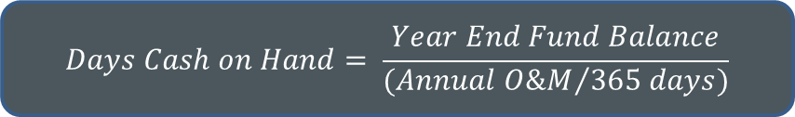
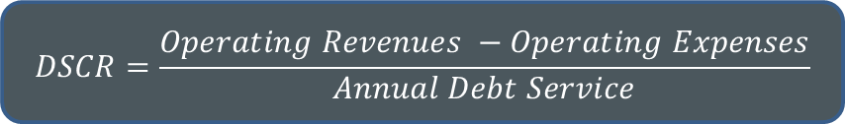
Evaluating Performance
Key Performance Indicators:
Debt Service Coverage Ratio (DSCR):
Target: 2.0x | Bond Covenant Minimum: 1.25x
Days Cash on Hand:
Operating Reserve:
Water: 60 to 90 days
Sewer: 45 to 60 days
Stormwater: 30 to 45 days
Combined Target: between 150 days and 250 days cash-on-hand
Replacement Reserve Funding (RRF):
Target: Equal to Annual Depreciation (phased in by 2024)
$$DSCR=\frac{Operating Revenues −Operating Expenses}{Annual Debt Service}$$
$$Days Cash on Hand= \frac{Year End Fund Balance}{{(Annual O\&M}/{365 days)}}$$

Slide 5
Evaluating Performance
 | 2018 Plan | Outcome | Comments
DSCR (Parity Bond Debt) | 1.9x | 2.2x | Stronger than projected revenues and lower O&M costs
Operating Reserves | Meet all targets | Operating reserve targets met
Combined Cash on Hand | 716 days cash on hand | 939 days cash on hand | Lower O&M costs contributed to higher reserves
Replacement Reserve Funding | Phasing on track for all utilities | Phasing on track for all utilities
Key finding: 2018 was a strong year for the City’s utilities – performance met or exceeded the 2018 Plan

Slide 6
Water Year-End-Actual Update
No change to overall Rate Plan through 2023 (3.0% per year)
Slightly higher revenues
Slightly lower operating expenses
Significant changes to capital expenses
Including fully programmed AMI (implementation TBD)
Updated Fund Balances
New planned debt issuance to fund Zone 6 projects (next rate window, 2024)

Slide 7
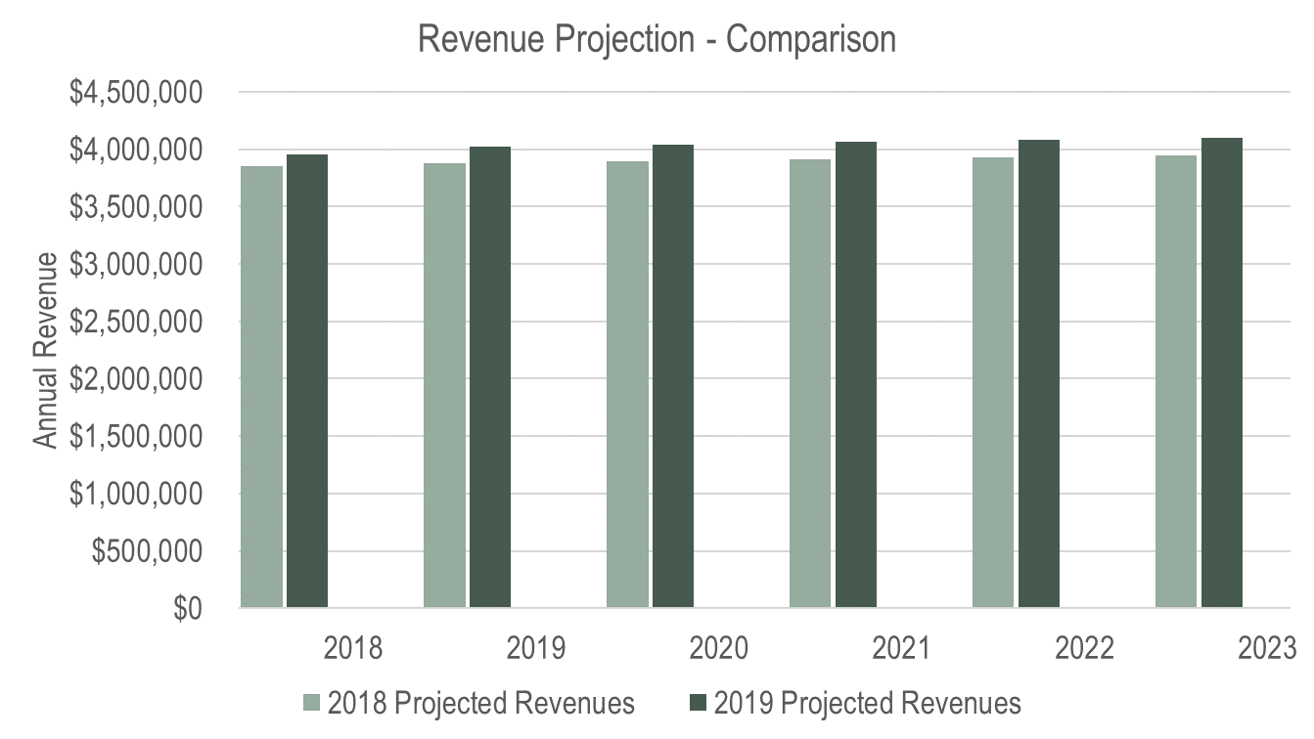
Water Year-End-Actual Update

Slide 8
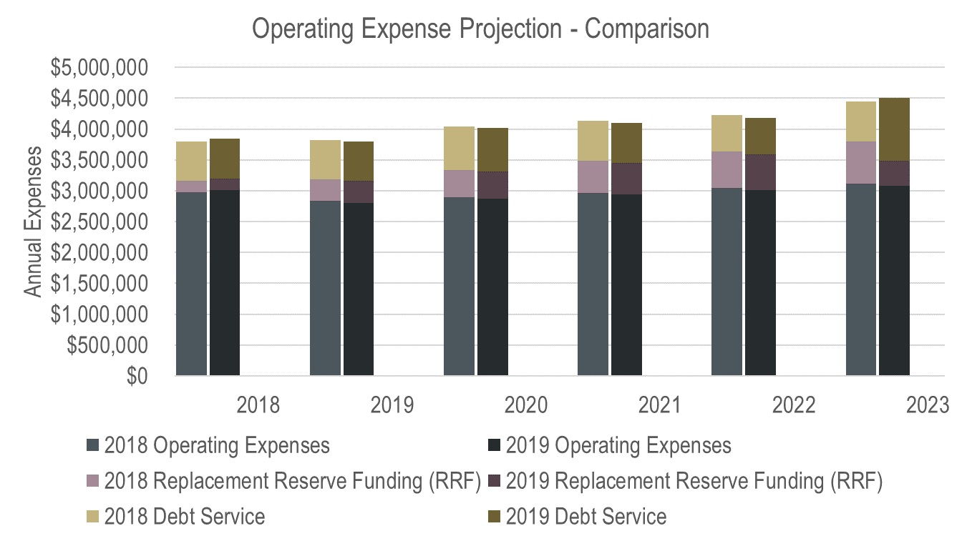
Water Year-End-Actual Update

Slide 9
Water Year-End-Actual Update

Slide 10
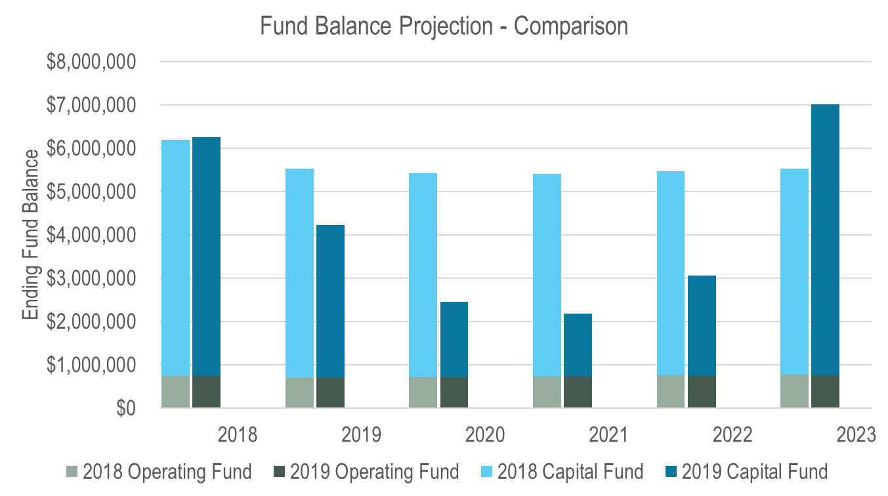
Water Year-End-Actual Update

Slide 11
Sewer Year-End-Actual Update
Reduction in Necessary Rate Plan (7.5% in 2020, then 5.0%)
Slightly higher revenues
Slightly lower operating expenses
No changes to capital expenses
Updated Fund Balances
Revised Revenue Bond plan based on managing capital fund balances

Slide 12
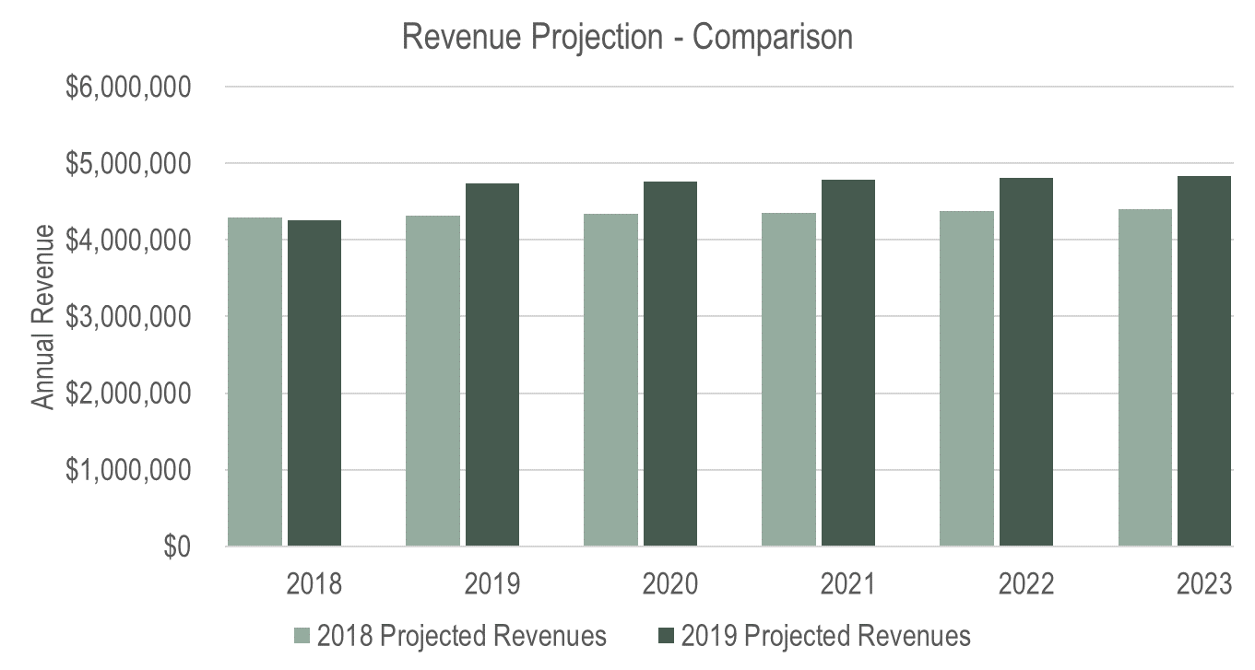
Sewer Year-End-Actual Update

Slide 13
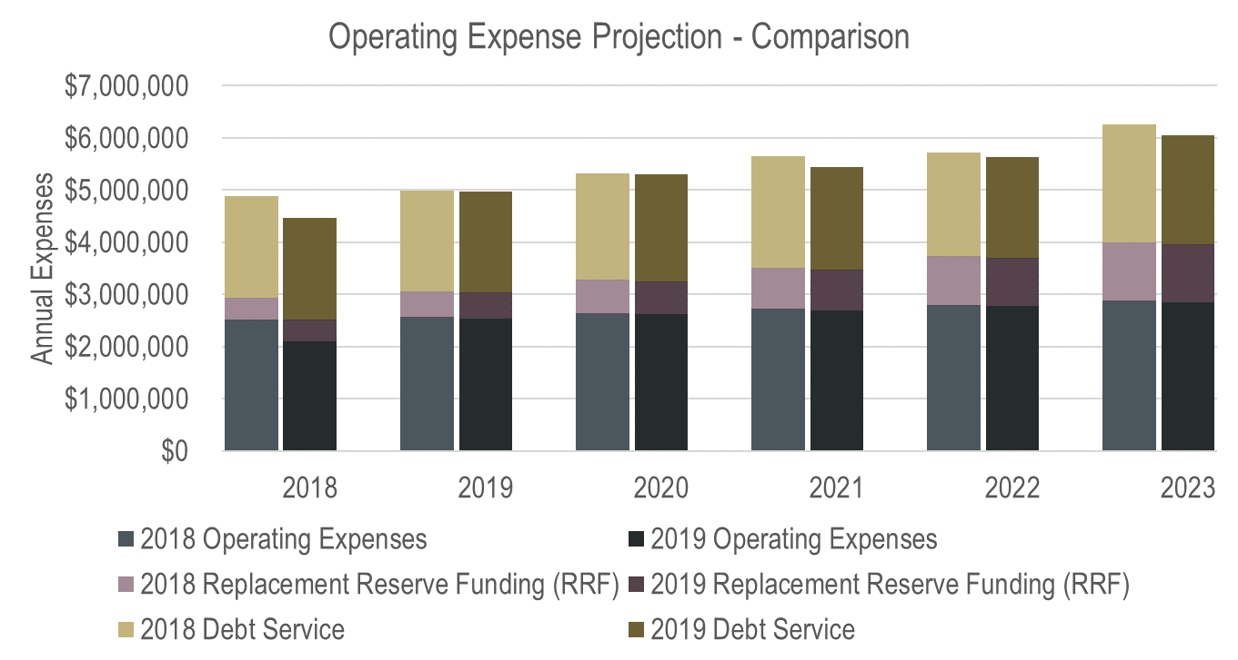
Sewer Year-End-Actual Update

Slide 14
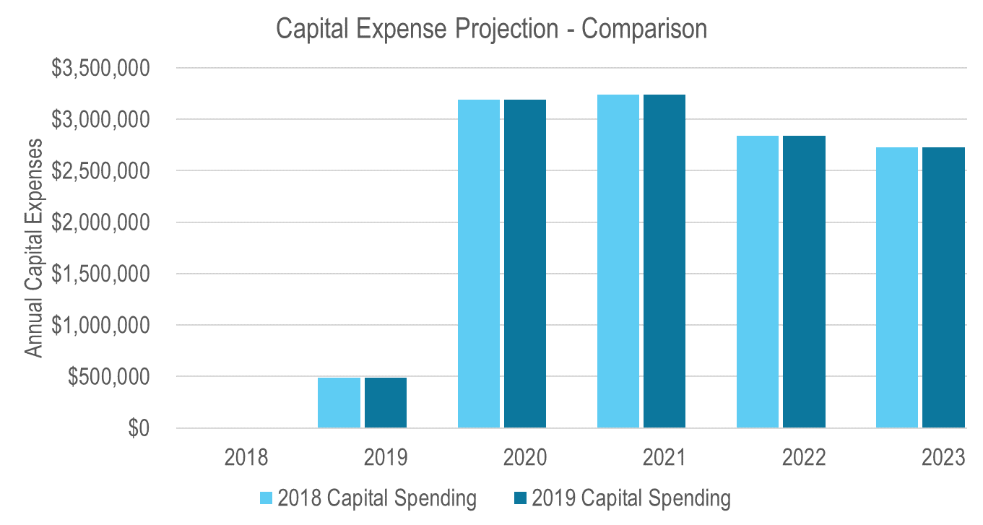
Sewer Year-End-Actual Update

Slide 15
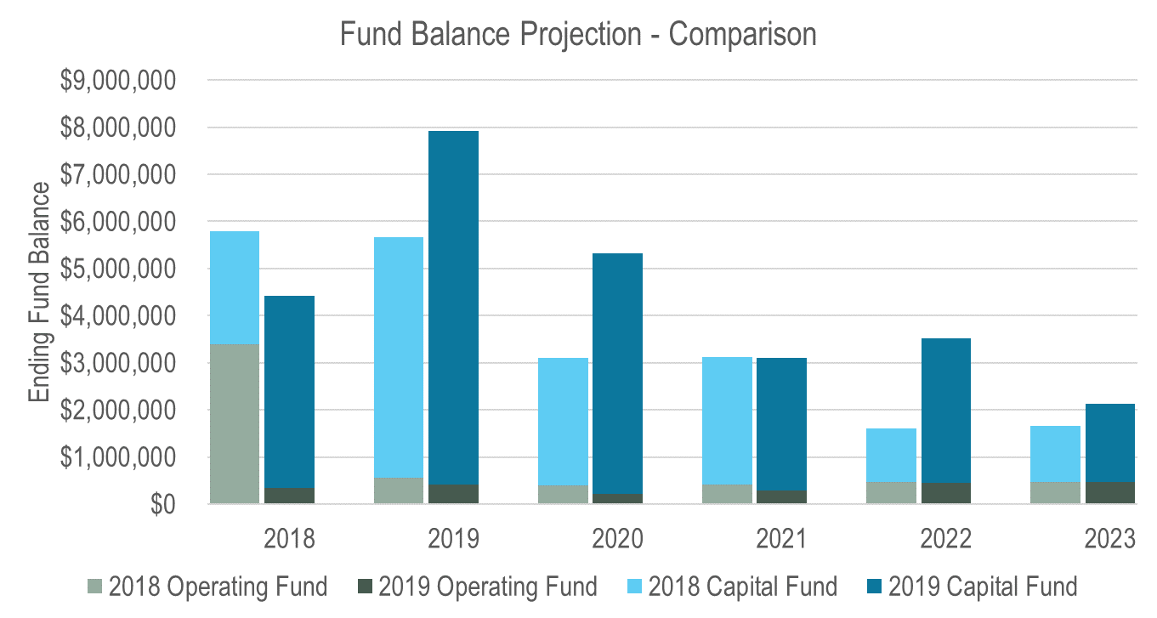
Sewer Year-End-Actual Update

Slide 16
Stormwater Year-End-Actual Update
Reduction in Necessary Rate Plan (3.0% per year)
Slightly higher revenues
No changes to operating expenses
No changes to capital expenses
Updated Fund Balances

Slide 17
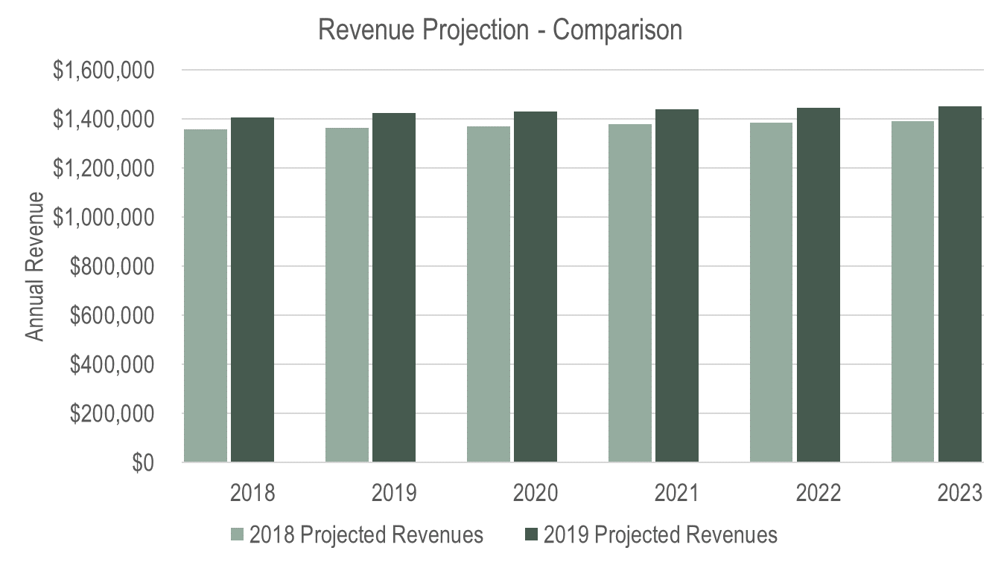
Stormwater Year-End-Actual Update

Slide 18
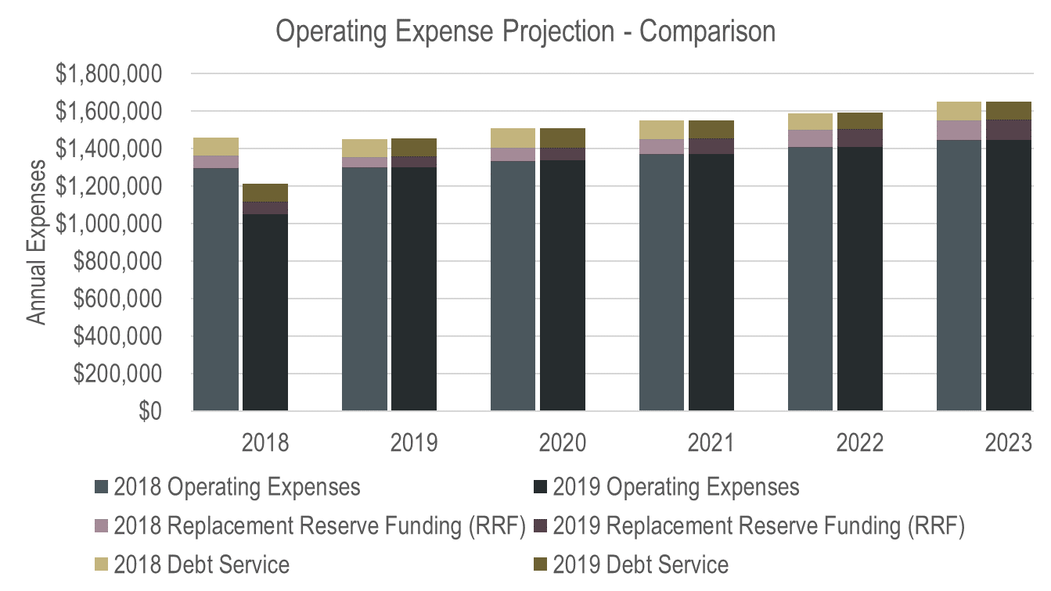
Stormwater Year-End-Actual Update

Slide 19
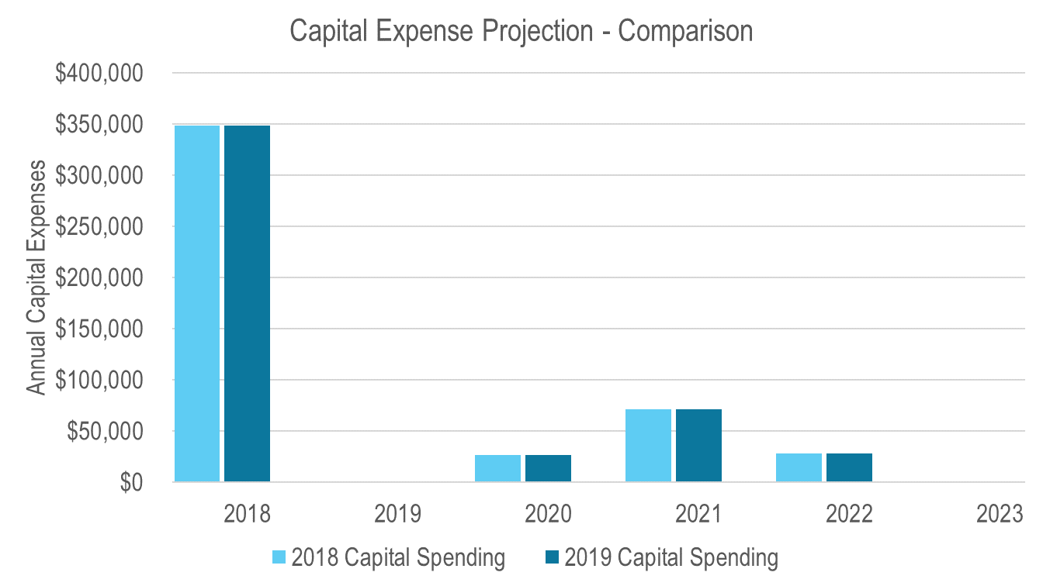
Stormwater Year-End-Actual Update

Slide 20
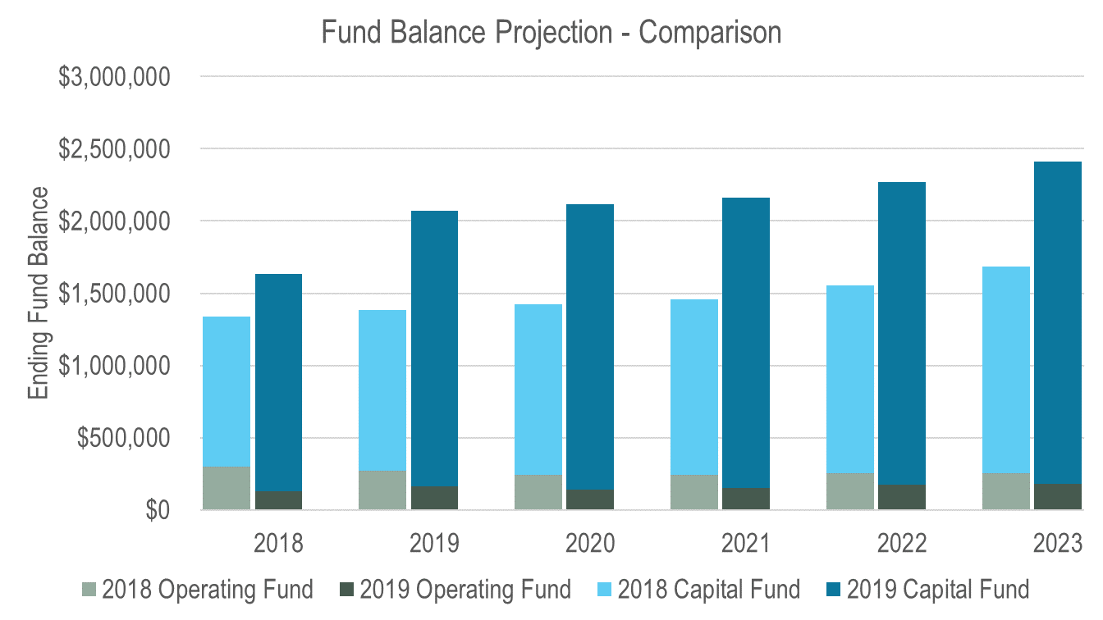
Stormwater Year-End-Actual Update

Slide 21
Monthly Billing Evaluation

Slide 22
Monthly Billing Evaluation
Review of staff’s budget impact estimates
Additional Budget Considerations:

Slide 23
Monthly Billing Evaluation
Budgetary Considerations
Rate Impact:
Non-Budgetary Considerations
Clearer signaling of usage behavior to customers
Smaller, more manageable bills
Greater administrative burden and complication
Water: 3% for 1 year
Sewer: 0.5% for 1 year
Stormwater: 3% for 1 year
Typical Residential Bill Impact: $4.52 per bi-monthly period ($2.26 per month)
Notes:
Closer alignment of demands to bills
Creates clearer connection between behavior and cost for customers
Can improve City’s year-to-date revenue projections
Clearer signaling of usage behavior
Can help customers identify leaks sooner
Can help reduce peak usage by sending a clearer price signal sooner
Smaller, more manageable bills
Minimizes rate shock due to bill variability
Allows for simpler household budgeting

Slide 24
Replacement Reserve Funding Alternatives

Slide 25
Replacement Reserve Funding Alternatives
Baseline 2018 Plan: Phase to fully funding Depreciation by 2024
Alternatives considered:
Achieve RRF Target from 2018 Plan
Delay attainment of RRF Target to support other initiatives
Modify RRF Target to be based on Depreciation Net of Debt Service

Slide 26
Replacement Reserve Funding Alternatives
 | Water Impact | Sewer Impact | Stormwater Impact
Attain 2018 RRF Target | Increase rate plan to 4.5% per year | No Change – DSCR & Reserve Minimums Control | No Change – DSCR & Reserve Minimums Control
Delay RRF Target Attainment | Maintain rate plan at 3.0% per year by deferring to 2028 | No Change – DSCR & Reserve Minimums Control | No Change – DSCR & Reserve Minimums Control
Change to Net Debt RRF Target | No Change – DSCR & Reserve Minimums Control | No Change – DSCR & Reserve Minimums Control | No Change – DSCR & Reserve Minimums Control
Notes:
Attain RRF: -Water: because of increased capital spending (Northshore)

Slide 27
Preferred Alternative

Slide 28
Scenarios
Water:
Updated Baseline
Preferred Alternative: Monthly Billing, Zone 5 & Zone 6 Improvements
Sewer:
Updated Baseline
Preferred Alternative: Monthly Billing, Zone 5 & Zone 6 Improvements
Stormwater:
Updated Baseline
Preferred Alternative: Monthly Billing

Slide 29
Water Scenarios

Slide 30
Sewer Scenarios

Slide 31
Stormwater Scenarios

Slide 32
Planned Revenue Bond Borrowing

Slide 33
Key Performance Indicators – RRF

Slide 34
Key Performance Indicators - DSCR

Slide 35
Key Performance Indicators – Cash on Hand

Slide 36
Typical Residential Rate Comparisons – Bimonthly
2018 Plan
2019 Base
Pref. Alt.

Slide 37
Typical Residential Rate Comparisons – Monthly
2018 Plan
2019 Base
Pref. Alt.
Monthly
Billing
Implemented

Slide 38
Next Steps
Incorporate your Feedback
Sewer SDC Recommendations (future work session)
Volumetric Sewer Rate Structure Recommendations (future work session)
Council Adoption later in year (implementation timing TBD)

Slide 39
Andy Baker
Project Manager
AndyB@fcsgroup.com
Direct 425.361.0391
Contact FCS GROUP:
(425) 867-1802
www.fcsgroup.com

Slide 40
Supplemental Slides

Slide 41
Rate Comparisons

