Slide 1


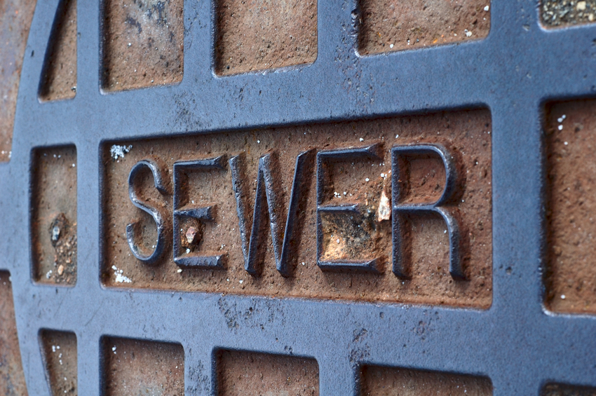


Water, Sewer, and Stormwater Rate Study Phase 1
Courtney Black, Project Manager
May 29, 2018

Slide 2


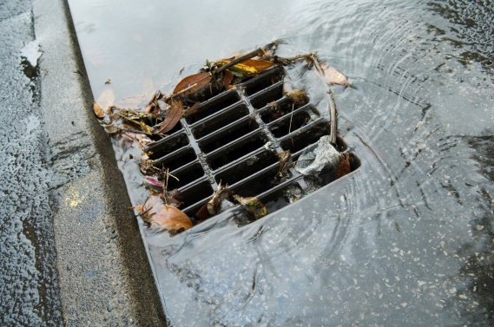
Our Firm
FCS GROUP Background:
Recognized leader in utility rate and fee innovation and successful outcomes
Independent and objective firm that has delivered high-quality, cost-effective consulting services in over 3,500 engagements and served more than 550 clients.

Slide 3
Background / Introduction
2018 Study Phase 1 Financial Management | 2018 Study Phase 2 Customer Impacts & Outreach
Capital Funding Analysis | System Development Charges
Policy Evaluation | Stormwater Credit Analysis
Operations Forecast | Water Rate Design
Scenario Analysis | Benchmarking
Rate Plan Alternatives | Public Outreach
Notes:
Water rate alternatives eliminating the water use allowance included in the fixed rate.
Revenue needs provide preliminary customer bill impacts that will be further impacted by rate design alternatives for water and the stormwater mitigation credit analysis.

Slide 4
Background / Introduction
 | Water | Sewer | Stormwater
Rate Increase | 3% annually 2014-2018 | 0% 2014-2016 2% in 2017 and 2018 | 0% from 2015-2018
Replacement Reserve Funding (RRF)* Annual Contribution | $184,809 in 2018 | $416,828 in 2018 | No specific amount budgeted
Notable Accomplishments | Achieved 60% of annual RRF phase-in policy target, reduced allowance in base charge | Achieved 60% of annual RRF phase-in policy target, Phase-in to equitable rate structure complete 2018 | CIP projects funded and complete
* Formerly Rate Funded System Reinvestment – updated terminology to Replacement Reserve Funding

Slide 5
Rate Study Objectives
Rate plan alternatives that consider and balance:
  Rate affordability
  Sufficiency of revenues to meet existing obligations
  Long-term sustainability of utility infrastructure
  Financial viability and credit-worthiness

Slide 6
Framework & Assumptions

Slide 7
Fiscal Policies
 | Purpose | Policy Target
Operating Reserve | Liquidity cushion to accommodate cyclical cash flow fluctuations | Water: 60 to 90 days Sewer: 45 to 60 days Stormwater: 30 to 45 days
Capital Contingency Reserve | To meet emergency repairs, unanticipated capital, and project cost overruns | Minimum balance 1% of capital assets
Debt Service Coverage | Compliance with existing debt covenants and maintain credit worthiness for future debt needs | 1.25 minimum 2.0 target
Replacement Reserve Funding | Reserve toward the accumulating liability as assets age toward replacement | Current budgeted level phased-in to annual depreciation target
Rate Setting | A multi-year financial plan | Five-year plan 2019-2023
Revenue Sufficiency | Set rates to meet the total annual financial obligations of the utility and be self supporting | Rates shall be set to cover O&M, debt service, and fiscal policy achievement
* Formerly Rate Funded System Reinvestment – updated terminology to Replacement Reserve Funding

Slide 8
Revenue Bond Coverage
Not a one-time reserve
Ongoing revenue cushion to mitigate bondholder risk
Defined in each bond covenant
Bond Year | Coverage Requirement | Net Revenue Calculation | Debt Calculation
2005 | 1.25 | Gross Revenue Less: Operation & Maintenance | Net Revenue in each calendar year will equal at least 1.25 times the Annual Debt Service for such year
2011 | 1.25
2014 | 1.25
2015 | 1.25
2017 | 1.25
Notes:
Target is 2.0 underwriters guidance for favorable ratings and terms

Slide 9
Replacement Reserve Funding (RRF)
A consistent cash amount from current rate revenue
  Pays for current R&R projects or
  Saved in fund to pay for future capital projects
  Policy-based and budgeted
  Reduces reliance on borrowing to fund R&R
Alternative annual funding targets
  Annual depreciation net of debt principal payment (historical policy)
  Annual depreciation (recommended update)
  Replacement cost depreciation (long-term target with asset management)

Slide 10
Sample Funding Approaches
Pipe Original Cost $50,000
1
25
50
Year 1
Depreciation $1,000
RC Funding $3,790
No Policy $0
1
25
50
Year 25
Depreciation $30,063
RC Funding $113,934
No Policy $0
1
25
50
Year 50
Borrowing
$205,564
$0
$279,246
Depreciation $73,683
RC Funding $279,246
No Policy $0
*1.5% interest earnings (LGIP 15 yr. avg.) and 3.5% capital cost inflation (ENR CCI 15 yr. avg.)
Pipe Replacement Cost $279,246

Slide 11
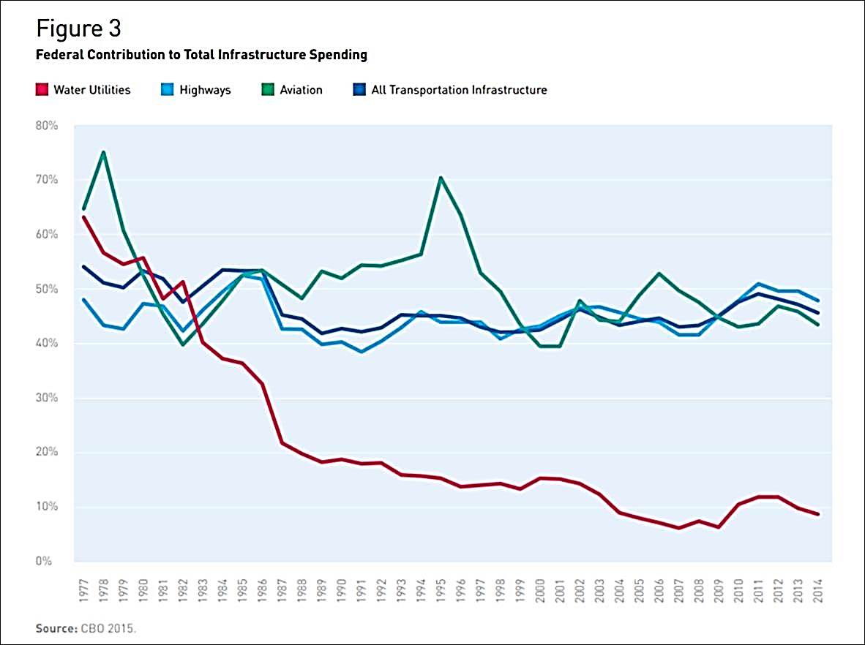
Decline in Federal Spending for Utilities
>60%
Water Utilities
<10%

Slide 12
Study Data and Assumptions
Study Foundation
Operating Cost | 2018 Budget
Fund Balances | 2017 Year-End
Capital Expenditures | Capital Improvement Programs (CIP) Scenarios
Revenue | 2018 Budget / In process of reconciling 2017 actuals
Forecast Assumptions
General Cost Inflation | Consumer Price Index 5 year average (2%)
Wages & Benefits | Employment Cost Index 5 year average (3% and 5%)
Capital Expenditures | ENR Construction Cost Index 5 year average (3%)
Customer Growth | Budgeted Amount in 2018, 0.5% In future years

Slide 13
Capital Improvement Program Scenarios
Capital Improvement Program
Fully Programmed | All projects identified by staff, consultants and regulators to meet department objectives for growth, compliance and system efficiencies.
Phased: Critical Near-term | All critical path projects that have been identified as minimally necessary to avoid negative impacts to compliance with regulatory agencies or growth (economic and population).

Slide 14
How Much Revenue is Needed
Fiscal Policy Achievement

Forecast of O&M Costs
Annual Revenue Needs

Existing and New Debt Service

Revenue Bond Coverage Obligations

Slide 15
Water

Slide 16
Operating Forecast
Taxes
Indirect Costs
Operations
Maintenance
Administration
Notes:
10% City Utility
5.029 State
1.5 B&O

Slide 17
Fully Programmed CIP Funding Structure
Total CIP: $11.5m
$2.5m funded by revenue bonds

Slide 18
Phased CIP Funding Structure
Total CIP: $4.1m
Fully funded by existing reserves

Slide 19
Water Revenue Requirement – Fully Programmed
Return
$83.51 $87.27 $91.20 $95.30 $99.11 $103.08
4.5% annual rate increases in 2019-2021
4% annual rate increases from 2022-2023
$2.5m debt issuance in 2021 ($11.5m CIP)
RRF 90% funded in 2023 ($815k)
SFR average bimonthly bill: Assumes ¾” Meter, 7 ccf per month

Slide 20
Water Revenue Requirement – Phased CIP
Return
$83.51 $85.60 $87.74 $89.93 $92.18 $94.48
2.5% annual rate increases
RRF 90% funded in 2023 ($680k)
SFR average bimonthly bill: Assumes ¾” Meter, 7 ccf per month

Slide 21
Water Revenue Requirement – Existing Rates
Return
$83.51 $83.51 $83.51 $83.51 $83.51 $83.51
RRF 34% funded ($250k in 2023)
Phased CIP
SFR average bimonthly bill: Assumes ¾” Meter, 7 ccf per month

Slide 22
Water Revenue Requirement – Reduce Rates
Return
$83.51 $75.16 $75.16 $75.16 $75.16 $75.16
10% rate reduction in 2019, maintained through 2023
Phased CIP
No RRF
$85k (3%) O&M reduction in 2023
SFR average bimonthly bill: Assumes ¾” Meter, 7 ccf per month

Slide 23
Water Bimonthly Bill Comparison
SFR average bimonthly bill: Assumes ¾” Meter, 7 ccf per month
Notes:
Camas no utility tax

Slide 24
Sewer

Slide 25
Operating Forecast
Taxes
Indirect Costs
Operations
Maintenance
Administration
Notes:
10% City utility tax
3.852 State
1.5 B&O

Slide 26
Fully Programmed CIP Funding Structure
Total CIP: $12.5m
$4.1m funded by revenue bonds
Includes $10m at the plant and full re-rating and permit renewal

Slide 27
Phased CIP Funding Structure
Total CIP: $12m
$3.6m funded by revenue bonds
Includes $10m at the plant and full re-rating and permit renewal

Slide 28
Sewer Revenue Requirement – Fully Programmed
Return
$106.22 $117.37 $129.70 $143.32 $150.48 $158.01
Programmed maintenance FTE staffed in 2019
10.5% annual increases from 2019-2021
5% annual increases from 2022-2023
$4.1m debt issuance in 2021 ($12.5m CIP)
RRF 90% funded in 2023 ($1.05m)
SFR average bimonthly bill

Slide 29
Sewer Revenue Requirement – Phased CIP
Return
$106.22 $116.31 $127.36 $139.46 $146.43 $153.75
9.5% annual increases in 2019-2021
5% annual increases in 2022-2023
No programmed maintenance FTE
$3.6m debt issuance in 2021 ($12m CIP)
RRF 90% funded in 2023 ($1m)
SFR average bimonthly bill

Slide 30
Sewer Revenue Requirement – Existing Rates
Return
$106.22 $106.22 $106.22 $106.22 $106.22 $106.22
No RRF
$6.4m debt issuance ($2.8m higher)
Phased CIP
$130k (5%) O&M reduction in 2019
$830k (30%) O&M reduction in 2023
SFR average bimonthly bill

Slide 31
Sewer Revenue Requirement – Reduce Rates
Return
$106.22 $95.60 $95.60 $95.60 $95.60 $95.60
10% rate reduction in 2019, maintained through 2023
No RRF
$6.4m debt issuance
$500k (20%) O&M reduction in 2019
$1.2m (44%) O&M reduction in 2023
SFR average bimonthly bill

Slide 32
Bimonthly Bill Comparison
Comparable for recent treatment plant/upgrades
SFR average bimonthly bill
Notes:
Camas no utility tax

Slide 33
Stormwater

Slide 34
Operating Forecast
Taxes
Indirect Costs
Maintenance & Administration
Notes:
10% City utility
1.5% B&O

Slide 35
Fully Programmed CIP Funding Structure
Total CIP: $900k
Fully funded by existing reserves

Slide 36
Phased CIP Funding Structure
Total CIP: $125k
Fully funded by existing reserves

Slide 37
Stormwater Revenue Requirement – Fully Programmed
Return
$31.48 $35.73 $37.52 $39.39 $41.36 $43.43
Existing Deficiency
Programmed Engineer FTE in 2019
13.5% increase in 2019
5% annual increases from 2020-2023
CIP cash funded ($900k)
RRF 90% funded in 2023 ($110k)
SFR average bimonthly bill

Slide 38
Stormwater Revenue Requirement – Status Quo
Return
$31.48 $32.90 $34.38 $35.92 $37.00 $38.11
No programmed Engineer FTE
4.5% annual increases in 2019-2021
3% annual increases in 2022-2023
RRF 90% funded ($95k)
Fully programmed CIP
SFR average bimonthly bill

Slide 39
Stormwater Revenue Requirement – Existing Rates
Return
$31.48 $31.48 $31.48 $31.48 $31.48 $31.48
Coverage requirement exceeds cash requirement
RRF 25% funded ($25k in 2023)
Fully programmed CIP
$40k (3%) O&M reduction in 2019
$160k (13%) O&M reduction in 2023
SFR average bimonthly bill

Slide 40
Stormwater Revenue Requirement – Reduce Rates
Return
$31.48 $28.33 $28.33 $28.33 $28.33 $28.33
10% rate reduction in 2019, maintained through 2023
RRF 25% funded ($25k in 2023)
Fully programmed CIP
$160k (14%) O&M reduction in 2019
$285k (24%) O&M reduction in 2023
SFR average bimonthly bill

Slide 41
Preliminary Stormwater Credit Analysis
Current NPDES permit holders receive 75% discount
A reduced credit would generate additional revenue from permit holders
A revenue neutral option would reduce the stormwater rate per ESU
Notes:
14.32.040 Credits for qualified existing or new stormwater facilities.
(1) The city of Washougal recognizes that some commercial property owners have constructed private on-site stormwater quality and quantity mitigation facilities (“facilities”) which may aid the city in controlling the overall effects of stormwater pollution and those other problems necessitating that the city enact this chapter. Properties or portions of properties with facilities that meet one of the criteria listed below, to the city’s satisfaction, shall receive a reduction of 75 percent from the monthly fee charged under WMC 14.32.030 as currently enacted or hereafter amended.
(a) Any property with a properly maintained water quantity and quality facility that meets or exceeds the design requirements of the 2005 Department of Ecology Stormwater Management Manual for Western Washington.
(b) Any property that has an active and valid NPDES permit that includes stormwater requirements. A copy of the permit and the Storm Water Pollution Prevention Plan (SWPPP) shall be provided to the city

Slide 42
Stormwater Bimonthly Bill Comparison
SFR average bimonthly bill
Notes:
Camas no utility tax

Slide 43
Review

Slide 44
Bimonthly Combined Bill Comparisons
SFR average bimonthly bill

Slide 45
Rate Affordability Test
Median Household Income - City of Washougal from census.gov
Projected bimonthly bills based on Fully Programmed scenarios
Affordability index based on Drinking Water State Revolving Fund Loan Program affordability threshold to determine eligibility for principal forgiveness
Notes:
Subsidy
“The department is providing some principle forgiveness this year. It will be based on an Affordability Index (percentage of MHI that the average water bill will be after the loan). Projects where the average monthly water rate will exceed 2 percent of the MHI for the service area will qualify.” (DWSRF)

Slide 46
Administration Recommendation
Water – Phased CIP
  2.5% annual increases
  RRF target 90% achieved in 2023
Sewer – Fully Programmed CIP
  10.5% annual increases in 2019-2021, 5% annual increases in 2022-2023
  Programmed staffing
  RRF target 90% achieved in 2023
Stormwater – Rate Credit, Status Quo
  4.5% annual system-wide increases in 2019-2021, 3% in 2022-2023
  29% rate reduction [preliminary] with cost-based credit policy update (Phase 2)
  Fully programmed CIP, cash funded
  NPDES credit adjusted (pending Phase II findings)

Slide 47
Administration Recommendation
Water – Phased CIP
Sewer – Fully Programmed
Stormwater – Status Quo Rate Credit Update (pending Phase II)

Slide 48
Utility Capital Projects and Compliance
Background
  All utilities projects are done to meet the following requirements:
    Regulatory Compliance
    Capacity for growth based on the City of Washougal Comprehensive Land Use Plan
Plans
  Each utility has a planning document to comply with the above referenced guidelines.
    In the planning documents staff, consultants and regulators opine of required projects to ensure compliance (Capital Improvement Plan (CIP).
Wastewater
  Wastewater has undertaken approximately $17M in expansion and upgrades from 2012-2018 and will require an additional $11M in the next 5 years to comply with the CIP.
  The city is currently working with DOE on our NPDES permit renewal. Once DOE is satisfied the city is moving forward to comply with the Criteria for Sewage Works Design Manual, the NPDES will be renewed with existing capacity limitations.
  If the city chooses to defer/not to comply with the requirements of the plans, significant impacts and restrictions could be placed on the NPDES permit as well as a possible moratorium/restriction on growth.

Slide 49
WWTP Expansion Background
2012 – 2018 WWTP – Phase I Improvements to comply with the DOE Criteria for Sewage Works Design Manual | 2019 – 2023 WWTP – Phase II Improvements to comply with DOE Criteria for Sewage Works Design Manual
Oxidation Ditch #2 Primary UV Primary Electrical Room 2nd Generator Primary Influent Pump Station New Effluent Pump Station Decant Facility Contract Dredge/Haul of ~450 dry tons of Biosolids. | Contract Dredge/Haul of Biosolids (~2,200 dry tons in inventory on-site) Decommission Lagoons 3 & 4 (~6 acres) Biosolids Mechanical Plant Anoxic Selector
Total Investment - $17,000,000 | Required Investment - $11,000,000

Slide 50
Wastewater Deferral Implications
Outcomes of deferral include
  WWTP will not be re-rated to include new capacity of the 2nd Oxidation Ditch which could lead to a moratorium if we meet 85% of current capacity in either flow, BOD or TSS for 3 consecutive months.
2017-2018 Wet Weather Capacity Averages
Flow – 1,465,000 (65.40% of capacity)
BOD – 3,358lbs (84.79% of capacity)
TSS – 3,222 (81.36% of capacity)
Current Capacity | Capacity to include 2nd Ox Ditch after Phase 2 is completed
2,240,000 gallons per day | 4,370,000 gallons per day
BOD – 3,960lbs | BOD – 9,141lbs
TSS – 3,960lbs | TSS – 10,055lbs

Slide 51
Rate Scenario Options
Water
  Fully Programmed
  Phased CIP
  Existing Rates
  Reduce Rates
Sewer
  Fully Programmed
  Phased CIP
  Existing Rates
  Reduce Rates
Stormwater
  Fully Programmed
  Status Quo
  Existing Rates
  Reduce Rates

Slide 52
Next Steps
Preliminary direction and feedback
Study Phase 2
  SDCs
  Stormwater Rate Credits
  Water Rate Design
  Benchmarking
  Public Outreach

Slide 53
Courtney Black
Project Manager
courtneyb@fcsgroup.com
Direct 425.241.9343
Contact FCS GROUP:
(425) 867-1802
www.fcsgroup.com

Slide 54
Appendix: Water Bimonthly Bill Forecast
SFR average bimonthly bill

Slide 55
Appendix: Sewer Bimonthly Bill Forecast
SFR average bimonthly bill

Slide 56
Appendix: Stormwater Bimonthly Bill Forecast
SFR average bimonthly bill

