Slide 1
2021 Public Works
Annual Report
Presented by Trevor Evers
Our mission is to provide leadership and effective, fiscally responsible services that achieve our community's vision.

Slide 2
2021 Public Works Annual Report
The Washougal Public Works Department strives to maintain high productivity without sacrificing our level of service. Each Division in the Department has successfully kept cost increases to a minimum by consistently seeking efficiencies in operations, grant funding, and cooperation with other agencies.

Slide 3
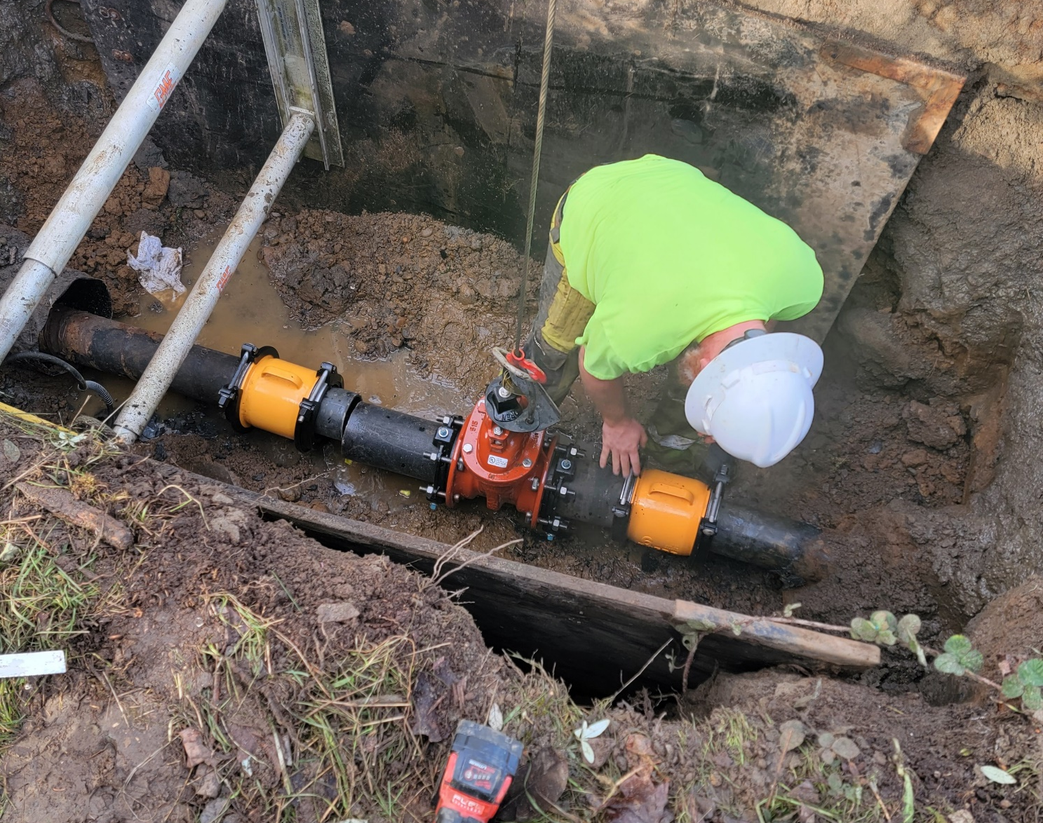
Water
The Water Division of Public Works is responsible for the day-to-day operation and maintenance of water production, storage, and delivery facilities.
In 2021, the Water Division:
Serviced 21,300 customers
Produced 603,243,000 Gallons of Water
Tested 1,353 Backflow Devices (82% compliance for 2021)
Conducted 4,908 Water Quality Sampling Tests
Completed 5,031 Service Orders & Utility Locates (20.4 per workday)
Repaired 7 Water Leaks (2 Mainline)

Slide 4
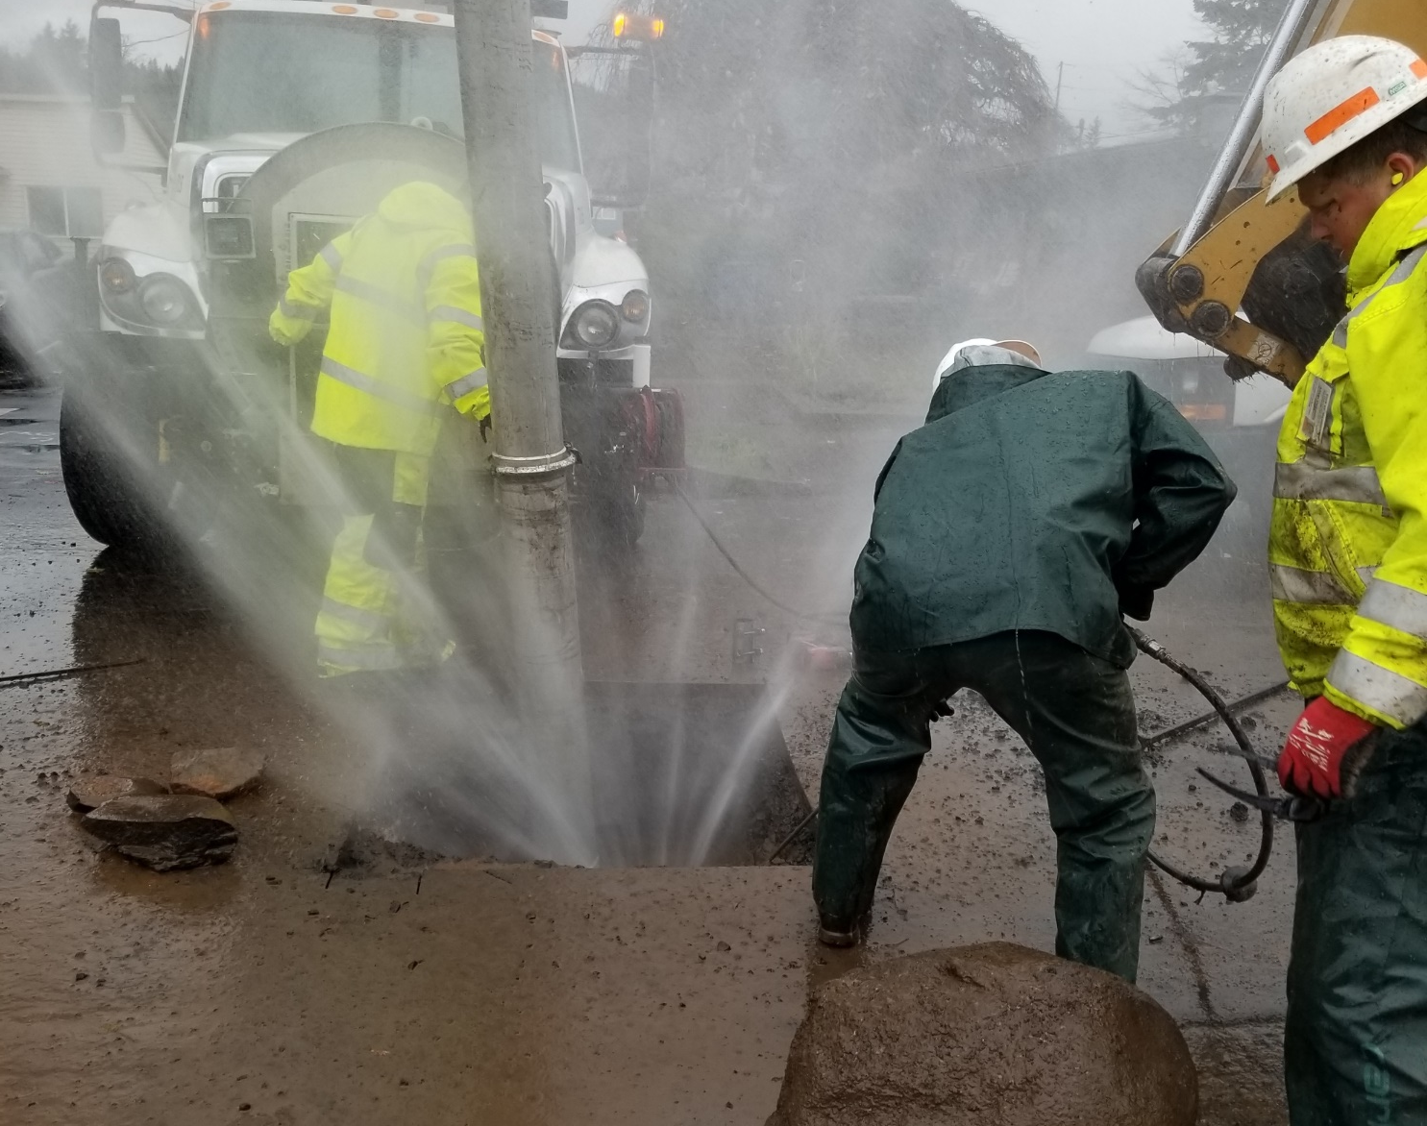
Water
2021 Accomplishments
Installed 1,472 radio read water meters. The project is 55.6% complete.
Completed the American Water Infrastructure Act Risk and Resilience Assessment and Emergency Response Planning updates

Slide 5
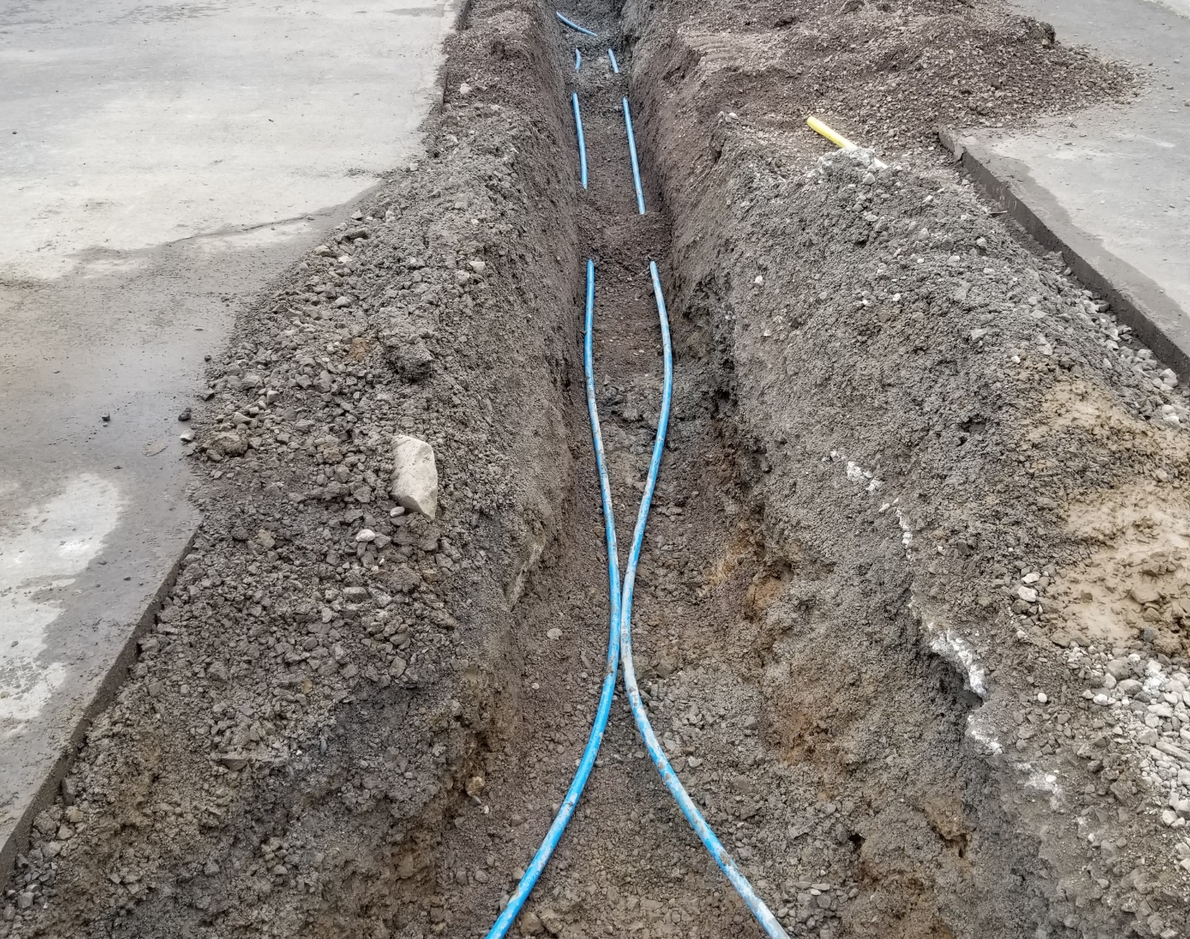
Water
2022 Goals and Projects
Install ~1,200 radio read water meters to move the citywide project to ~80% complete
Bring online the city’s 8th Reservoir in the northwest section of town
Adopt the Water System Plan document to guide the city over the next 10 years
Implement an asset management system to track maintenance and develop a condition assessment of the water system

Slide 6
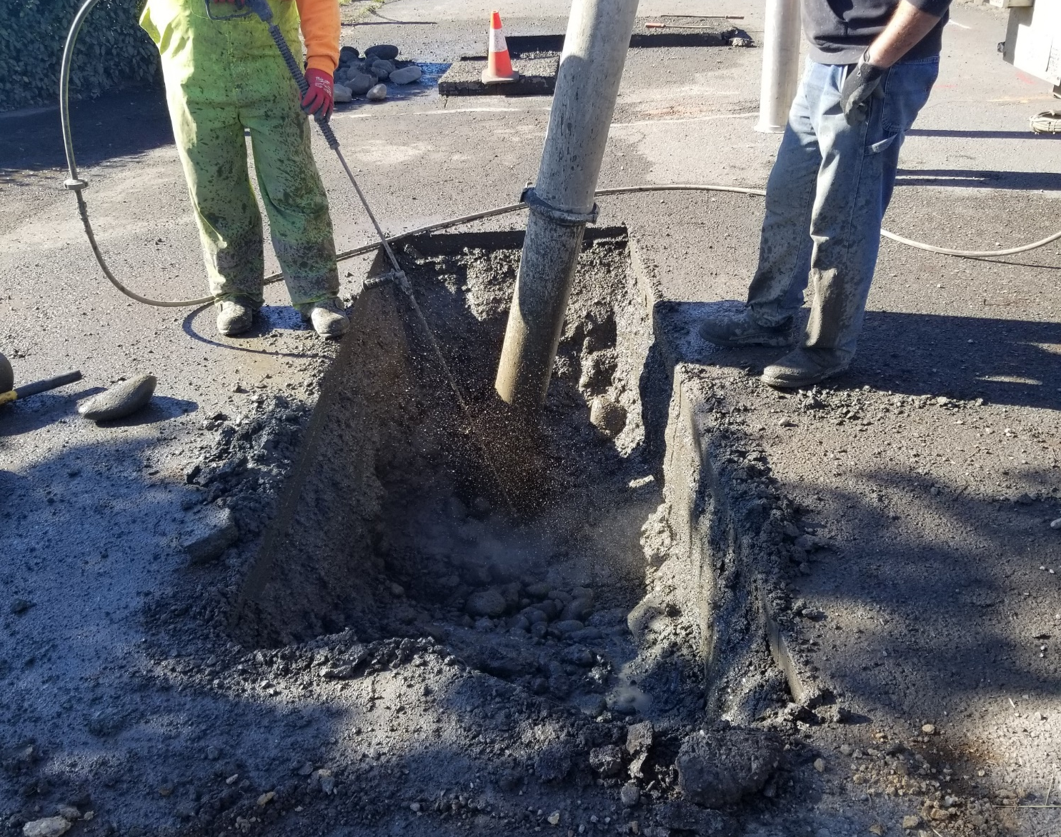
Wastewater
The Wastewater Division of Public Works is responsible for wastewater collections, sanitary sewer pump operations, wastewater treatment, and discharge into the Columbia River.
In 2021, the Wastewater Division:
Experienced Zero Service Outages
Treated 448,825,000 Gallons of Wastewater
Produced 225 Dry Tons of Biosolids
Completed 24 Fat, Oil and Grease (FOG) Inspections
Conducted 5,588 Wastewater Lab Tests
Inspected 312 Sewer Manholes

Slide 7
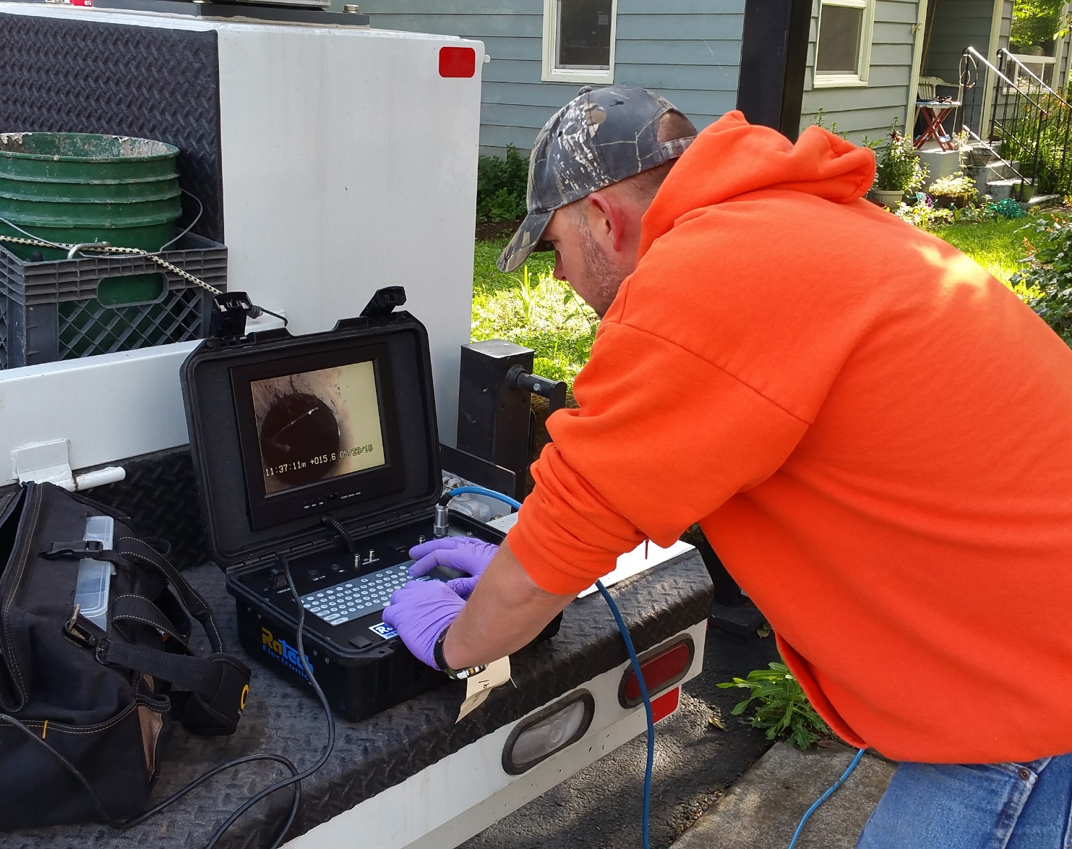
Wastewater
2021 Accomplishments
Completed the Sewer Facility Planning document to guide the city with upcoming capital facility projects
Upgraded three lift stations with new pumps to increase capacity and better service areas of town through growth

Slide 8
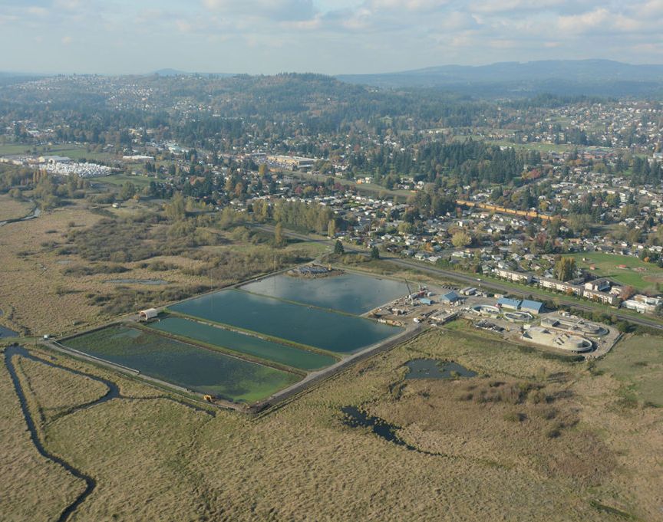
Wastewater
2022 Goals and Projects
Add the city’s 15th lift station in the northwest section of town
Relocate and improve capacity of lift station #1 in the center of town
Design the biosolids mechanical plant upgrades at the WWTP
Implement an asset management system to track maintenance and develop a condition assessment of the sewer system

Slide 9
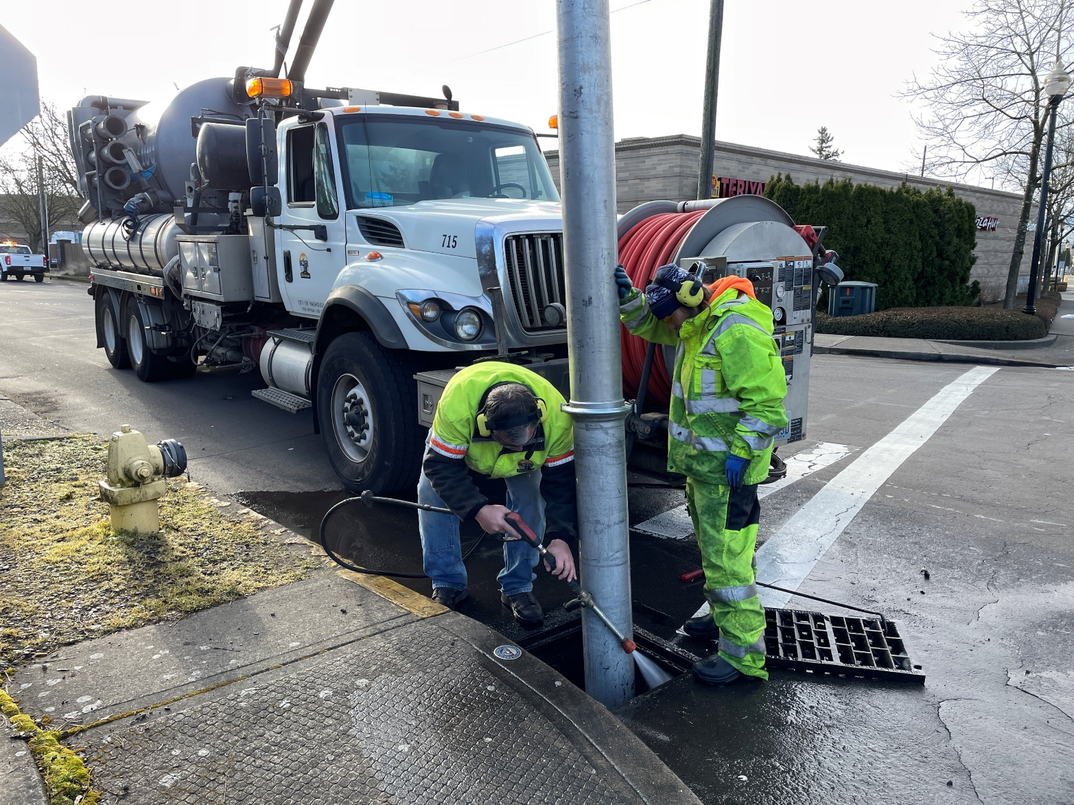
Stormwater
The Stormwater Division maintains the City’s stormwater management system which includes conveyance, flood control, and pollution remediation and reduction.
The Stormwater Division maintains:
1,786 Catch Basins
178 Drywells
180 Water Quality Facilities
38 Miles of Stormwater Lines
1,144 Stormwater Manholes

Slide 10
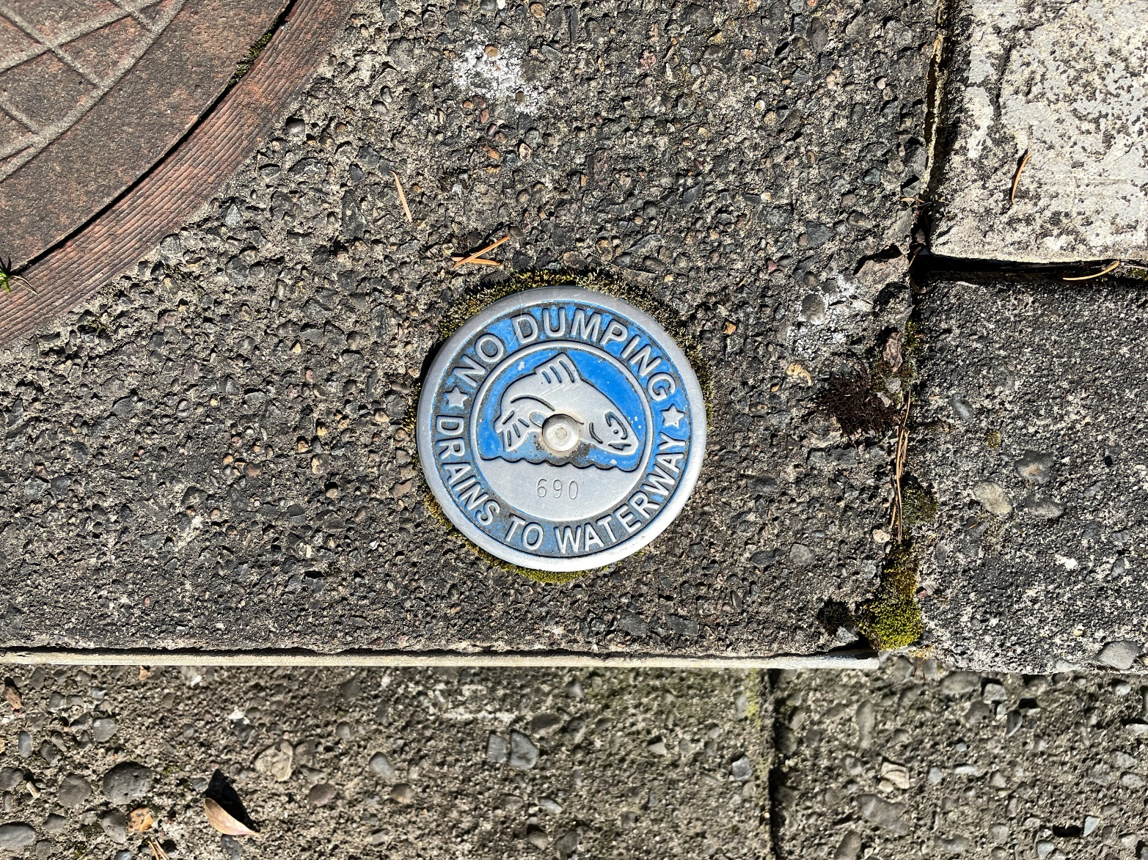
Stormwater
2021 Accomplishments
Removed 252 tons of debris from Stormwater facilities
Collected 185 Cubic Yards of debris by street sweeping
Cleaned 927 Catch Basins
2022 Goals and Projects
Inspect 100% of all municipally owned or operated permanent stormwater treatment and flow control facilities
Inspect over 80% of all public and private post-2009 installation treatment and flow control facilities
Implement Cartegraph to track stormwater facility maintenance

Slide 11
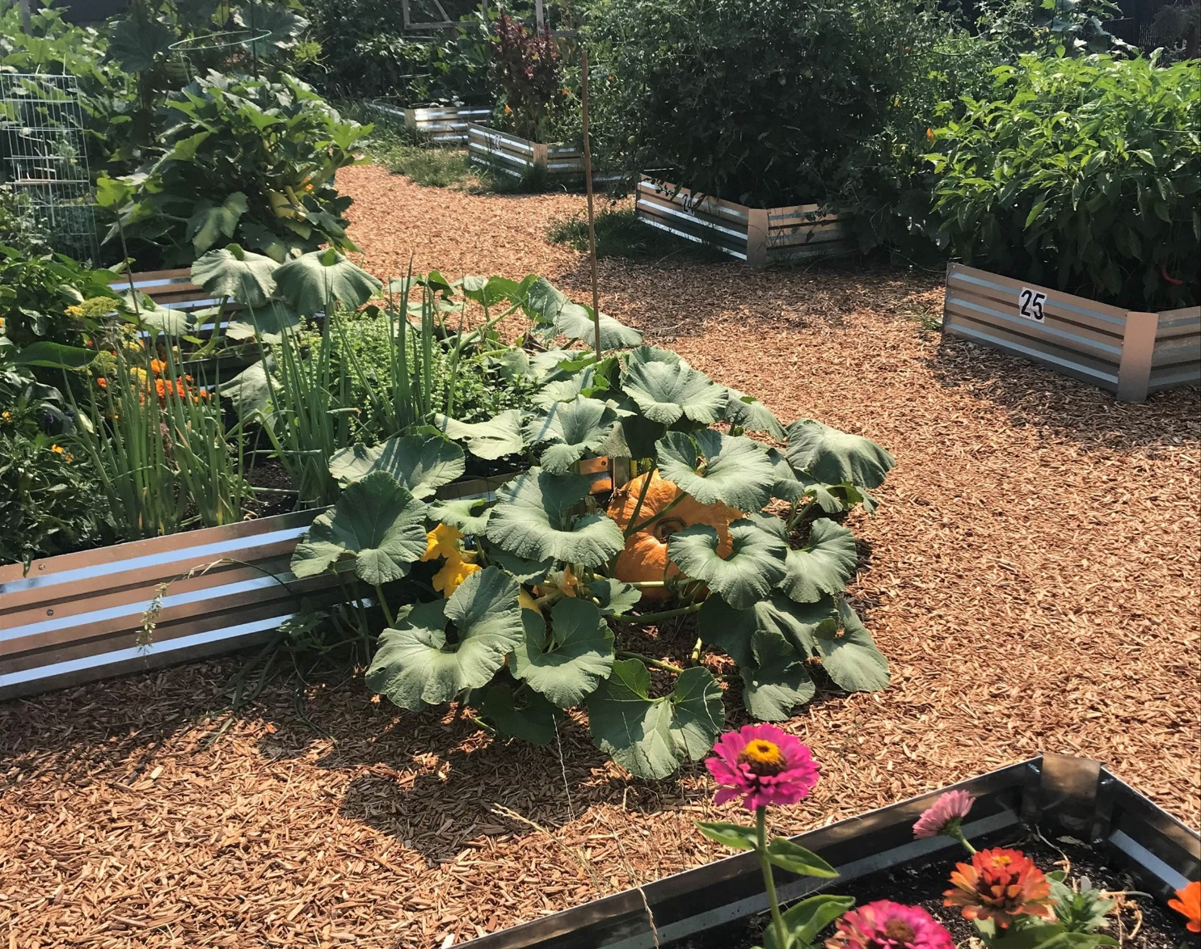
Parks
The Parks and Cemetery Division of Public Works is responsible for maintaining parks, the cemetery and open spaces.
The Parks Division is responsible for:
93 Acres of Parkland
3.2 Miles of Trails
8 Playgrounds
1 Community Garden
5 Baseball Fields
6 Pickleball Courts
1 Disc Golf Course

Slide 12
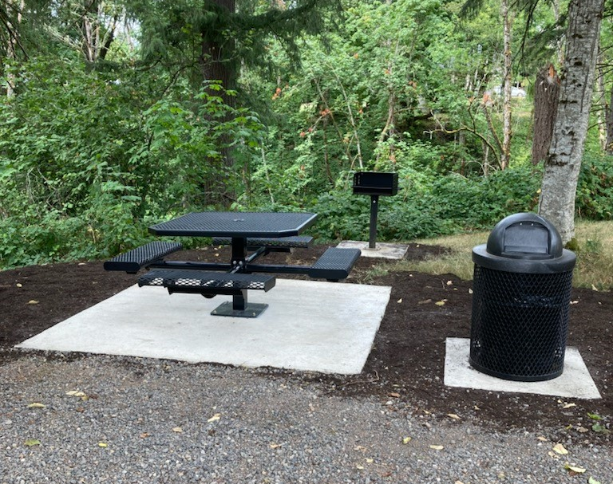
Parks
2021 Accomplishments
Received Community Block Grant for Hamllik Park
Received Park Foundation Grant for Pickleball Court
Repainted all restrooms and the Hartwood Park barn with anti-graffiti paint
Designed new Hartwood Disc Golf Course
Hired one new employee for parks
Started Recreation program
Replaced all Park signs
Completed Park Master Plan and implemented new Park Impact Fee

Slide 13
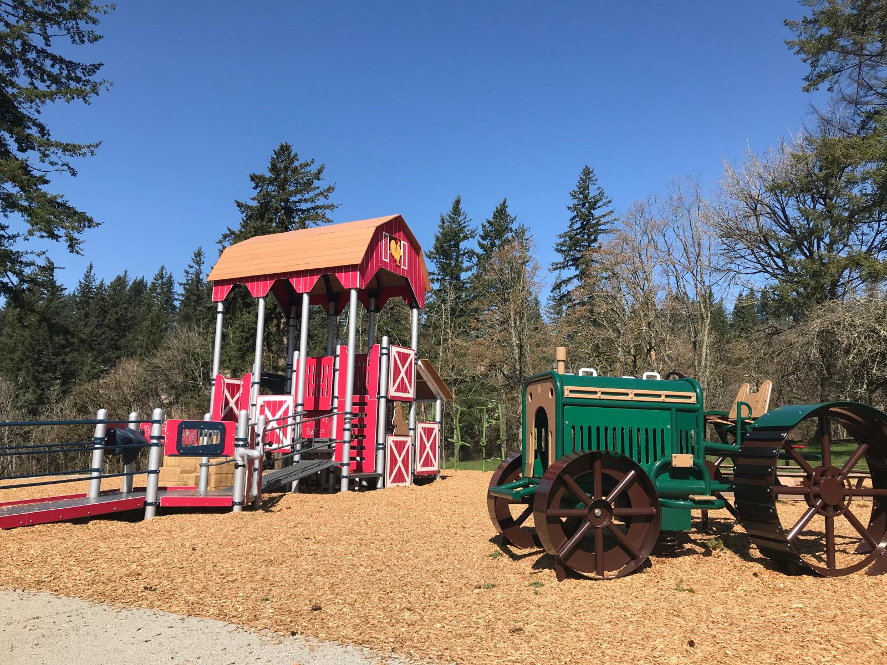
Parks
2022 Goals and Projects
Open new Hartwood Disc Golf Course in early June 2022
Replace Hamllik Playground by April 2022
Update Community Center for potential future Recreation Activities
Resurface Pickleball court by June 2022
Implement Cartegraph the City’s work order System to track, schedule and review Park maintenance

Slide 14
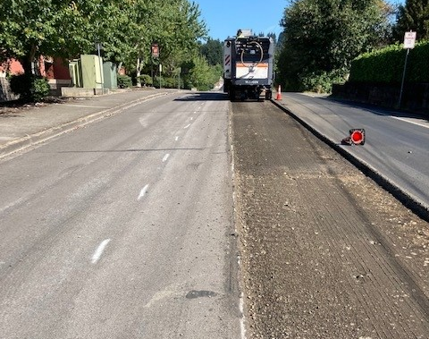
Streets
The Streets Division includes pavement maintenance, traffic management, safety improvements, street signs, signalization, pavement markings, and landscape maintenance.
The Streets Division is responsible for:
136 Lane Miles of City Streets
33 Miles of Sidewalks

Slide 15
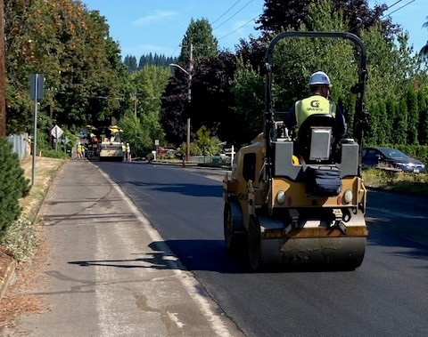
Streets
2021 Accomplishments
Pavement Condition Index (PCI) 79
Applied crack seal to 10% of streets (annual target is 33%)
Applied 45,168 square yards of chip/fog seal
Applied 3,006 tons of hot mix asphalt (HMA)
Took advantage of HMA prices and put down much more than usual HMA and maintained the overall PCI

Slide 16
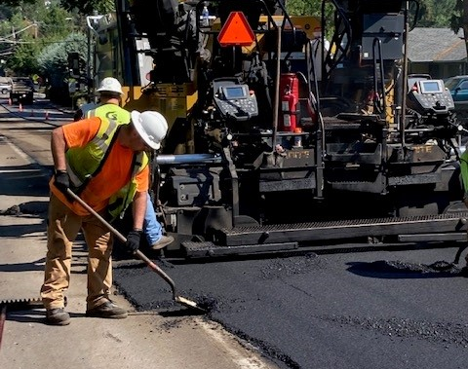
Streets
2022 Goals and Projects
Maintain the Current Pavement Condition Index (PCI)
Apply AR (asphalt, rubberized) chip seal to E-Street
Complete HMA grind/inlay 32nd Street between “J” and “W”
Apply type 3 micro-seal on LeBrun from Shepherd to Lookout Ridge Drive
Complete type two slurry seal for several streets, in the Rolling Meadows neighborhood and Turtle Terrace area
Chip seal Campen Creek areas

Slide 17
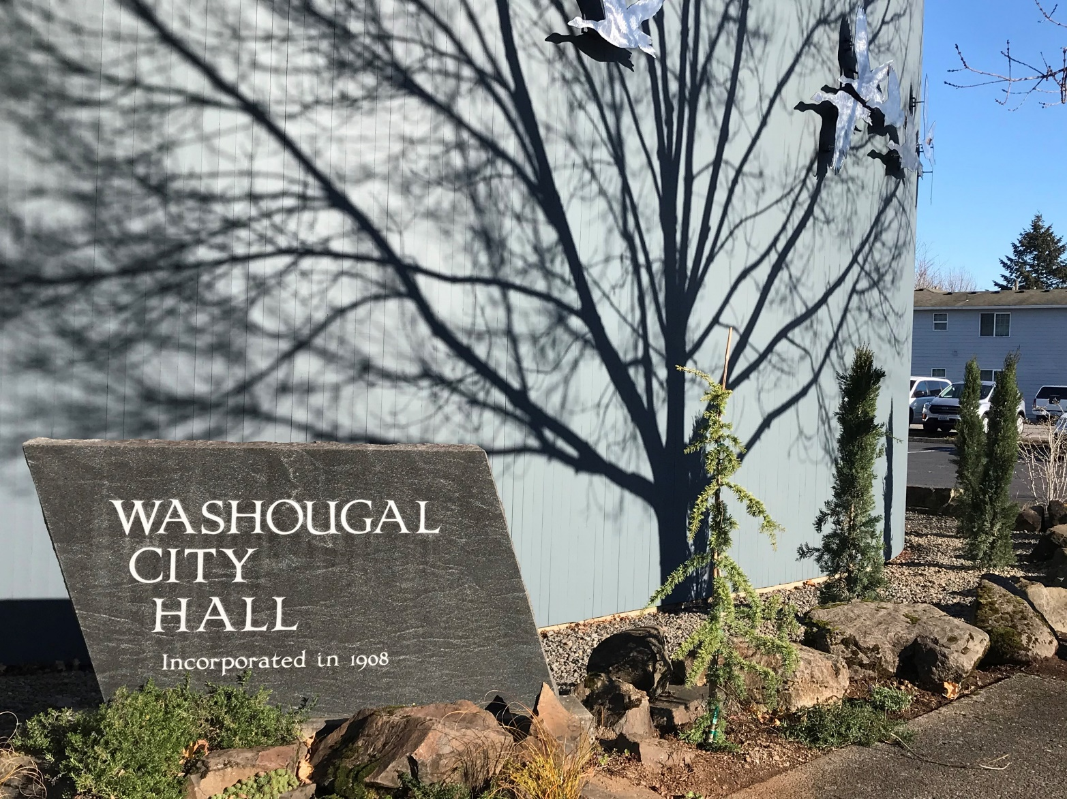
Facilities
The City of Washougal operates multiple office and maintenance buildings. Staff tend to custodial, landscape, mechanical, cosmetic, and capital construction projects for all general fund operated buildings.
The Facilities Division is responsible for:
16 Buildings

Slide 18
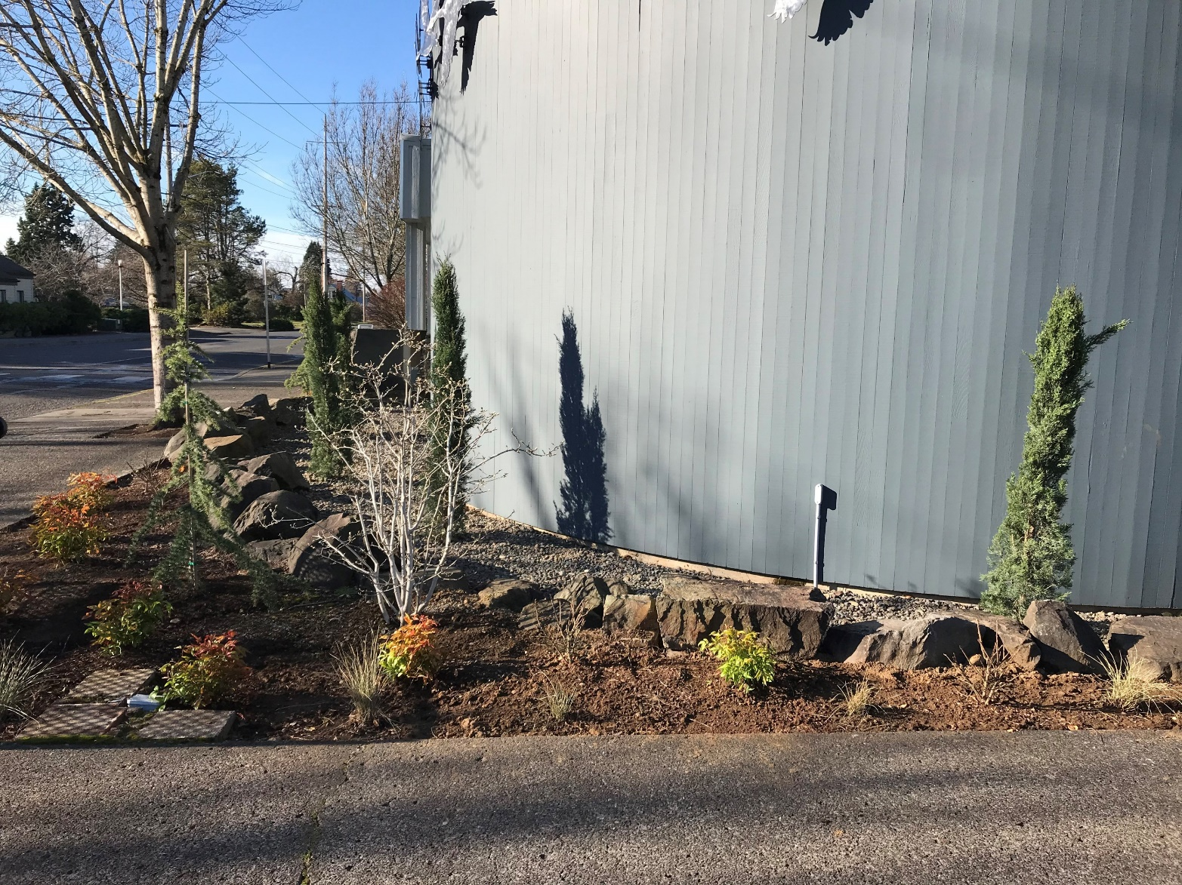
Facilities
2021 Accomplishments
Replaced City Hall Carpeting
Upgraded Police Department Kitchen and Evidence Room
Replaced Roof on Exec House garage, Water Admin, and McGuire Property
Converted Exec House garage space to Special Event storage
Improved City Hall Courtyard
Planted new trees around City Hall Campus
Repainted Exec House, Permit Center, park restrooms, and Red Barn
Painted interior and installed new flooring at the Community Center

Slide 19
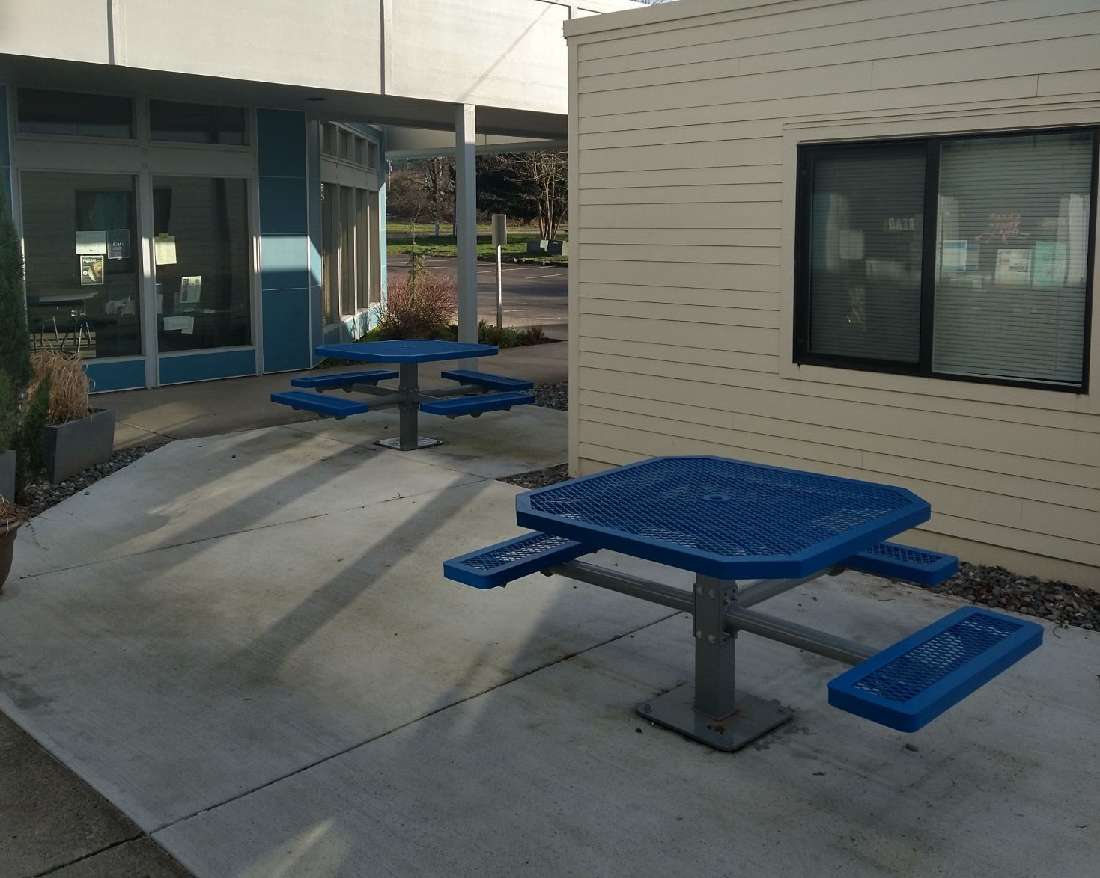
Facilities
2022 Goals and Projects
Built new furniture for Seniors
Upgraded Community Center restrooms
Upgraded side chamber space
Finish Social Service Improvements
Start conceptual design and construction for Operations Center
Install new flooring in Police Department
Work on flooring project for Library
Work on doing more Facility projects in house

Slide 20
Public Works Performance Management Roadmap
Engage with the citywide strategic planning process to develop specific, measurable goals for each public works division.
Develop a performance measurement framework to quantify the department’s progress towards its goals.
Deploy Cartegraph, an operations management system, to track maintenance and asset conditions.
Install Samsara Fleet Management hardware on 53 city vehicles, to capture data on vehicle performance and utilization.
Expand capital improvements program to include schedule and budget reporting.

Slide 21
Thank You

