Slide 1
Police Annual Report
Presented by Chief Wendi Steinbronn
Our mission is to provide leadership and effective, fiscally responsible services that achieve our community's vision.

Slide 2

Agenda
2019 Accomplishments
Budget Breakdown
Highlights & Overview
Goals for 2020

Slide 3
Accomplishments for 2019
Hired new Chief of Police
Completed evidence audit with Clark County Sheriff’s Office
Revised department mission and value statement
Filled open detective position
LEMAP Review prep preparation for WASPC
Completed Naloxone training

Slide 4
New Mission, Vision, Values
Mission- Maintain the trust and confidence of our community while delivering the highest level of service possible, enforcing the laws without bias, and providing a safe environment for all.
Vision- Provide professional, proactive, and personable police services. Embrace an open relationship with our community and government organizations.
Values-
Honesty: We are committed to the highest standards of honesty and ethical conduct, which are the cornerstones of our profession.
Respect: We recognize the authority we hold and will treat others as we would like to be treated.
Character: We strive to achieve the highest standards of personal and organizational excellence as well as the character to confront fear, danger, uncertainty, and intimidation.

Slide 5
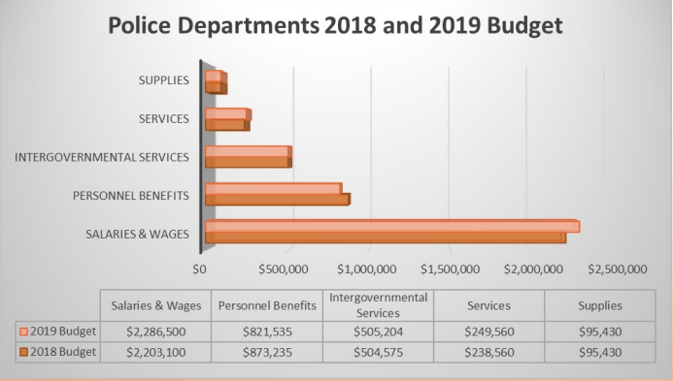
Police 2019 Budget Breakdown
Primary Expenditures:
With 25 full time employees, the primary expense for the police department is employee salaries and benefits. In 2019 all categories except personnel benefits and supplies experienced an increase.

Slide 6
Department Statistics: Overview
12 officers assigned to patrol in 2019
14,178 calls and a population of 16,500
1,182 calls per patrol officer in 2019
 | 2015 | 2016 | 2017 | 2018 | 2019 | % change (2015-2019)
Total Calls | 12,523 | 12,588 | 12,913 | 13,379 | 14,178 | 13.22%
Population | 15,170 | 15,560 | 15,760 | 16,020 | 16,500 | 8.77%
Notes:
2015 forward for charts!

Slide 7
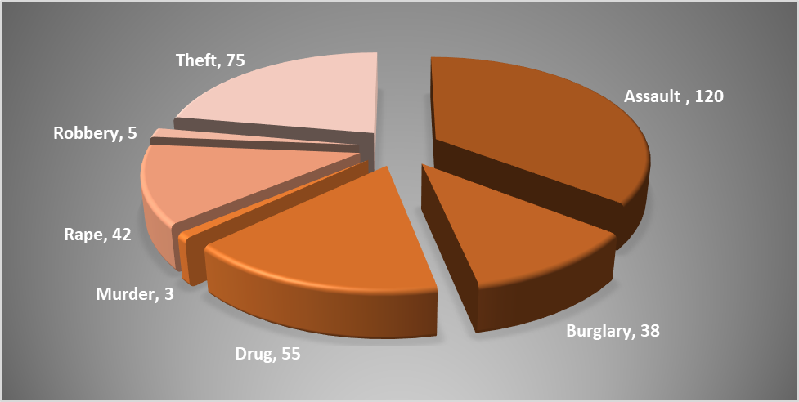
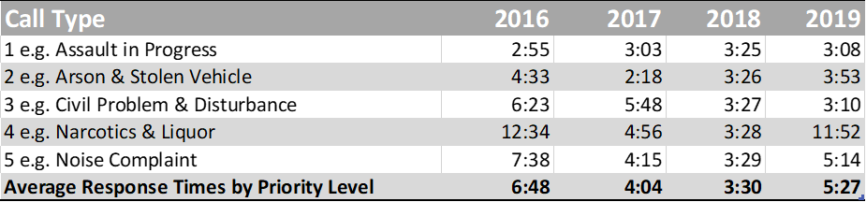
Department Statistics: Crime

Slide 8
911 Dispatched Calls for Service per Patrol Officer
 | 2014 | 2015 | 2016 | 2017 | 2018 | 2019 | % change (2014-2019)
Washougal | 784 | 738 | 775 | 783 | 956 | 884 | 13.76%
Camas | 430 | 433 | 483 | 623 | 631 | 501 | 16.51%
Battle Ground | 633 | 650 | 669 | 731 | 889 | 1002 | 58.29%

Slide 9
Police: Training
 | 2014 | 2015 | 2016 | 2017 | 2018 | 2019
Average Hours of Training | 120 | 110 | 89 | 100 | 206 | 85

Slide 10
Calls for Service (Drug Related)
 | 2012 | 2013 | 2014 | 2015 | 2016 | 2017 | 2018 | 2019 | % change (2011-2018)
Vice - Narcotics | 60 | 66 | 109 | 120 | 103 | 88 | 87 | 43 | -28%
Overdose | 26 | 15 | 20 | 7 | 11 | 9 | 5 | 4 | -85%

Slide 11
Calls for Service (Traffic)
 | 2012 | 2013 | 2014 | 2015 | 2016 | 2017 | 2018 | 2019 | % change (2011-2017)
Total Traffic Calls | 2,004 | 1,810 | 1,653 | 1,770 | 2,370 | 2,756 | 3,388 | 3,197 | 59.53%
Drunk Driver | 94 | 90 | 116 | 134 | 116 | 96 | 94 | 58 | -38.30%

Slide 12
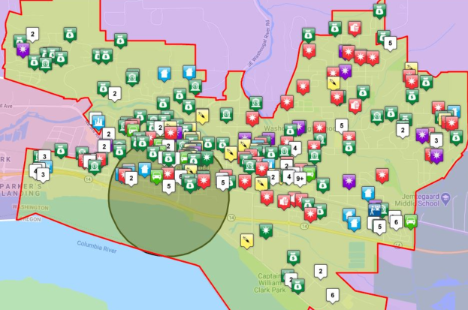
Crime Statistics
CRIME STATISTICS*
 | 2017 | 2018 | 2019 | % Change
Assault | 102 | 197 | 111 | 8.82%
Burglary | 40 | 51 | 36 | -10.00%
Drug | 98 | 87 | 47 | -52.04%
Murder | 1 | 0 | 3 | 200.00%
Rape | 20 | 35 | 28 | 40.00%
Robbery | 3 | 0 | 4 | 33.33%
Theft | 252 | 397 | 243 | -3.57%

Slide 13
Department Statistics: Animal Control Overview

Slide 14
Department Statistics: Animal Impounds
 | 2014 | 2015 | 2016 | 2017 | 2018 | 2019 | % Change 2014-2019
Washougal | 84 | 91 | 94 | 92 | 67 | 47 | -44%
Camas | 80 | 60 | 63 | 54 | 54 | 45 | -44%
Total | 164 | 151 | 157 | 146 | 121 | 92 | 44%

Slide 15
2020 Goals
Fill the open Police Captain position.
Complete tasks created from LEMAP audit and submit accreditation documents.
Complete a police program evaluation to evaluate service delivery.
Implement a regular data reporting system.
In partnership with Community Development, develop a system for identifying and abating chronic nuisance properties.
Complete the Continuity of Operation Plan (COOP) for the Police Department.

Slide 16
Thank you! Any questions?

