Slide 1
2023 Annual Public Works Report City Council Workshop – April 8, 2024
Presented by Trevor Evers – Public Works Director
Our mission is to provide leadership and effective, fiscally responsible services that achieve our community's vision.

Slide 2
What we will cover in this Annual Report
Streets
Maintenance and Operations
Accomplishments and Goals
Parks
Maintenance and Operations
Accomplishments and Goals
Facilities
Maintenance and Operations
Accomplishments and Goals
Cemetery
Maintenance and Operations
Accomplishments and Goals
Conclusion
Questions
Public Works Strategic Plan
Capital Improvement Plan (CIP)
2024 CIP Storybook
Engineering
Overview
Responsibilities and Staffing
Accomplishments and Goals
Water
Maintenance and Operations
Accomplishments and Goals
Wastewater
Maintenance and Operations
Accomplishments and Goals
Storm
Maintenance and Operations
Accomplishments and Goals

Slide 3
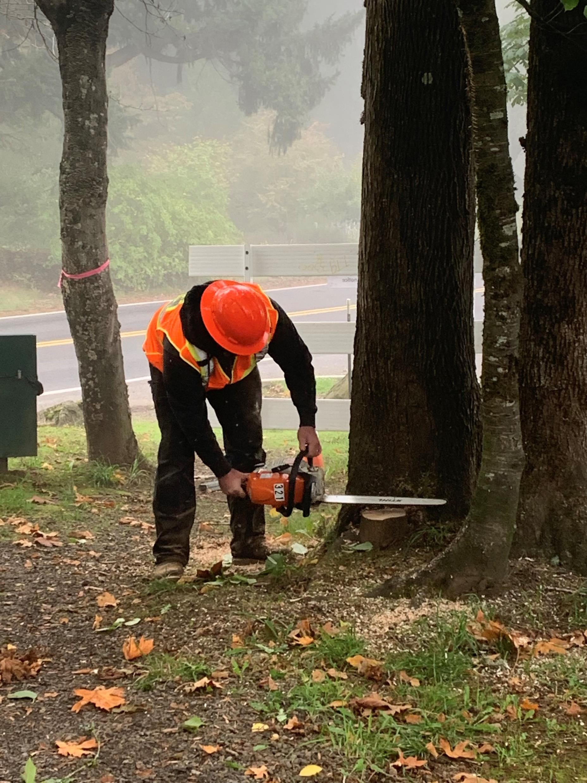
Public Works Strategic Work Plan
Our mission is to provide fiscally responsible services that promote our vision of a safe and beautiful community that can be enjoyed for generations to come.

Slide 4
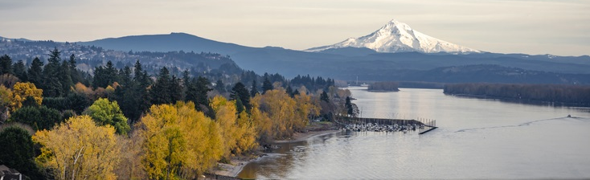
2024 Plan
We take our job seriously serving the community’s 17,390 residents. This means focusing on the work that keeps the community safe, while planning for tomorrow. The Fiscal Year 2024 Strategic Work Plan sets out a road map for the work ahead. Some of the goals can be achieved over the coming year. Others will take several years, but ones that we think will help us to better serve the community and make lives better for the Citizens of Washougal.

Slide 5
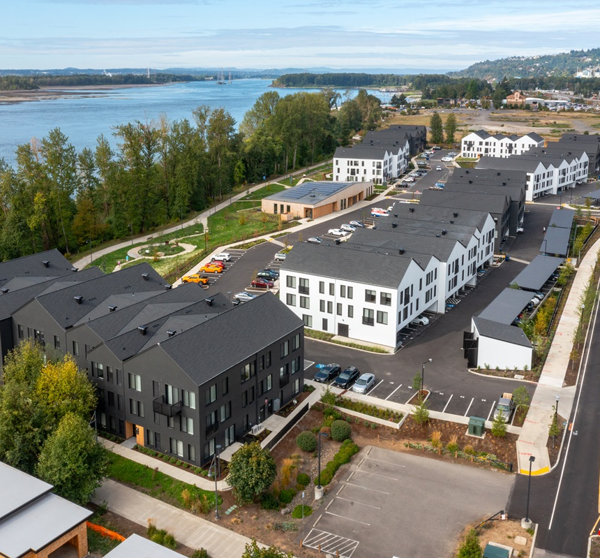
Capital Improvement Plan
What is the Capital Improvement Plan?
The Capital Improvement Plan (CIP) is the City of Washougal’s plan for large-scale infrastructure improvement projects. The Growth Management Act requires that our Comprehensive Plan include Capital Facilities Elements for all of our facilities programs, including: water, wastewater, stormwater, parks, general facilities, and streets. The City has capital facilities plans for all of these areas and our Cemetery. Projects identified in our plans for a given year can include upgrades, enhancements and repairs to our utility system, street network, parks and trails system, cemetery and general facilities

Slide 6
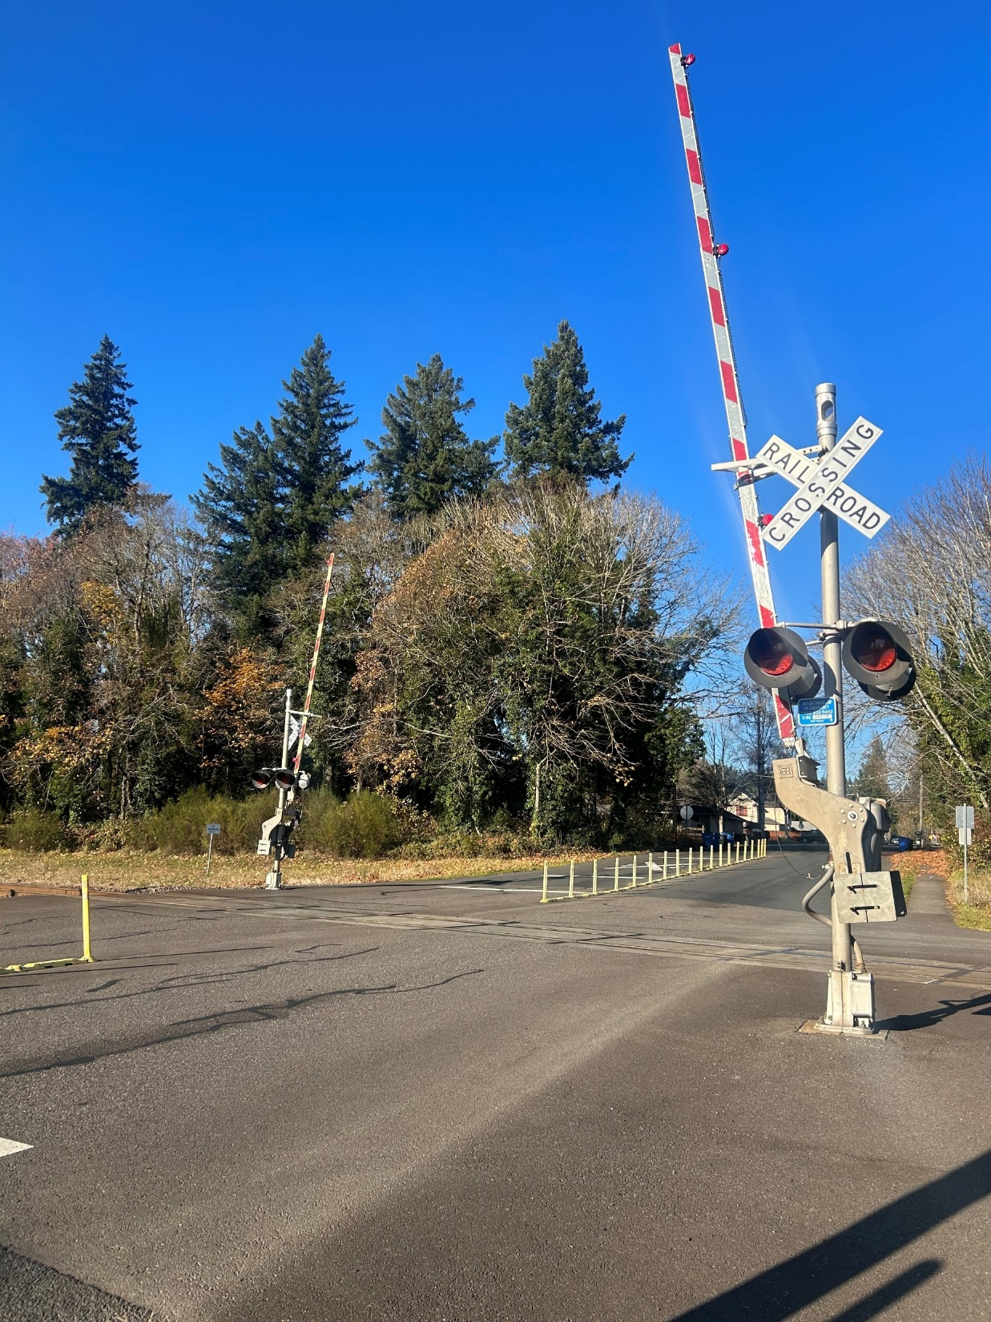
2024 Capital Improvement Projects Storybook
2024 Capital Improvement Projects (arcgis.com)

Slide 7
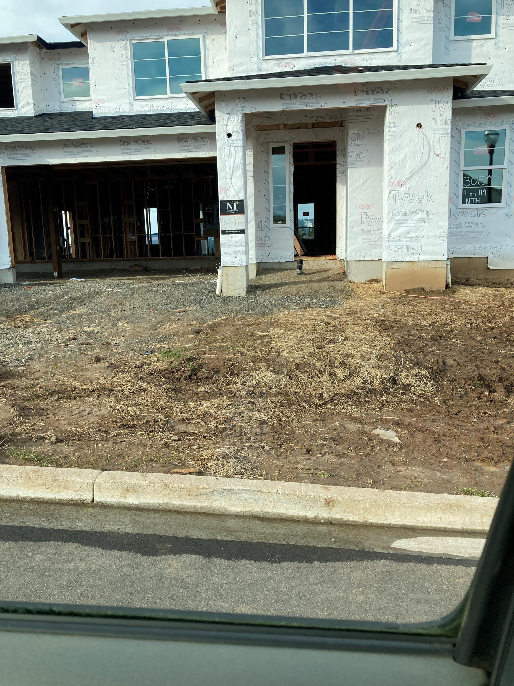
Engineering Overview
OVERVIEW
The Engineering Department works to develop and improve the services and facilities important to everyday life in Washougal. The division has an important role in the design, construction, and maintenance of public works systems: water, sewer, stormwater, streets, and parks.
The Engineering Department creates and implement the city’s Capital Improvement Plan (CIP). The division also ensures that private and public developments comply with adopted plans and development standards to protect our quality of life.

Slide 8
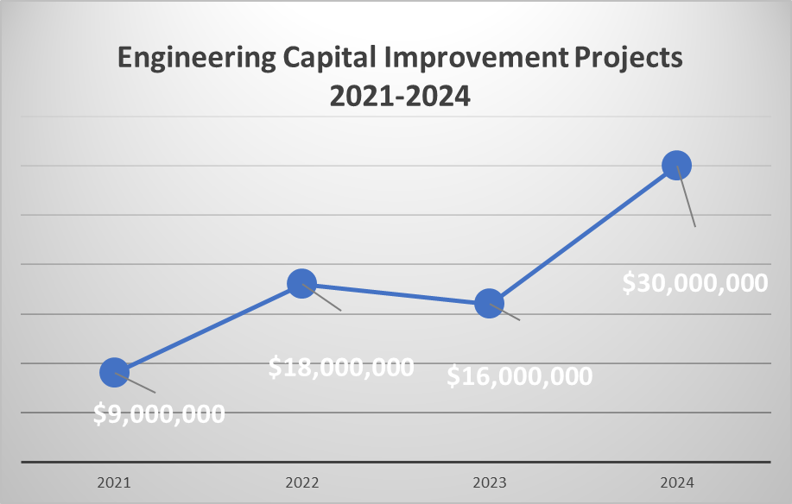
Engineering Responsibilities
The City of Washougal has worked very hard to implement projects, but the increase in projects have doubled without any increase in staffing:
2024 The City has 34 Projects with the budget of over $30 Million (please note Fire Station/Police Station budget NOT included)
2023 the city had 18 projects budget of $16 Million.
2022 the city had 25 projects budget of $18 Million.
2021 the city had 19 projects budget of $9 Million.

Slide 9
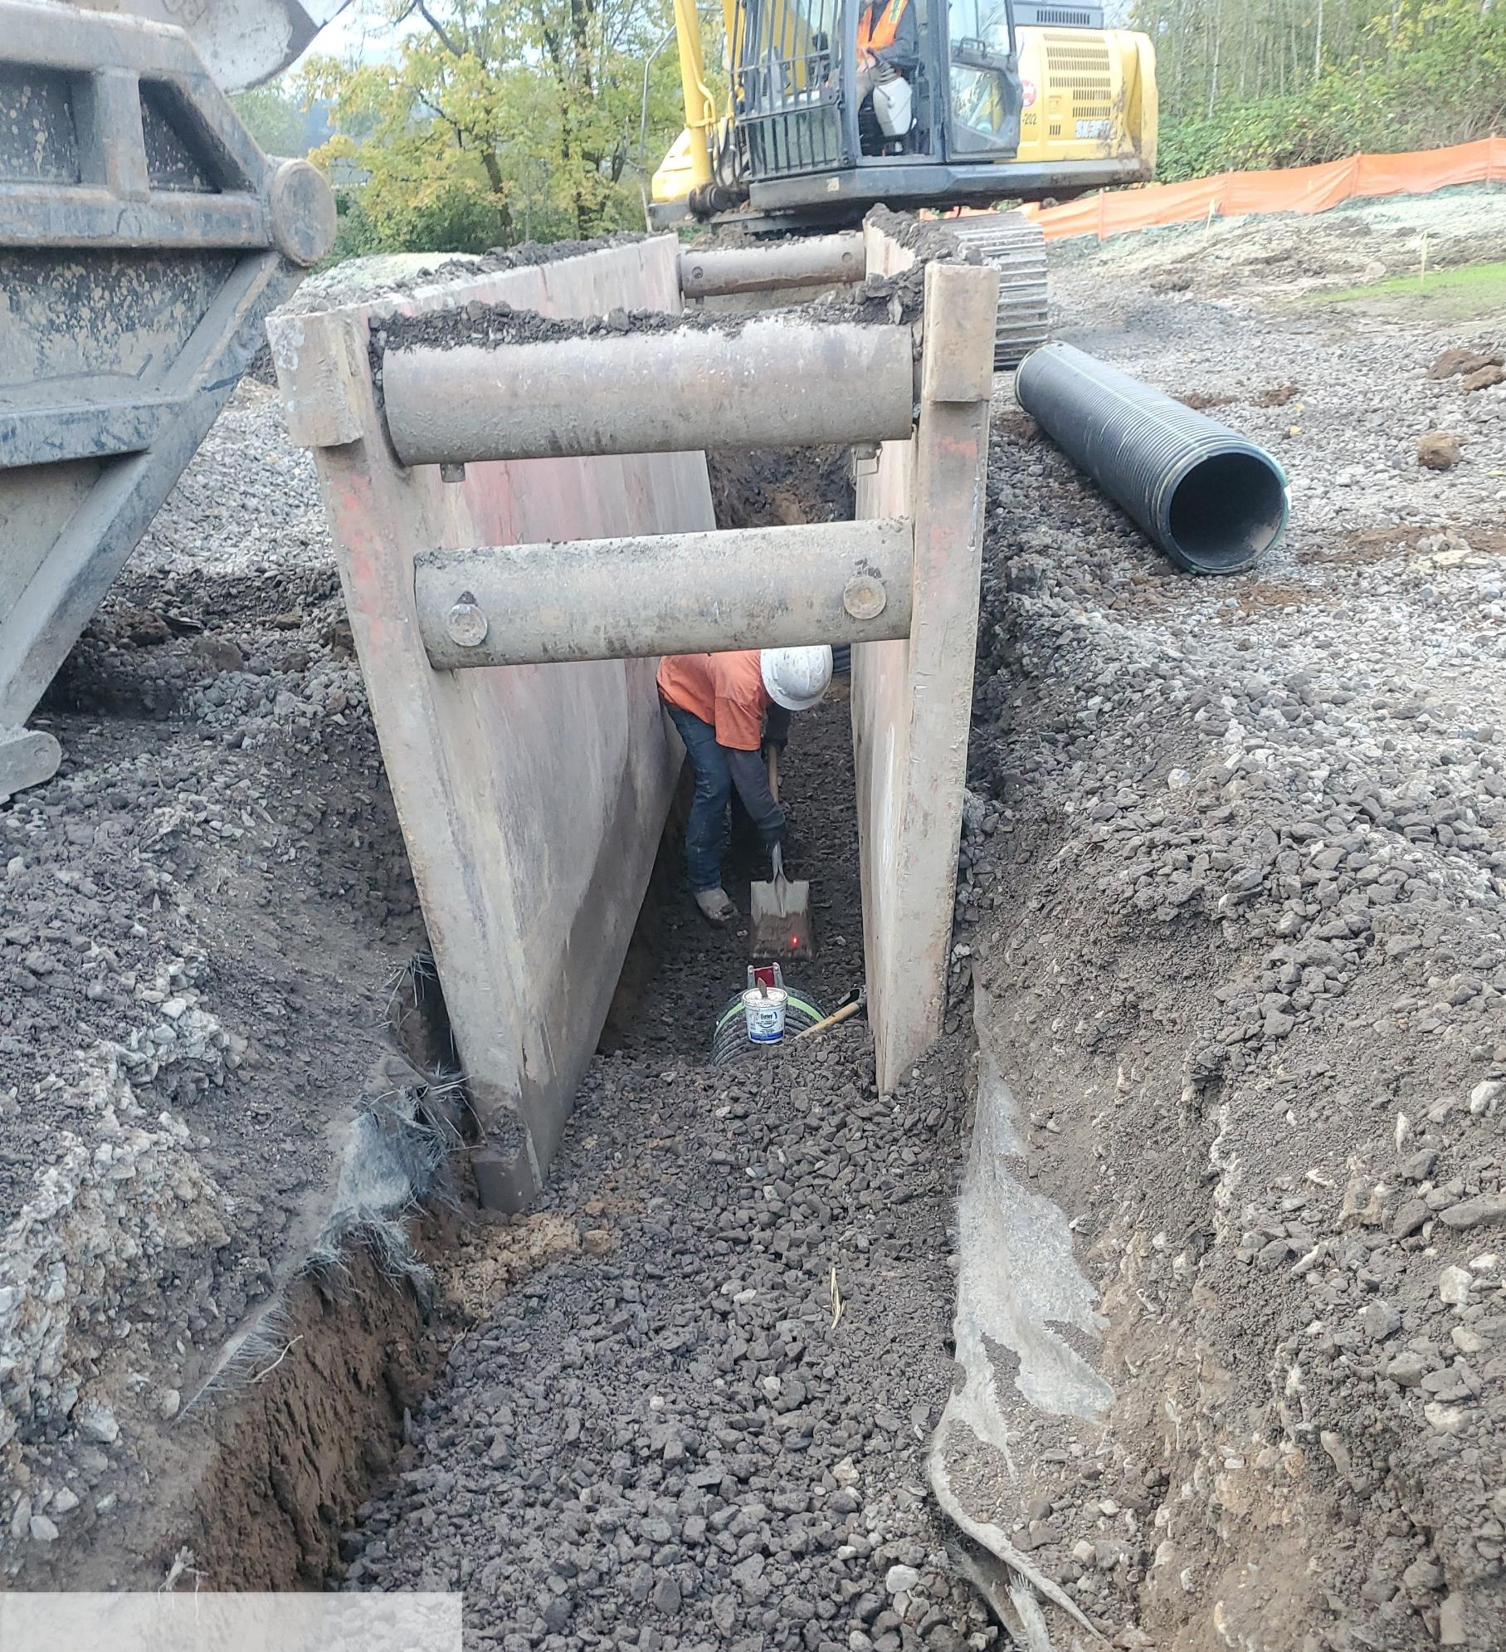
Engineering 2023 Accomplishments
11 Capital projects either completed or substantially completed
213 right of way permits processed
$1,968,440 in Transportation grants awarded in 2023
78 transportation related public requests received and processed
Successful adoption of 6 year transportation improvement program

Slide 10
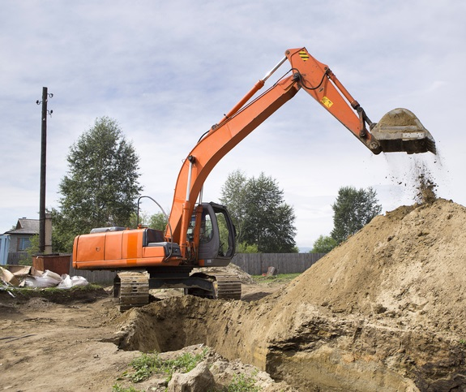
Engineering 2024 Goals
Implementation of Traffic Calming Program
Update right of way permit and processes
Implementation of Updated ADA Transition Plan
Continue to apply for grants related to Capital Improvement Projects
Start Transportation Capital Facilities Plan Update as part of the Comprehensive Plan Update (CMG)
Continue to track and progress Capital Projects
Complete construction on Public Works Building
Complete design for Washougal Revitalization Towncenter Project (CMG)
Complete construction for Hamllik Basketball Court (CMG)
Complete Jemtegaard Trail
Update Pavement Condition ratings
Update designs for East County Social Service Building for Phase II
Complete Lift Station #1
27th Street Shared Use Path Design will be completed

Slide 11
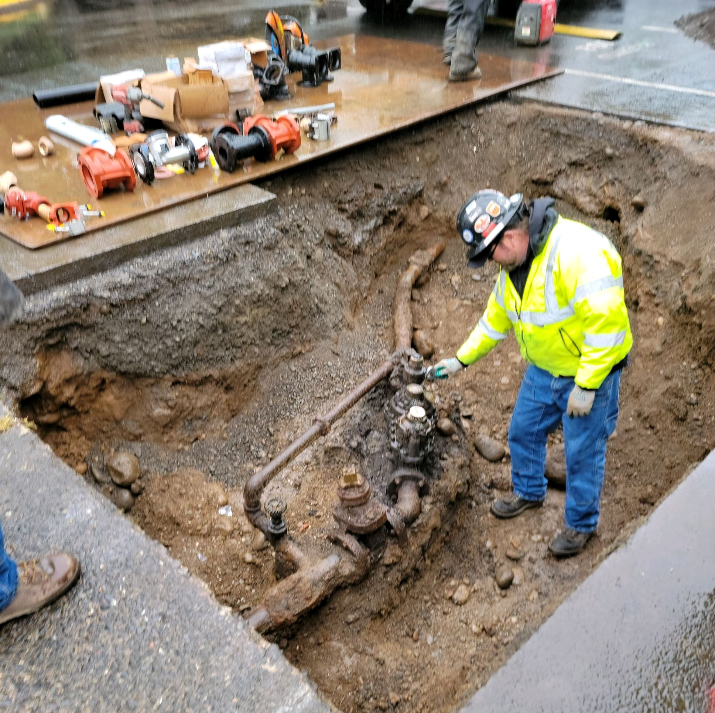
Water Maintenance Overview
OVERVIEW
The Water Division of Public Works is responsible for the daily operation and maintenance of water production, storage, and delivery facilities.
Water Operations and Maintenance is responsible for:
Water Gallons Produced – 606,983,000
Number of Backflow Devices Tested – 1,515 (83.5% compliance)
Water Quality Sampling Tests – 4,689
Service Orders & Utility Locates Completed – 4,336 (17.6/workday)
Water Leaks Repaired – 14 (4 Mainline)
Servicing 5,972 accounts/connections

Slide 12
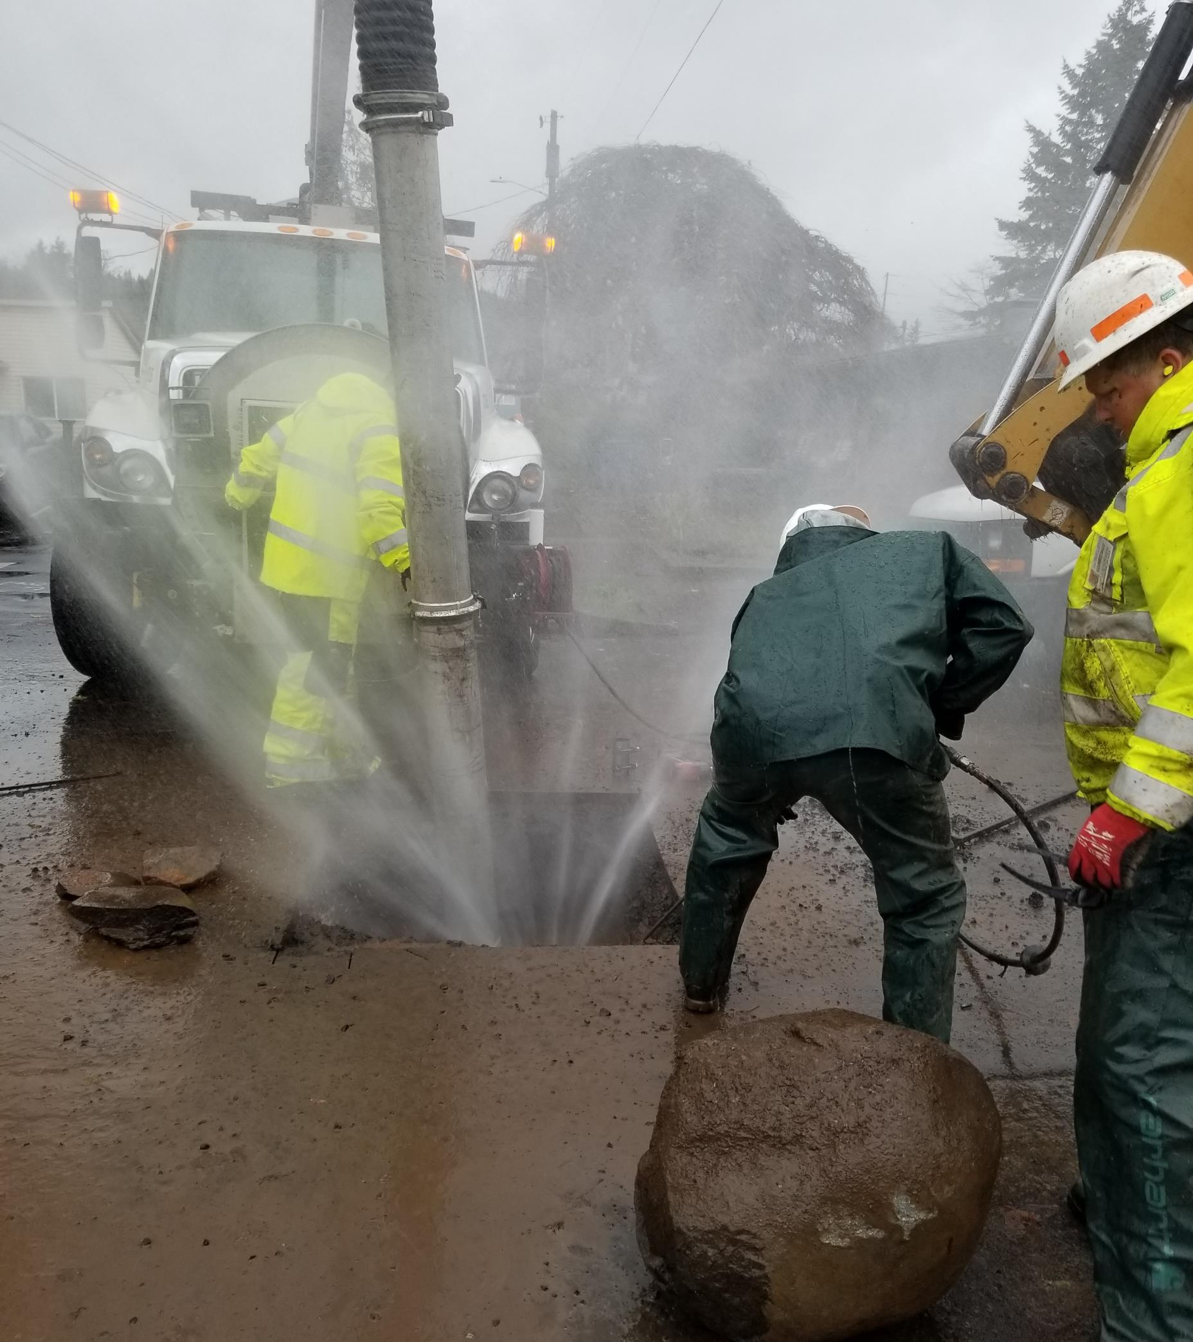
Water Accomplishments and Goals
Water Operations and Maintenance 2023 Accomplishments:
1,262 water meter replacements – 21.6% of water system
Security Upgrades at remote sites
Well #6 Maintenance & Rehabilitation
Leak Detection Survey
System Master Plan 99% complete
Rate Study & Community Engagement
11,001 hours of System Maintenance completed
Water Operations and Maintenance 2024 Goals and Projects:
Adopt Water System Plan
Adopt Water Rates for 2024-2028 (CMG)
Water Main Repair/Extension/Replacement
Installation & Integration of Automated Meter Reading Infrastructure

Slide 13
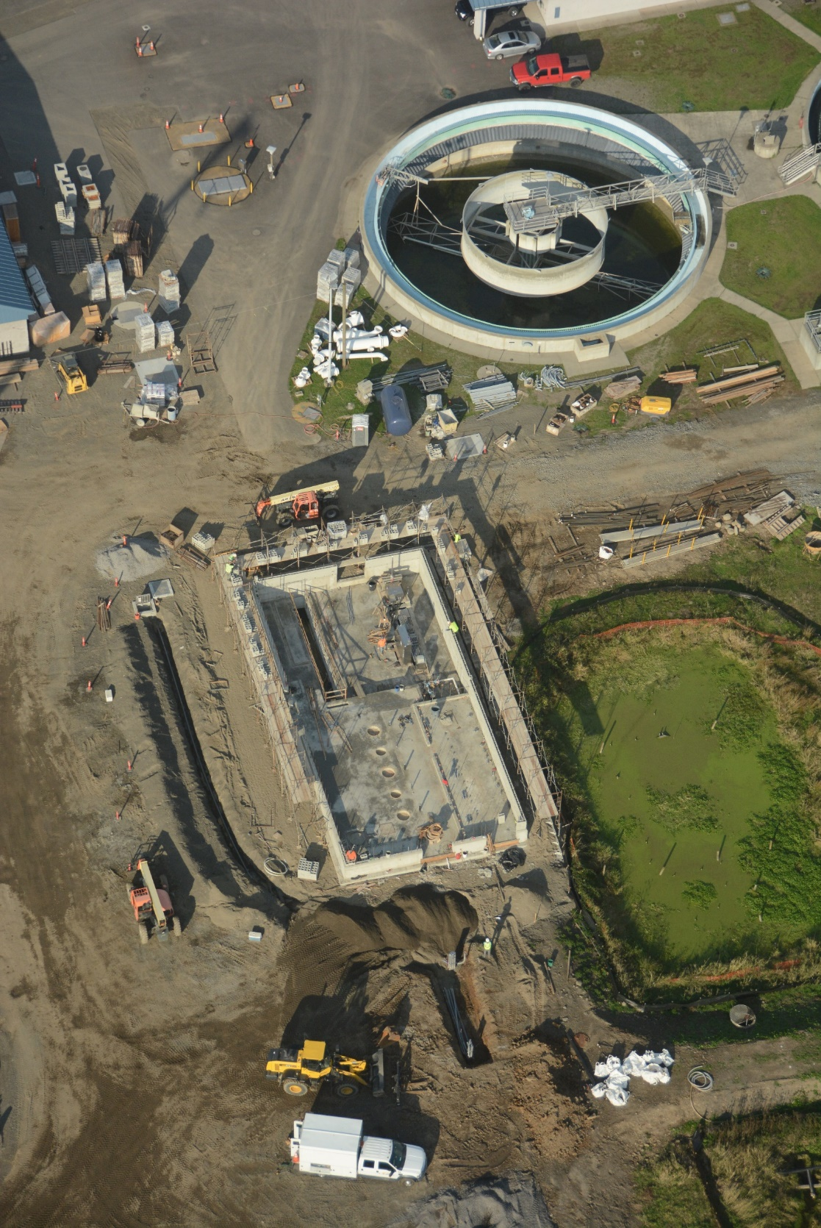
Wastewater Operations and Maintenance
Overview
The Wastewater Division of Public Works is responsible for wastewater collections, sanitary sewer pump stations, wastewater treatment and discharge to the Columbia River. The wastewater division’s typical duties includes: Manhole Inspections, Preventative maintenance programs, Pump station checks , Wastewater plant maintenance, and Wastewater treatment.
Wastewater Operations and Maintenance is responsible for:
442,147,000 Millions Sewer Gallons Treated
294 (Dry Tons) Sewer Biosolids Produced
24 Fat, Oil and Grease (FOG) Inspections
5,577 Sewer Lab Tests
0 service outages or sewer mainline overflows
1,562 Sewer Manholes
15 Lift Stations

Slide 14
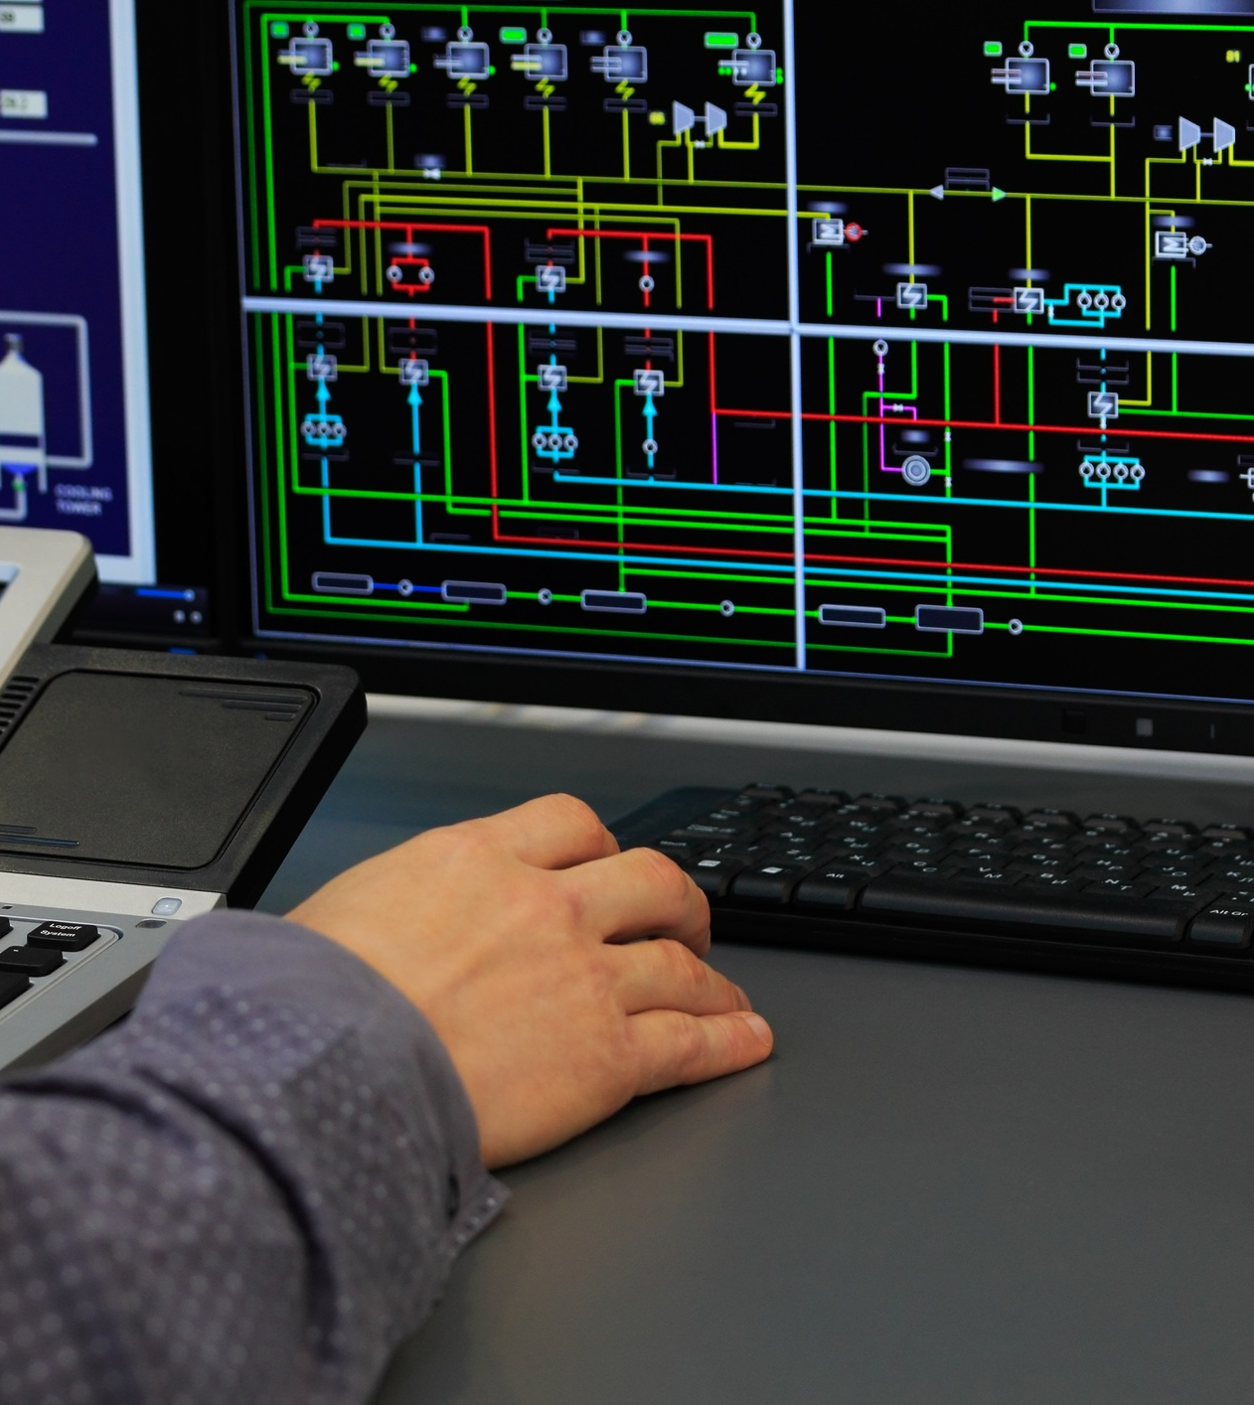
Wastewater Accomplishments and Goals
Wastewater Operations and Maintenance 2023 Accomplishments:
Completion of Lift Station No. 8
100% Design of Biosolids Treatment Facility & Anoxic Selector
100% Design of Lift Station #1 Relocation & Upgrade
SCADA Upgrades 90% complete
Rate Study & Community Engagement
9,531 hours of Wastewater Treatment Plant and System maintenance completed
Wastewater Operations and Maintenance 2024 Goals and Projects:
Biosolids Treatment Facility & Anoxic Selector Construction beginning Q1/Q2 2024 (CMG)
Relocation of Lift Station No. 1 Construction beginning Q1 2024
Adopt Sewer Rates for 2024-2028 (CMG)
SCADA Upgrades Completion

Slide 15
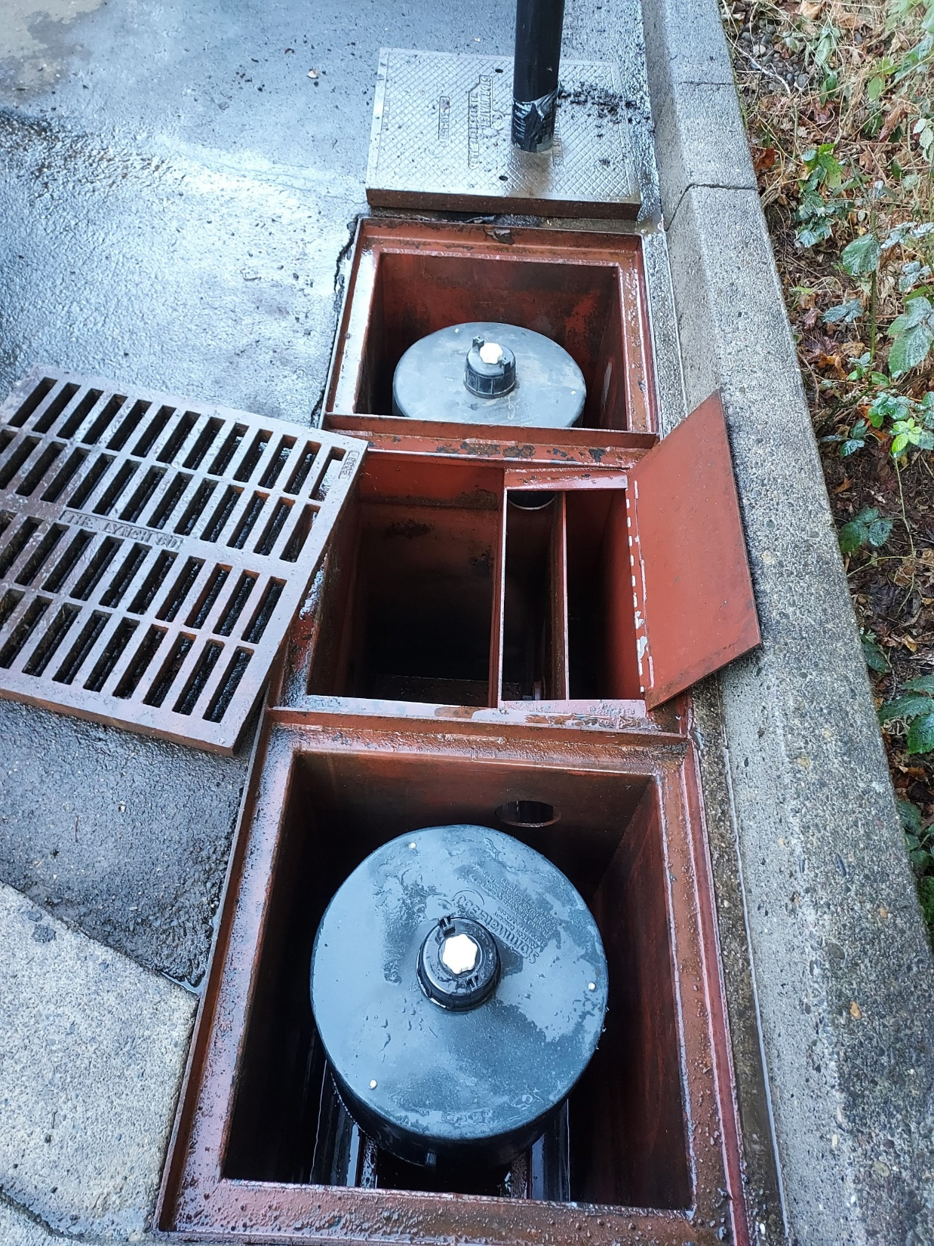
Stormwater Maintenance
OVERVIEW
The Stormwater Utility Division maintains the City’s stormwater management system which includes conveyance, flood control, and pollution remediation and reduction infrastructure. Stormwater is any water that comes from precipitation or snowmelt. In cities and towns, impervious surfaces such as roads, sidewalks, and roofs prevent stormwater from naturally soaking into the ground. This runoff then picks up pollutants like oil, gas, fertilizer, and sediment before flowing into storm drains and local streams. In mitigation of these urban impacts, the Stormwater Utility Division ensures compliance with the Western Washington Phase II Municipal Stormwater Permit. This regulatory permit has requirements Washougal must abide by for proper treatment and flow control of stormwater runoff for the protection of natural water bodies and drinking water sources.
Stormwater Maintenance is responsible for:
1,830 catch basins
222 drywells
244 stormwater treatment/flow-control facilities
40+ miles of stormwater lines
122 source control inspection sites
182 private stormwater facility inspection sites
97 stormwater outfalls

Slide 16
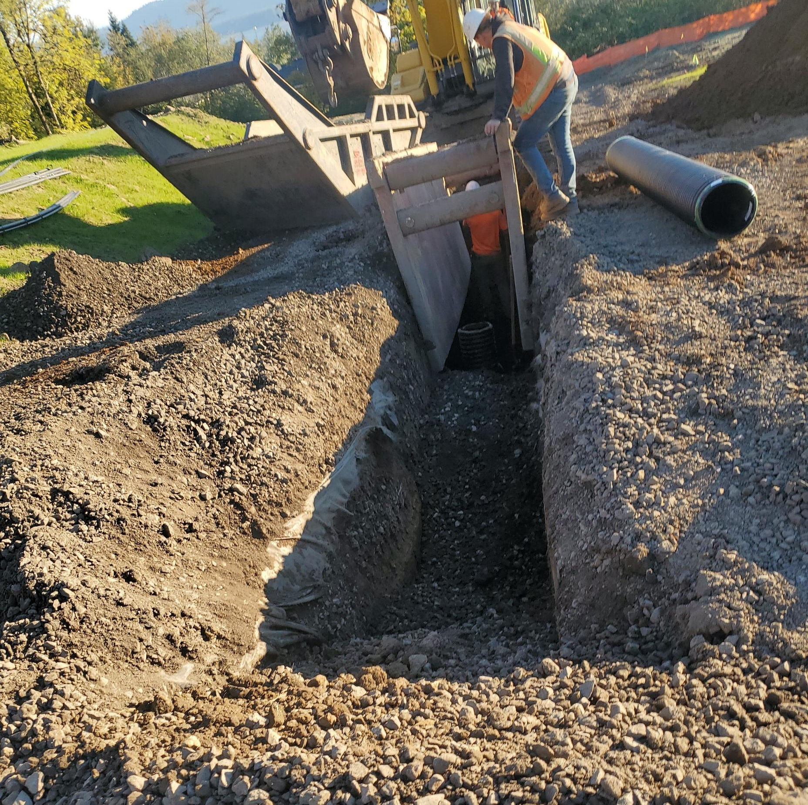
Stormwater Accomplishments
2023 Stormwater Program Accomplishments:
746 catch basins inspected and maintained
294 stormwater facility maintenance visits performed
310 stormwater facility inspections performed
Completion of six (6) drainage projects to alleviate flooding at: 11th & C St, 3rd & C St, 20th & E St, 5th & K St, Water Reservoir 1, and Buffalo Ranch Subdivision
Completion of Stormwater Management Action Plan (SMAP)
Implemented ArcGIS Survey123 for digital tracking of stormwater maintenance and inspection activities

Slide 17
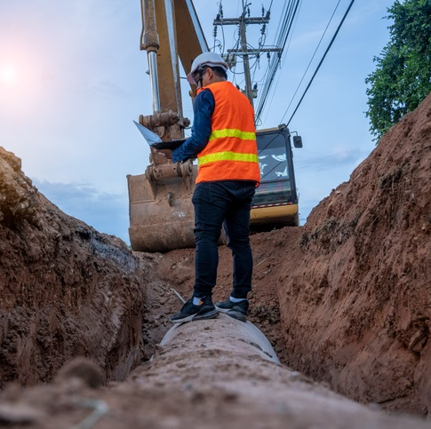
Stormwater Goals
2024 Stormwater Program Goals
Construction of 4 to 6 drainage projects to alleviate flooding or failed stormwater infrastructure
Construction of stormwater infrastructure improvements associated with Lift Station No.1
Compliance with the Municipal Stormwater Permit, which includes meeting all maintenance and inspection requirements
Secure grant funding for construction of the Mable Kerr Riparian Restoration Project with LCEP, and design of the Q St Infiltration Pond Retrofit Project
Completion of the Stormwater Master Plan
Inspect, maintain, and retrofit 27 Stormwater Treatment Filter Vaults

Slide 18
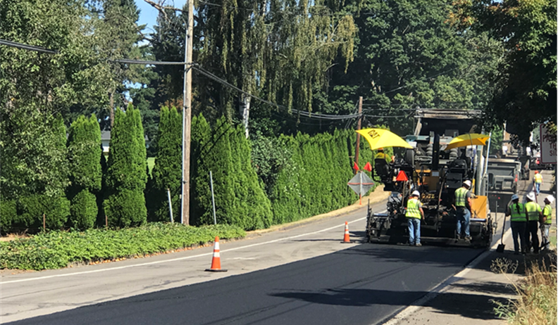
Street Maintenance
OVERVIEW
The Streets Division encompasses pavement maintenance and improvement, traffic management, safety improvements, street signs, signalization and pavement markings, and landscape maintenance.
Streets and Pavement Management is responsible for: Miles of City Streets 66.2 (centerline) (A.k.a. 134 lane miles)

Slide 19
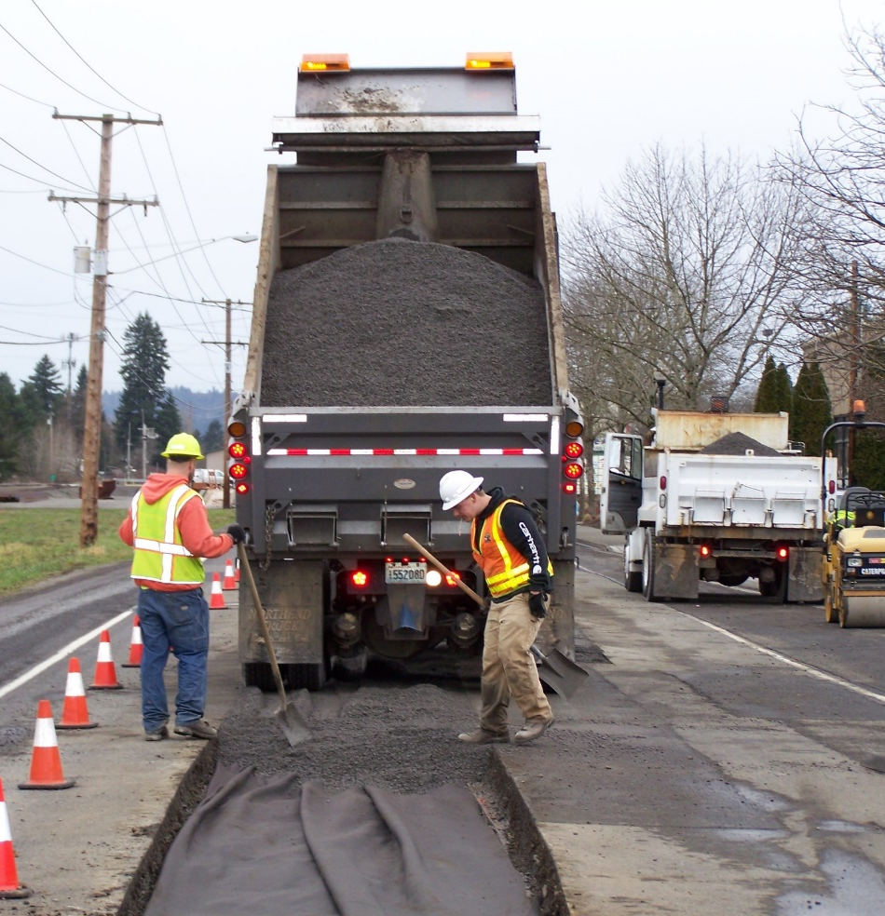
Street Accomplishments and Goals
Streets 2023 Accomplishments:
129,633 lineal feet of Crack Seal
36,777 Square Yards of Chip Seal
21,236 square yards of Hot Mix Asphalt on Grind/Inlay
Completed 433 square yards of dig-out and replaced 73.5 tons of hot mix asphalt in preparation for slurry seal
Pavement Condition Index (PCI) – 81
Replacement of sidewalks on Main from 21st – 22nd (north side) and from 19th – 20th (south side)
Streets 2024 Goal and Projects:
Main Street Grind/Inlay project with TIB Grant (CMG)
Rail Crossing Improvements (CMG)
Traffic Calming Initiatives
Maintain the current PCI
Current 2024 Goals for Street Improvements are:
~130,000 lineal feet of Crack Seal
~25,000 square yards of Chip Seal
~11,000 square yards of Grind/Inlay
~5,000 square yards of dig-outs
16,211 square yards of Slurry Seal
Replacement of sidewalks Downtown – Sections TBD
32nd St Railroad Underpass – Design Method Selection (CMG)
Pedestrian and Bike Improvements (CMG)

Slide 20
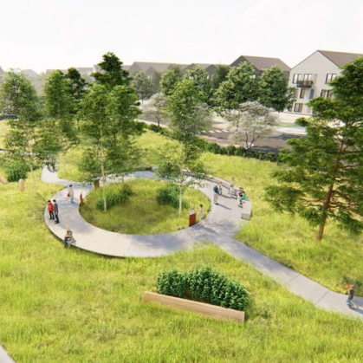
Park Maintenance
OVERVIEW
The Parks and Cemetery Division of Public Works is responsible for maintaining parks, cemetery and open spaces.
Park Maintenance is responsible for:
93.44 Acres of Parkland,
3.2 Miles of Trails,
8 Playgrounds,
1 Community Garden
1 Disc Golf Course
5 Baseball fields, and
6 Pickleball Courts

Slide 21
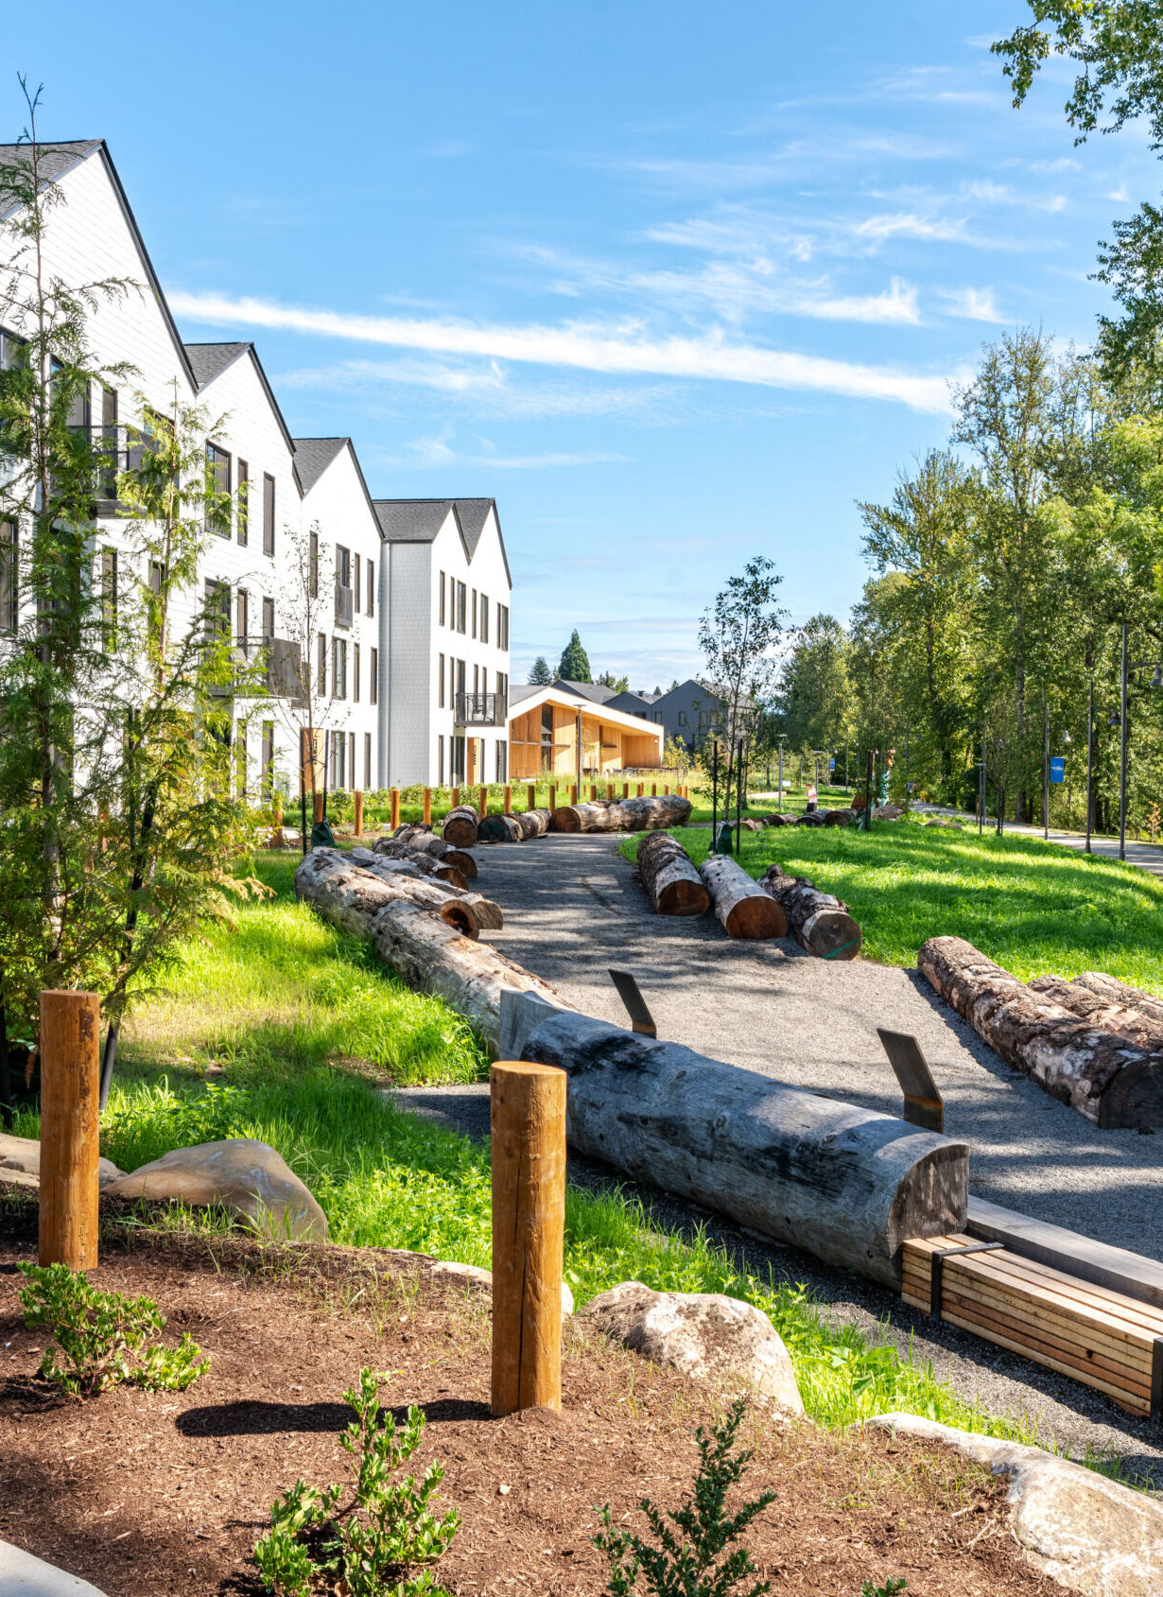
Park Accomplishments and Goals
Parks 2023 Accomplishments:
Security Improvements to Hathaway Park (lighting/cameras)
New Fencing to Lower Hathaway
Construction of new Public Restroom @ Reflection Plaza
Established composting program for the Community Garden
Removal of 62 dangerous trees at Kerr Park
6,167 hours of Parks maintenance completed
Parks 2024 Goals and Projects:
Hathaway Park Lighting Improvements (CMG)
Field & Fence improvements - Bates Field/Lower Hathaway (CMG)
Field & Dugout Improvements – Hamllik (CMG)
Basketball Court construction- Hamllik (CMG)
Regrade Community Garden and place additional garden boxes
Replenish chips in all play structures for safety
Replacement of Upper Hathaway Park Play Structure (if funded via grant)
Conceptual Plan for Schmid Family Park
Washougal Town-Center Revitalization (Civic Campus) (CMG)
Recreation Programming (CMG)

Slide 22
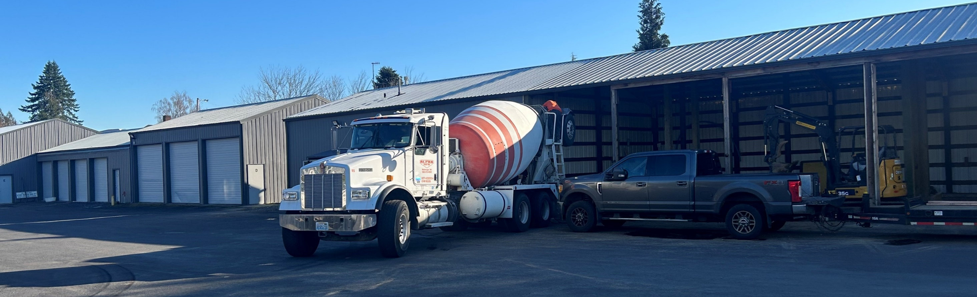
Facilities Maintenance
Facilities Overview
The City of Washougal owns several public buildings and properties throughout the city, including City Hall, Permit Center, Fire, Police and the Public Works Center. The city also leases additional space to provide public services to the entire community.
Facilities is responsible for:
20 Buildings
Over 65,000 square feet
Building valuation +$30.5 Million

Slide 23
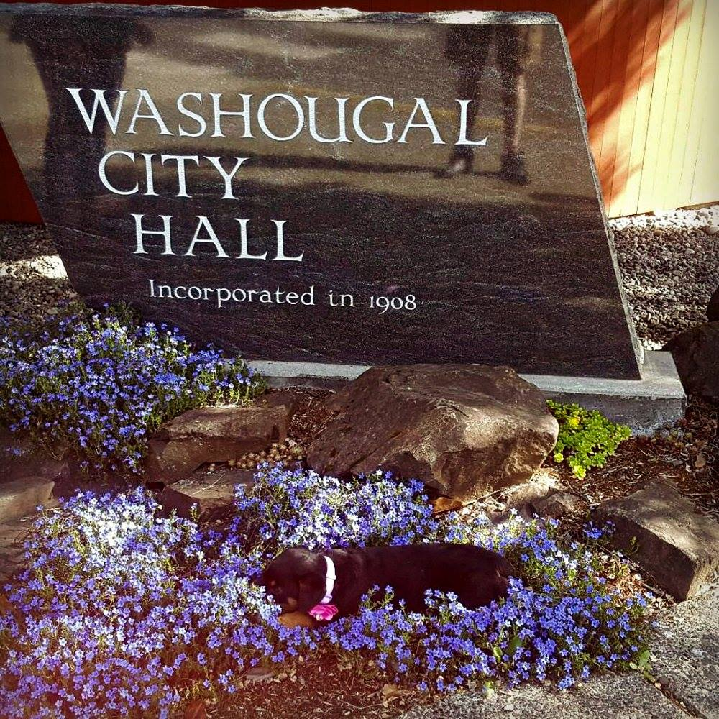
Facilities Accomplishments and Goals
Facilities 2023 Accomplishments:
Security upgrades at Public Works
Lighting upgrades at Public Works
Painting of Bldgs. B/C, D, E & F at Public Works
Concrete floors and new garage doors on Bldg D at Public Works
Removal of the fuel station at Public Works
Began design of Public Works Operations Center Building A centralization and improvements
Restructure of office space at Permit Center
Closed in stairwell at Permit Center
Replaced 4 water heaters
Reconstruction of the Side Chambers after a water leak
Replaced gearbox Police Department Gate
Took over operations of 1220 A Street in October (former Silver Star location)
2,688 hours of Facilities maintenance completed
Facilities 2024 Goals:
Public Safety Complex – Fire Station 43 replacement (CMG)
Facilities Master Plan (CMG)
Public Works Operations Center Improvements (CMG)

Slide 24
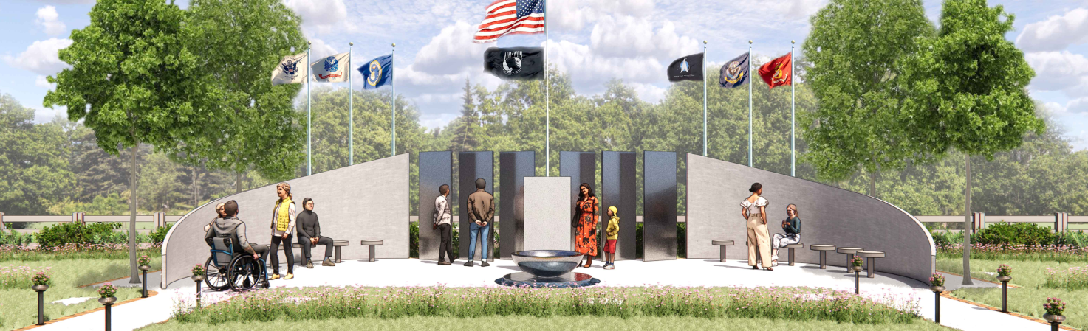
Cemetery Maintenance
Cemetery is responsible for:
12 Acres of grounds
Maintenance of 3,863 internments
Cemetery 2023 Accomplishments:
31 internments
Irrigation leak detection and repairs
Turf Improvements
Began conceptual design of the new Veteran’s Memorial
1,153 hours of Cemetery maintenance completed

Slide 25
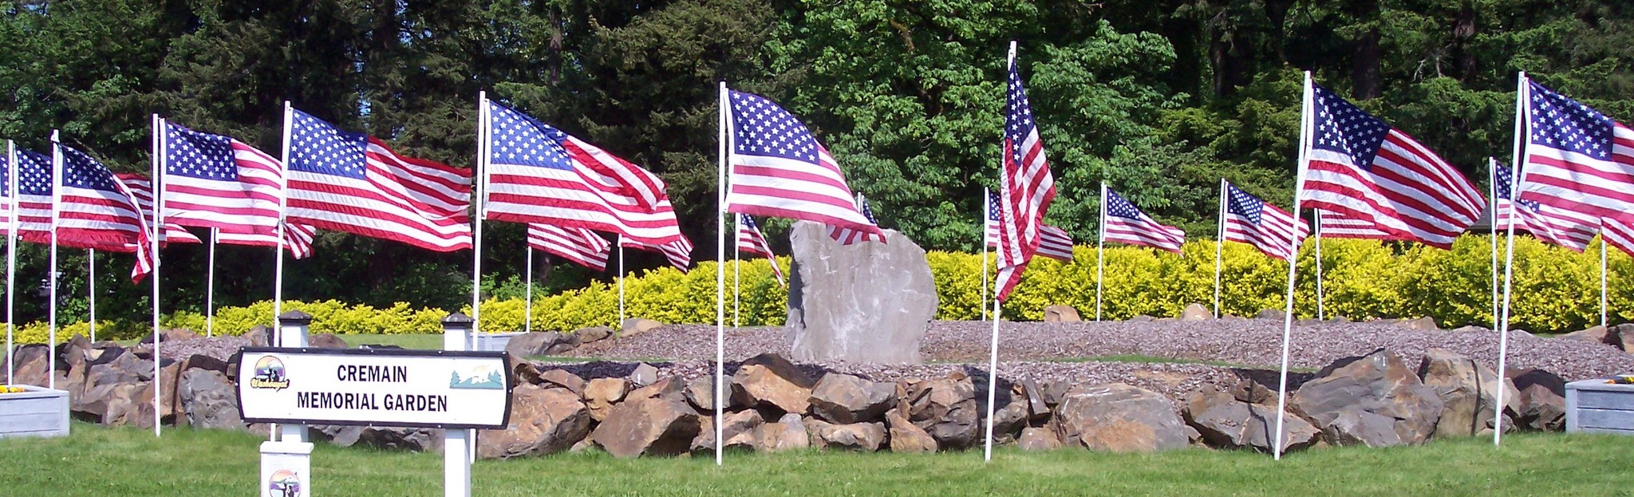
Cemetery Projects
Cemetery 2024 Goals and Projects:
Irrigation leak detection & repairs
Section A & B Marker restoration/repair
Continue to Improve Turf quality and irrigation efficiency
Photos of markers uploaded to the Cemetery site
Veteran’s Memorial construction (funding dependent)

Slide 26
Thank you and any questions!!

