Slide 1
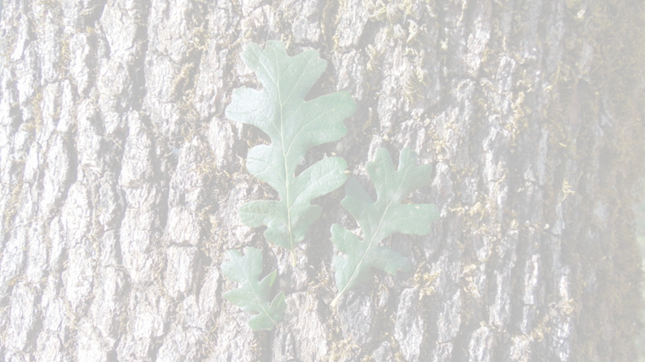
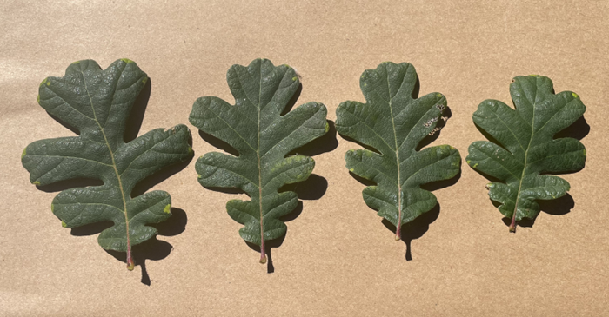
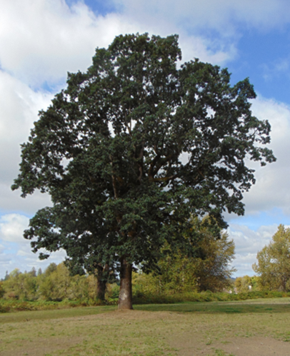

About the Oregon White Oak
Oregon White Oak (Quercus garryana) is an important native tree in the Pacific Northwest. Known for its unique characteristics, this tree plays a vital role in our local ecosystem.
Oregon White Oak woodlands are used by an abundance of mammals, birds, reptiles, and amphibians. More than 200 species of native wildlife use Washington’s oak woodlands. Some are found exclusively in association with this oak species, such as various moths, butterflies, gall wasps, and spiders.
Acorns, oak leaves, fungi, and insects provide food. They provide important roosting, nesting, and feeding habitat for wild turkeys and other birds and mammals. Dead oaks and dead portions of live oaks harbor insect populations and provide nesting cavities for native and migratory birds.
Oregon White Oak woodlands are recognized as an important element of the natural and cultural histories of Washington state. They provide aesthetic, economic, and recreational value to the citizens of Washington, and they are vital to many of the animals that inhabit them.
Oregon White Oak Education and Identification Guide
This guide aims to educate you about the significance of the Oregon White Oak and assist you in identifying it. By understanding it’s unique characteristics and recognizing it in your environment, you not only enhance your appreciation for this remarkable tree, but also play a vital role in its conservation, helping to protect this important species and the ecosystems it supports.
Conservation and Protection
Oregon White Oak woodlands were a significant component of the Willamette Valley landscape before non-indigenous settlers colonized the region. Land-use impacts have since left only fragmented remnants of this once-expansive ecosystem. Agricultural expansion, suburban and urban development, fire suppression, and conversion to more merchantable Douglas fir have dramatically reduced the extent of these woodlands.
Oregon White Oak communities are now one of North America's most imperiled vegetation types. Estimates suggest that the extent of oak communities now account for less than 10% of their historic range. Populations of many associated species have also declined partly because of their reliance on declining oak woodlands. To help conserve oak woodlands, Oregon White Oaks are protected under Washington state law from unpermitted removal.
COMMUNITY DEVELOPMENT

Slide 2

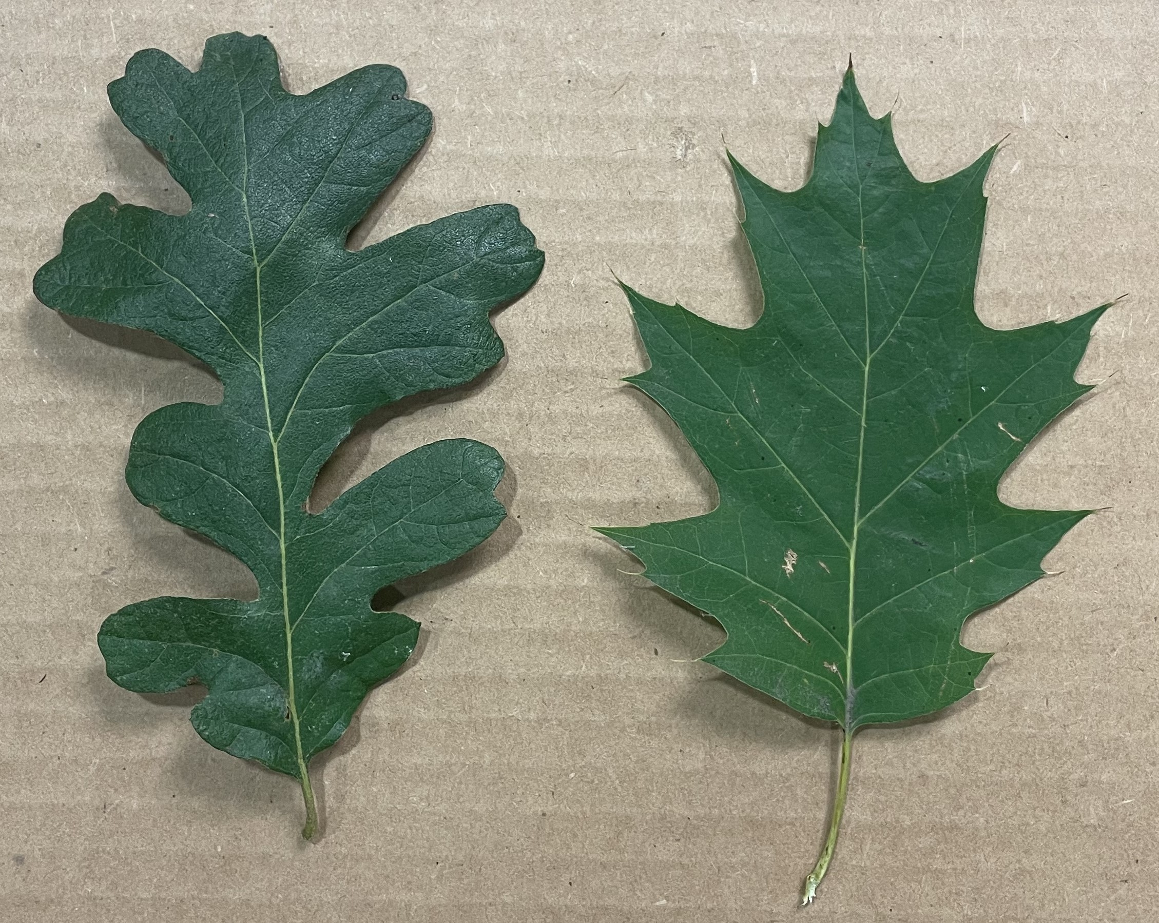
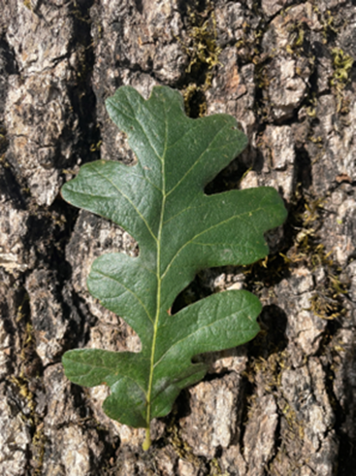
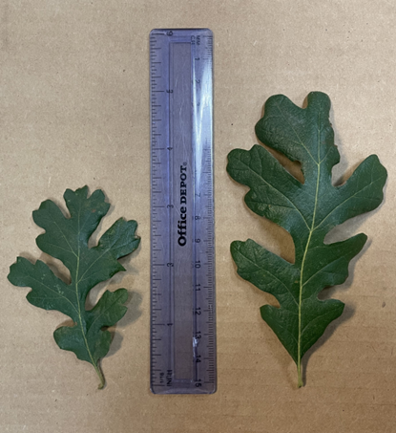
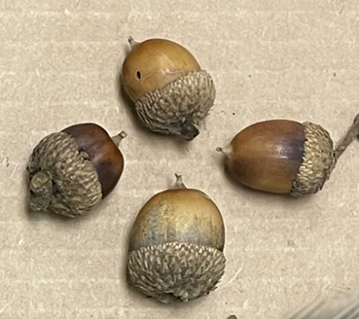
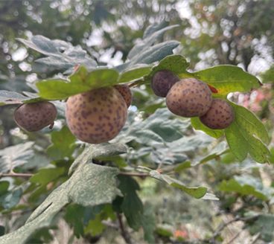
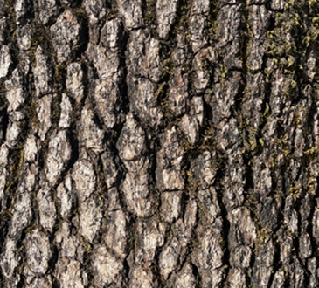
Oregon White Oak Identification Features
Leaves
Shape: The leaves are evenly and deeply lobed with rounded leaf tips. Pinnately lobed with 5-9 lobes each.
Size: Leaves can grow between 3-6 inches long.
Color: Deep green in summer, changing to yellow and reddish hues in the fall.
Bark
Texture: The bark is thick and rough, appearing gray to brown.
Fissures: Mature trees develop deep fissures in their bark.
Form/Branching/Structure
Structure: Overall structural appearance varies and is dependent on neighboring, competing species. Singular (field-grown) specimens have contorted branching habits, with an upright, oval canopy. Those near forested areas generally have a larger vertical crown, with fewer lower branches.
Uniqueness: Each individual Oregon White Oak is a unique reflection of its history of growth, and does not maintain uniform growth habits/structure like many other oak species.
Acorns
Description: Acorns are oval-shaped, about 1 inch long, with a scaly cap covering part of the nut.
Ripening: Acorns mature in the fall and serve as an essential food source for wildlife.
Galls
Appearance: Small, round, bulbous growths that can be clustered together on leaves, branches or buds. Galls range from green to reddish brown and may have a smooth or matte appearance.
Size: They can vary in size, typically measuring between ¼ to 1 inch in diameter.
Host Insect: Galls are formed by a parasitic wasp species that is relatively unharmful to the oak, and is not harmful to humans or animals.
Oregon White Oak leaf (left) with rounded lobes, in comparison to a Red Oak leaf (right) with pointed lobes (pictured above).
Oregon White Oak leaf against the bark of an Oregon White Oak tree (above).
Oregon White Oak leaves in varying stages of maturity in comparison to a 6” ruler (above).
Acorns pictured above, displaying their scaly cap and woody appearance.
Cluster of galls on the underside of an Oregon White Oak leaf. These can vary in color and in size (above).
The bark of an Oregon White Oak (above) with its grayish-brown coloring and furrowed appearance.

